Slide 1
What Makes a World Habitable?

Slide 2
Factors that make a Planet Habitable
Temperature
Water
Atmosphere
Energy
Nutrients

Slide 3
Temperature

Slide 4
Temperature
Temperature influences how quickly atoms & molecules move
Not enough of the factor
Low temperatures cause chemicals to react slowly, which interferes with the reactions necessary for life. Also low temperatures freeze water, making liquid water unavailable.
Just Right
Life seems limited to a temperature range of minus 15ºC to 115ºC. In this range, liquid water can still exist under certain conditions

Slide 5
Temperature
Too Much of the Factor
At about 125ºC, protein and carbohydrate molecules and genetic material (e.g., DNA and RNA) start to break apart. Also, high temperatures quickly evaporate water.
Situation in the Solar System
Surface: Only Earth’s surface is in this temperature range. (minus 15ºC to 115ºC)
Sub-surface: The interior of the solid planets & moons may be in this temperature range.

Slide 6
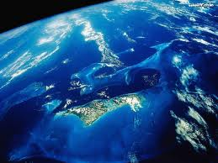
Water

Slide 7
Water
Water dissolves & transports chemicals within and to and from a cell
Not Enough of the Factor
The chemicals a cell needs for energy & growth are not dissolved or transported to the cell
Just Right
Water is regularly available. Life can go dormant between wet periods, but, eventually, water needs to be available.

Slide 8
Water
Too Much of the Factor
Too much water is not a problem, as long as it is not so toxic that it interferes with the chemistry of life
Situation in the Solar System
Surface: Only Earth’s surface has water, though Mars once had surface water and still has water ice in its polar ice caps. Saturn’s moon, Titan, seems to be covered with liquid methane.
Sub-surface: Mars & some moons have deposits of underground ice, which might melt to produce water. Europa, has a vast oceans beneath its outer shell if ice.

Slide 9
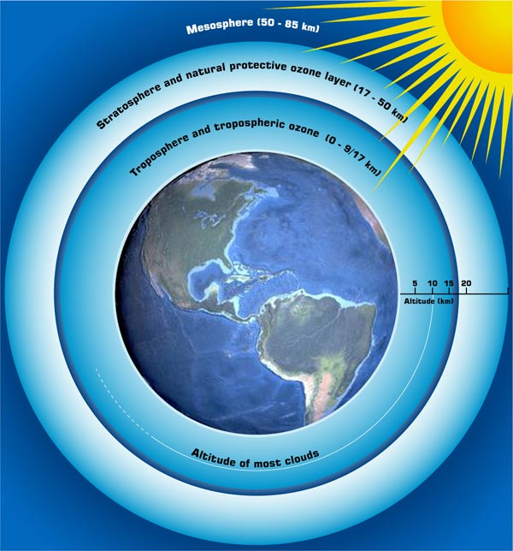
Atmosphere
Traps heat, shields the surface from harmful radiation, and provides chemicals needed for life, such as nitrogen and carbon dioxide.

Slide 10
Atmosphere
Not Enough of the Factor
Small planets and moons have insufficient gravity to hold an atmosphere. The gas molecules escape to space, leaving the planet or moon without an insulating blanket or a protective shield.
Just Right
Earth & Venus are the right size to hold a sufficient-sized atmosphere. Earth’s atmosphere is about 100 miles thick. It keeps the surface warm & protects it from radiation & small- to medium-sized meteorites.

Slide 11
Atmosphere
Too Much of the Factor
Venus’s atmosphere is 100 times thicker than Earth’s. It is made almost entirely of greenhouse gasses, making the surface too hot for life. The four giant planets are completely made of gas.
Situations in the Solar System
Of the solid planets & moons, only Earth, Venus, & Titan have significant atmospheres. Mars’ atmosphere is about 1/100th that of Earth’s, too small for significant insulation or shielding.

Slide 12
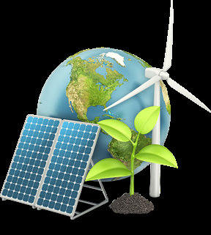
Energy
Organisms use light or chemical energy to run their life processes.

Slide 13
Energy
Not Enough of the Factor
When there is too little sunlight or too few of the chemicals that provide energy to cells, such as iron or sulfur, organisms die.
Just Right
With a steady input of either light or chemical energy, cells can run the chemical reactions necessary for life.

Slide 14
Energy
Too Much of the Factor
Light energy is a problem if it makes a planet too hot or if there are too many harmful rays, such as ultraviolet. Too many energy-rich chemicals is not a problem
Situation in the Solar System
Surface: The inner planets get too much sunlight for life. The outer planets get too little.
Sub-surface: Most solid planets & moons have energy-rich chemicals.

Slide 15
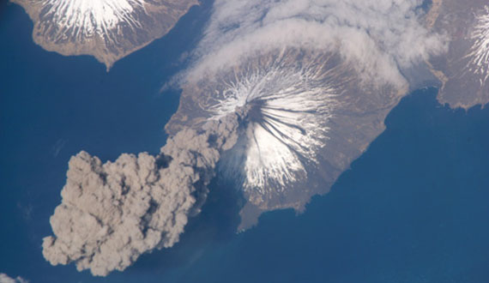
Nutrients
Used to build and maintain an organism’s body.

Slide 16
Nutrients
Not Enough of the Factor
Without chemicals to make proteins & carbohydrates, organisms cannot grow. Planets without systems to deliver nutrients to its organisms (e.g., a water cycle or volcanic activity) cannot support life. Also, when nutrients are spread so thin that they are hard to obtain, such as on a gas planet, life cannot exist.
Just Right
All solid planets & moons have the same general chemical makeup, so nutrients are present. Those with a water cycle or volcanic activity can transport and replenish the chemicals required by living organisms.

Slide 17
Nutrients
Too Much of the Factor
Too many nutrients are not a problem. However, too active a circulation system, such as the constant volcanism on Jupiter’s moon, Io, or the churning atmospheres of the gas planets, interferes with an organism’s ability to get enough nutrients.
Situation in the Solar System
Surface: Earth has a water cycle, an atmosphere, and volcanoes to circulate nutrients. Venus, Titan, Io, and Mars have nutrients and ways to circulate them to organisms.
Sub-surface: Any planet or moon with sub-surface water or molten rock can circulate and replenish nutrients for organisms.

