Slide 1
Science Starter: 1. Pick up Plickers card 2. Learning Target/Success Criteria
Tuesday October 23, 2018
Agenda:
10/30—Weathering, Erosion, Deposition, and Catastrophic Events Quiz
11/12—Vocabulary Quizizz
11/13—Unit 3 Part 2 DCA
Learning Target:
I will learn the various ecoregions of Texas.
Success Criteria:
I know how to label the ecoregions of Texas.

Slide 2
Plickers

Slide 3
1. Plickers 2. Good Things 3. Rater—Check in 4. TEKS Data Analysis pg. 3 5. Question of the Day…Ice Skating or Roller Skating/Roller blading 6. Ecoregions of Texas Video 7. Ecoregions of Texas Activity 8. DO THE RIGHT THING EVEN WHEN NO ONE IS LOOKING!

Slide 4
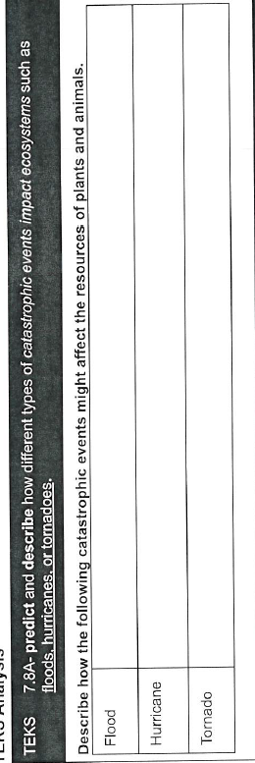
Pg. 3 TEKS Analysis
Pg. 5 Vocabulary
Catastrophic Event, Equilibrium

Slide 5
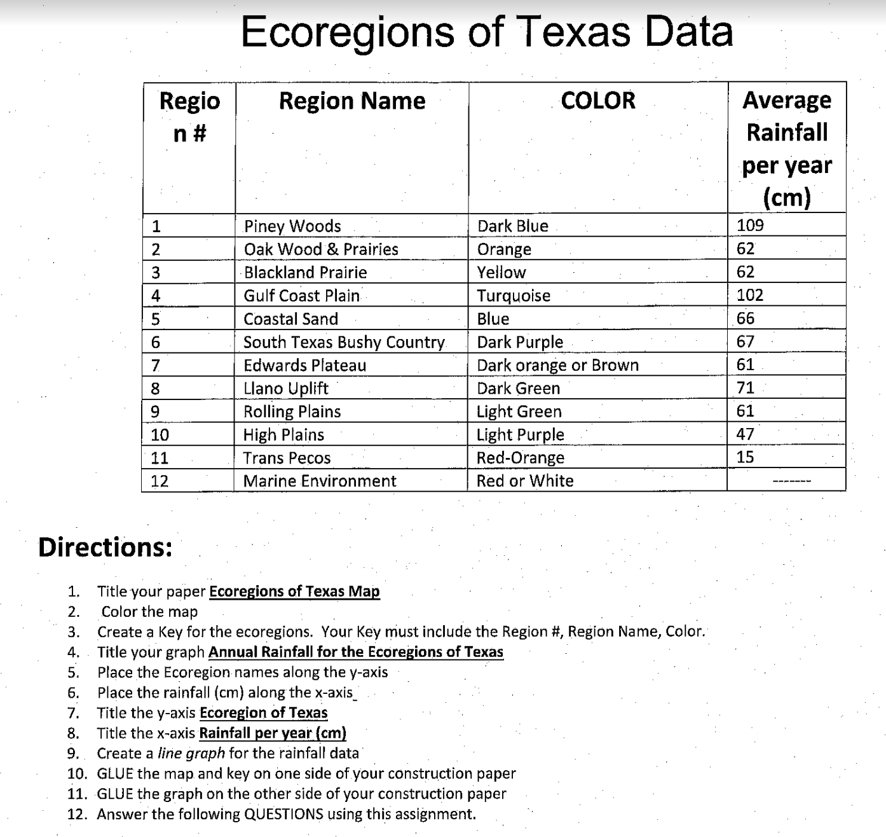
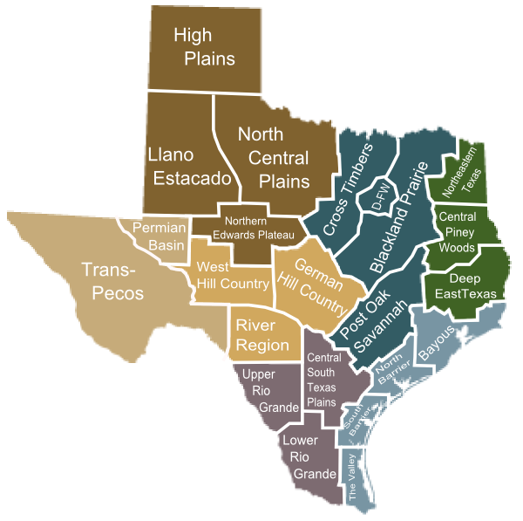
Ecoregions of Texas Handout
Construction Paper
Graph Paper
Lined Paper

Slide 6
DO THE RIGHT THING EVEN WHEN NO ONE IS LOOKING!!!

Slide 7
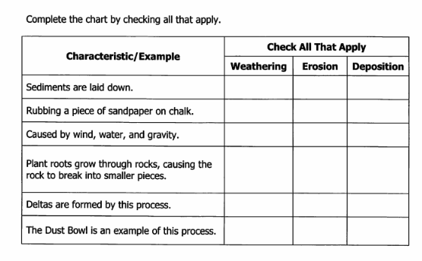
Science Starter: 1. Complete the warm-up & turn in. 2. Learning Target/Success Criteria
Wednesday October 24, 2018
Agenda:
10/30—Weathering, Erosion, Deposition, and Catastrophic Events Quiz
11/12—Vocabulary Quizizz
11/13—Unit 3 Part 2 DCA
Learning Target:
I will learn the various ecoregions of Texas and their characteristics.
Success Criteria:
I know how to describe the amount of precipitation of each ecoregion.

Slide 9
1. Good Things 2. Rater—Check in 3. Vide0—Edwards Plateau 4. Ecoregions of Texas Activity DO THE RIGHT THING EVEN WHEN NO ONE IS LOOKING!

Slide 10
Ecoregions of Texas Handout
Construction Paper
Graph Paper
Lined Paper

Slide 11
DO THE RIGHT THING EVEN WHEN NO ONE IS LOOKING!!!

Slide 12
Science Starter: 1. Learning Target/Success Criteria 2. Have map/graph out and ready to go!
Thursday October 25, 2018
Agenda:
10/30—Weathering, Erosion, Deposition, and Catastrophic Events Quiz
11/12—Vocabulary Quizizz
11/13—Unit 3 Part 2 DCA
Learning Target:
I will learn the amount of precipitation of each ecoregion in Texas.
Success Criteria:
I know how to create a line graph illustrating the Texas ecoregions and yearly rainfall in each ecoregion.

Slide 13
1. Good Things 2. Rater—Check in 3. Complete Ecoregions of Texas Activity—DUE FRIDAY! (Turn in when you have completed the activity!) Early Finishers—Check Google Classroom for 2 activities. A. Ecoregions Prezi B. Goin’ Cruisin’ DO THE RIGHT THING EVEN WHEN NO ONE IS LOOKING!

Slide 14
Ecoregions of Texas Handout
Construction Paper
Graph Paper
Lined Paper

Slide 15
DO THE RIGHT THING EVEN WHEN NO ONE IS LOOKING!!!

Slide 16
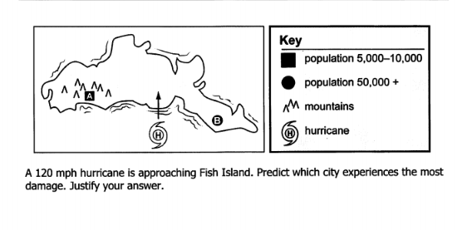
Science Starter: 1. Turn in Ecoregions of Texas activity! 2. Complete warm up
Friday October 26, 2018
Agenda:
10/30—Weathering, Erosion, Deposition, and Catastrophic Events Quiz
11/12—Vocabulary Quizizz
11/13—Unit 3 Part 2 DCA
Learning Target:
I will learn how tornadoes, hurricanes, floods, wildfires, earthquakes, and volcanoes effect ecosystems.
Success Criteria:
I know how to describe the effects of tornadoes, hurricanes, floods, wildfires, earthquakes, and volcanoes effect ecosystems.

Slide 18
1. Good Things 2. Rater—Check in 3. Catastrophic events videos pg. 20 4. Catastrophic events graphic organizer (extra handout/construction paper) DO THE RIGHT THING EVEN WHEN NO ONE IS LOOKING!

Slide 19
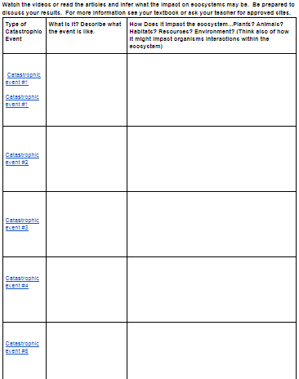

Slide 20
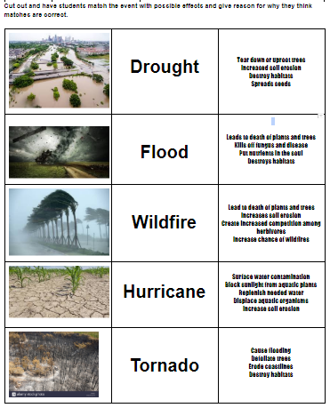

Slide 21
DO THE RIGHT THING EVEN WHEN NO ONE IS LOOKING!!!

