Slide 1
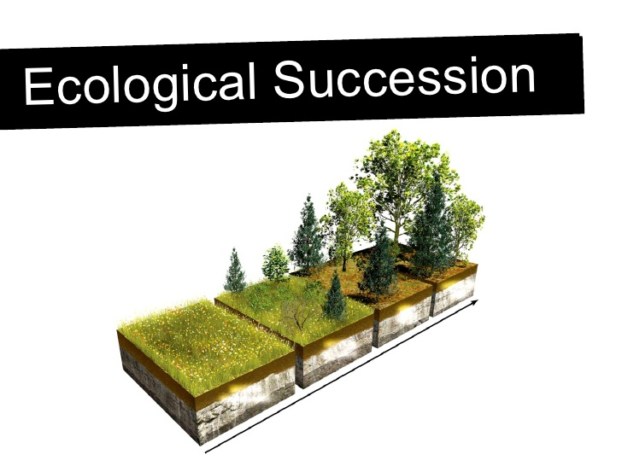
Science Starter 1. Complete Learning Target & Success Criteria 2. Question of the day…What was your favorite candy that you received from trick or treating last night?
Thursday November 1, 2018
Agenda:
11/9—Vocabulary Quiz
Succession and Watershed
11/13—Unit 3 Part 2 DCA
Learning Target:
I will learn the sequence of events that occur in primary & secondary succession.
Success Criteria:
I will be able to sequence the events in primary succession and secondary succession.

Slide 2
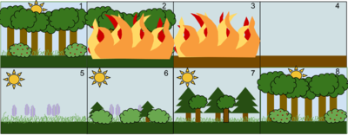
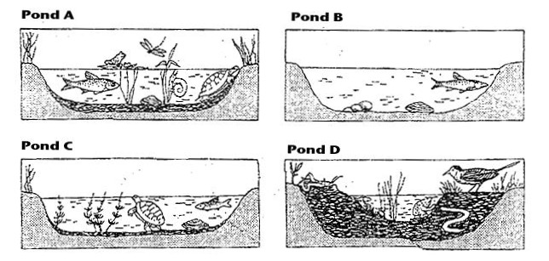
Good Things
Rater ?
Pg. 21—Ecological Succession Notes
Video—Climax Community
Textbook reading—pgs. 342-351
Launch--Do the right thing even when no one is looking

Slide 3
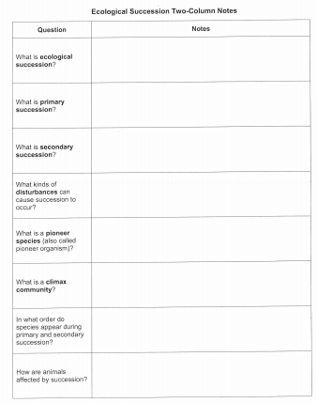
Pg. 21
Series of events by which life comes back
Occurs when you have bare rock or no soil left. Ex. volcano or new island “Surtsey”
Occurs when you have a disturbance & soil remains. Ex. wildfire, tornado
Disturbances: wildfire, tornado, human disturbances, tsunami, flood, hurricane, volcano, earthquake
Comes into an area after a disturbance. (It is a pioneer or first species in an area to start succession.)
Happens after succession and the ecosystem is not changing and is STABLE!
Primary Successions start with—bare rock, mosses, grasses, weeds, shrubs,
woody pioneers, fast growing trees, climax forest
Secondary Successions start with— mosses, grasses, weeds, shrubs, woody pioneers,
fast growing trees, climax forest
Primary Succession—no animals present to begin
Secondary Succession—plants destroyed and animals that survive move to another area to find shelter, food, water

Slide 4
Video—Climax Community
Pg. 343– Turn and talk with your shoulder partner
Pg. 344—How land ecosystems change
Pg. 345—Primary Succession
Pg. 346—Secondary Succession
Pg. 347—How Freshwater Ecosystems Change

Slide 5
Do the right thing even when no one is looking!!!

Slide 6
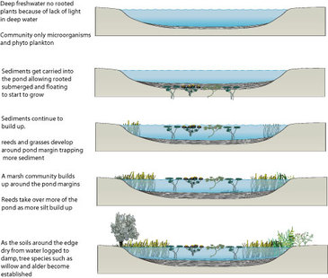
Science Starter 1. Complete Learning Target & Success Criteria 2. Pick up the reading on Pond Succession Read the article on pond succession.
Friday November 2, 2018
Agenda:
11/9—Vocabulary Quiz
Succession and Watershed
11/13—Unit 3 Part 2 DCA
Learning Target:
I will learn how to model succession in a habitat.
Success Criteria:
I will be able to model how succession occurs after a catastrophic events.

Slide 7
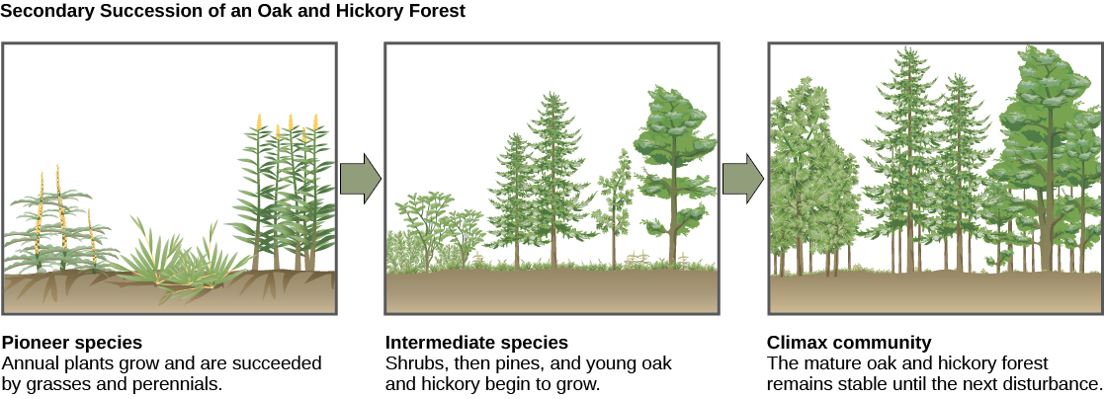
Good Things
Rater ?
Video—Amoeba Sisters
Complete video guide and turn in
Launch--Do the right thing even when no one is looking

Slide 8
Do the right thing even when no one is looking!!!

