Slide 1
Science Starter: Pick up the Unit 3 Analyzing Ecosystems Part 2 Workbook
Thursday October 18, 2018
Learning Target:
I will learn the different types of weathering. (mechanical & chemical)
Success Criteria:
I know how to define the types of weathering. (mechanical & chemical)
Agenda:
10/22- Plickers Quiz (Weathering, Erosion, and Deposition)
10/30—Quiz (Weathering, Erosion, Deposition and Catastrophic Events)
11/12—Vocabulary Quizizz
11/13—Unit 3 Part 2 DCA

Slide 2
1. Good Things 2. Rater 3. TEKS Analysis pg. 3 7.8B 4.Vocabulary pgs. 5-7 5. Weathering and Erosion Video 5. Weathering & Erosion pg. 8 6. Anticipation Guide pg. 9 7. Reading pgs. 11-15 8. Launch

Slide 4
Vocabulary:
Pg.5—Chemical Weathering, Deposition, Ecoregion, Erosion
Pg. 6—Mechanical Weathering
Pg. 7—Sediments, Weathering

Slide 5
Weathering, Erosion, & Deposition Video

Slide 6
Weathering and Erosion pg. 8-Class Discussion

Slide 7
Weathering & Erosion Anticipation Guide
Pg. 9 Before Reading
Read pgs. 11-15

Slide 8
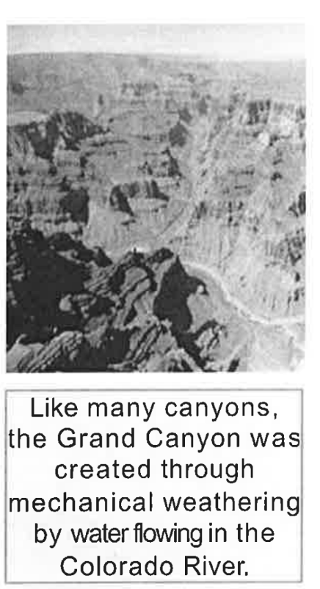
Pg. 11
Mechanical Weathering

Slide 9
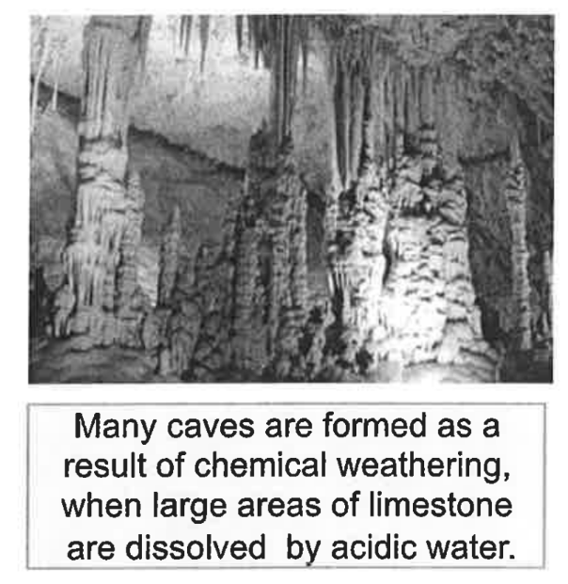
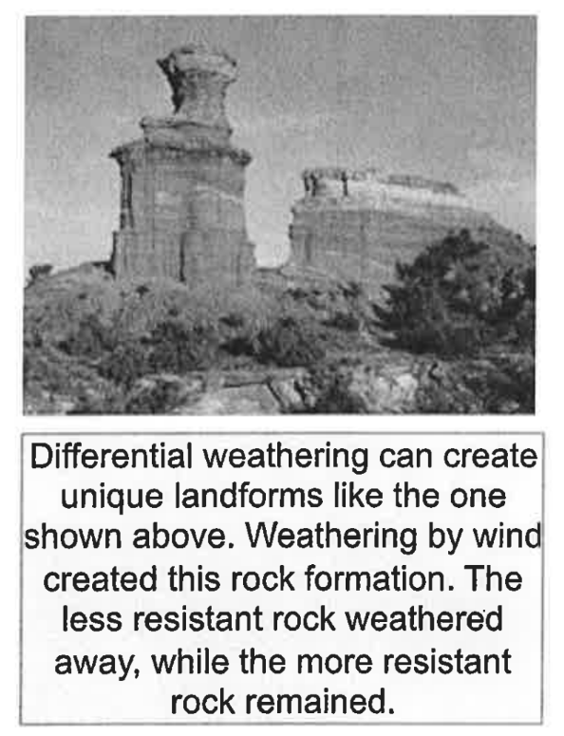
Pg. 12
Chemical Weathering

Slide 10
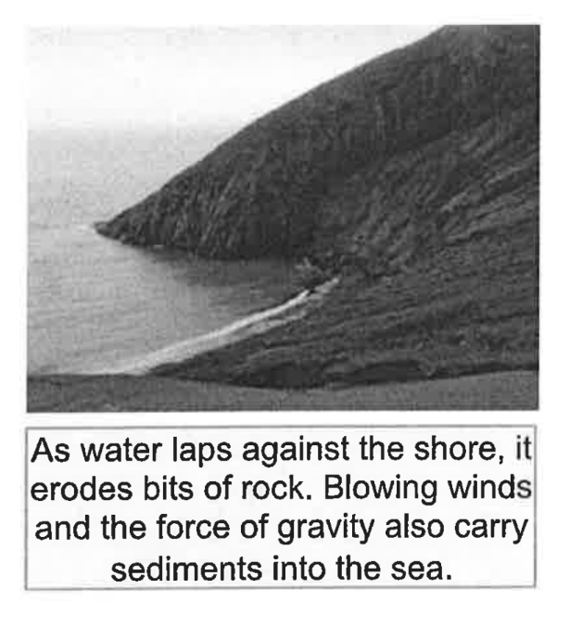
Pg. 13 Erosion

Slide 11
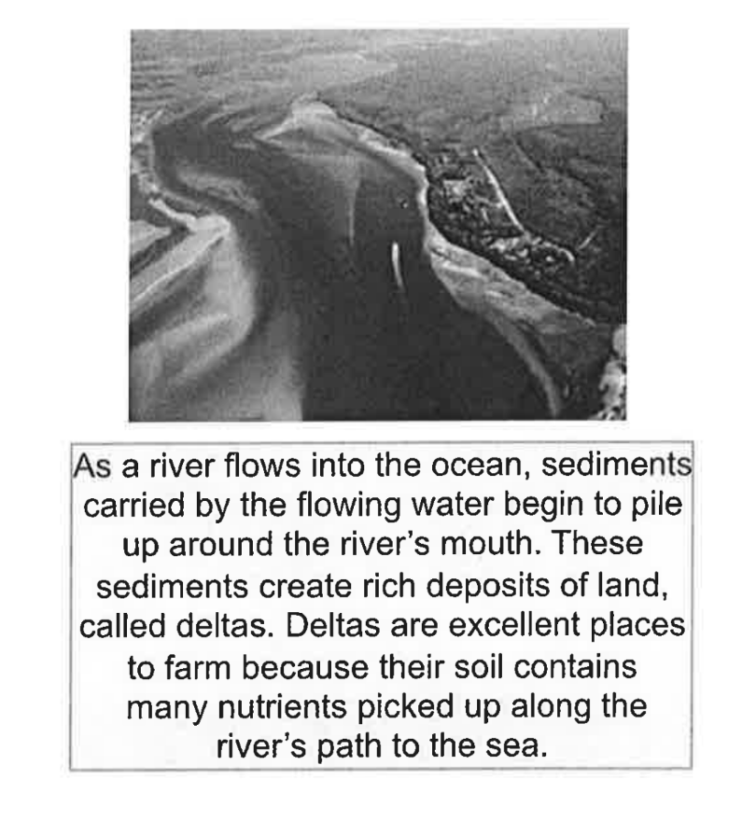
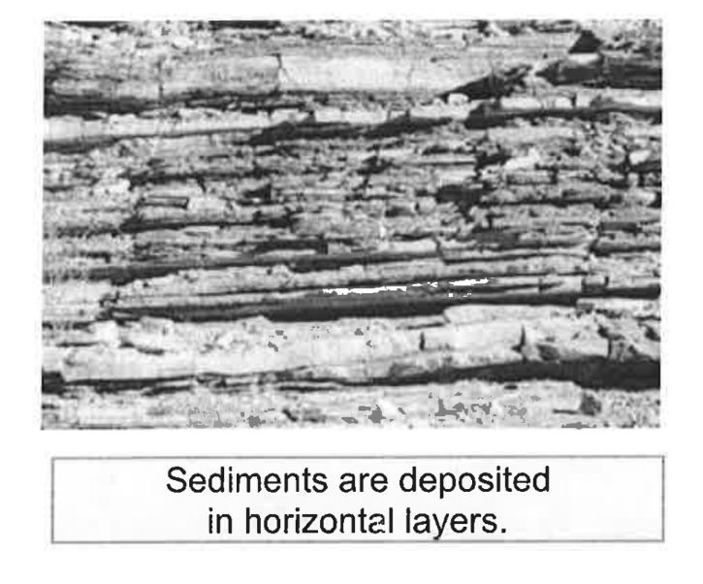
Pg. 14 Deposition

Slide 12
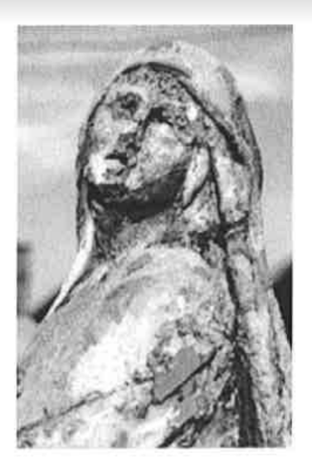
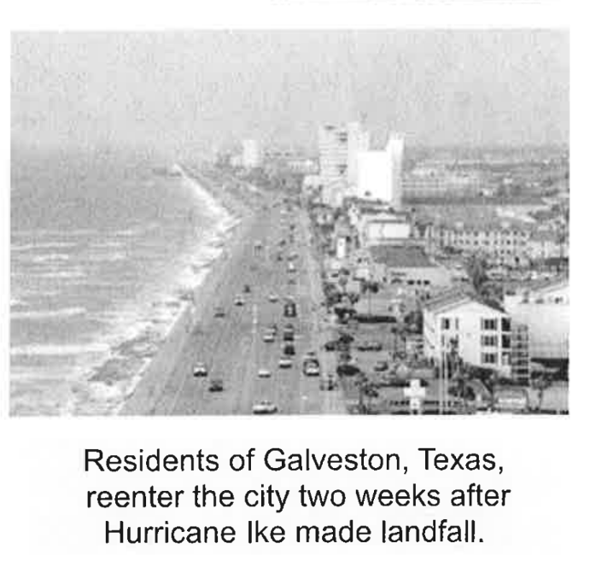
Pg. 15
Weathering

Slide 13
Weathering & Erosion Anticipation Guide
Pg. 9 After Reading
Answer the question about any responses you changed.

Slide 14
LAUNCH:
DO THE RIGHT THING EVEN WHEN NO ONE IS LOOKING!!!

Slide 15
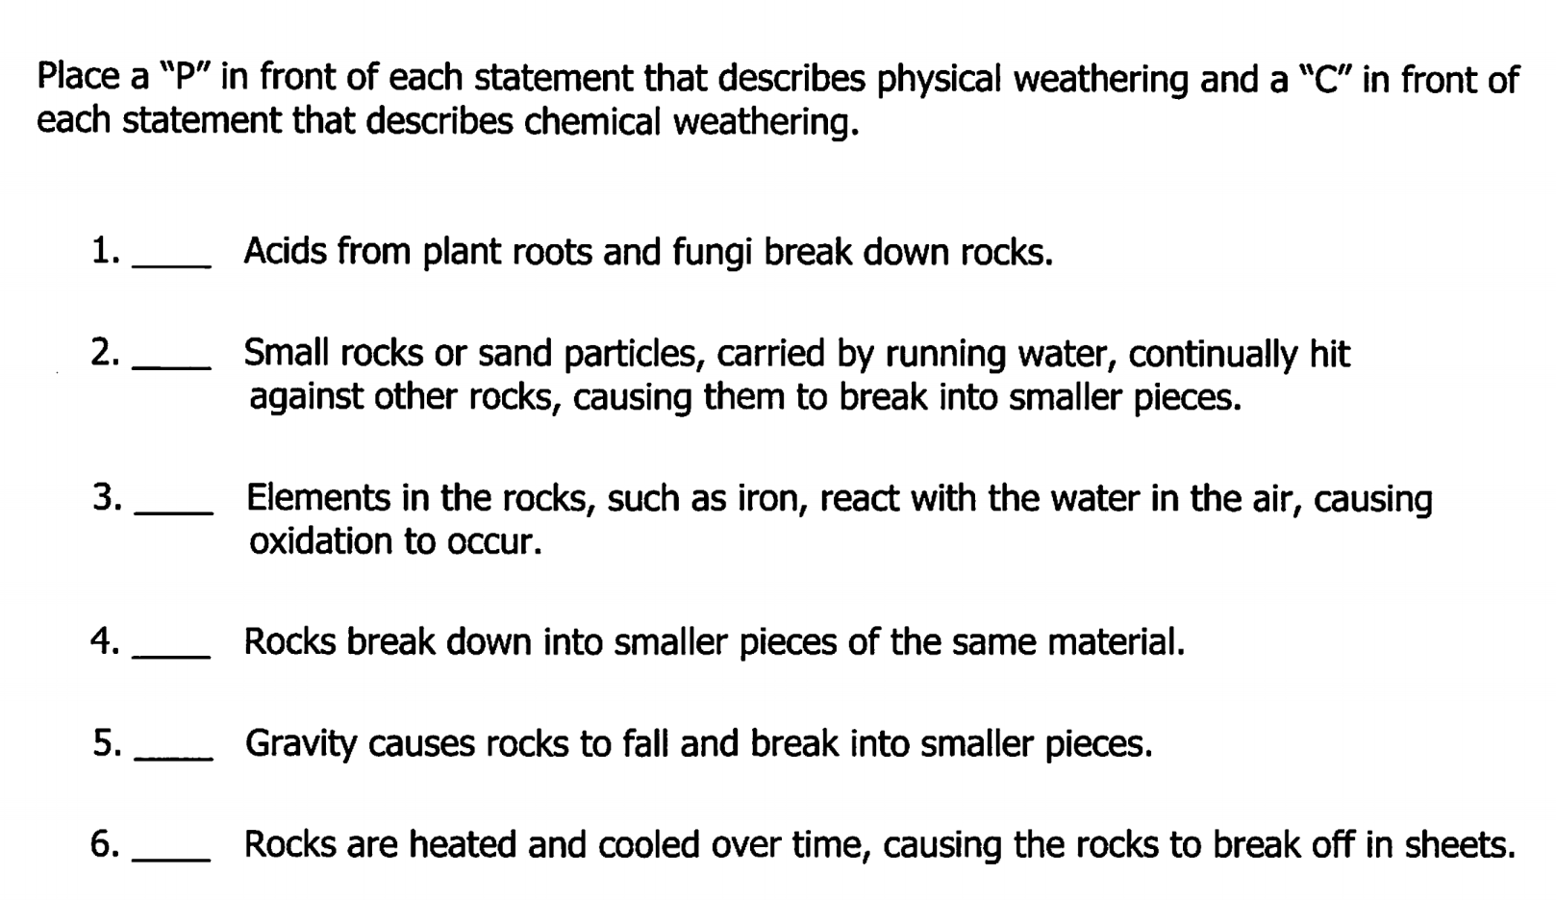
Science Starter: Warm up
Friday October 19, 2018
Learning Target:
I will learn the cause of weathering.
Success Criteria:
I know how to recognize the types of weathering. (mechanical & chemical)
Agenda:
10/22- Plickers Quiz (Weathering, Erosion, and Deposition)
10/30—Quiz (Weathering, Erosion, Deposition and Catastrophic Events)
11/12—Vocabulary Quizizz
11/13—Unit 3 Part 2 DCA

Slide 17
1. Good Things 2. Rater 3. Weathering and Erosion Video 4. Finish Reading pgs. 11-15 5. Complete the Anticipation Guide pg. 9 6. Weathering & Erosion pg. 10 7. Launch

Slide 18
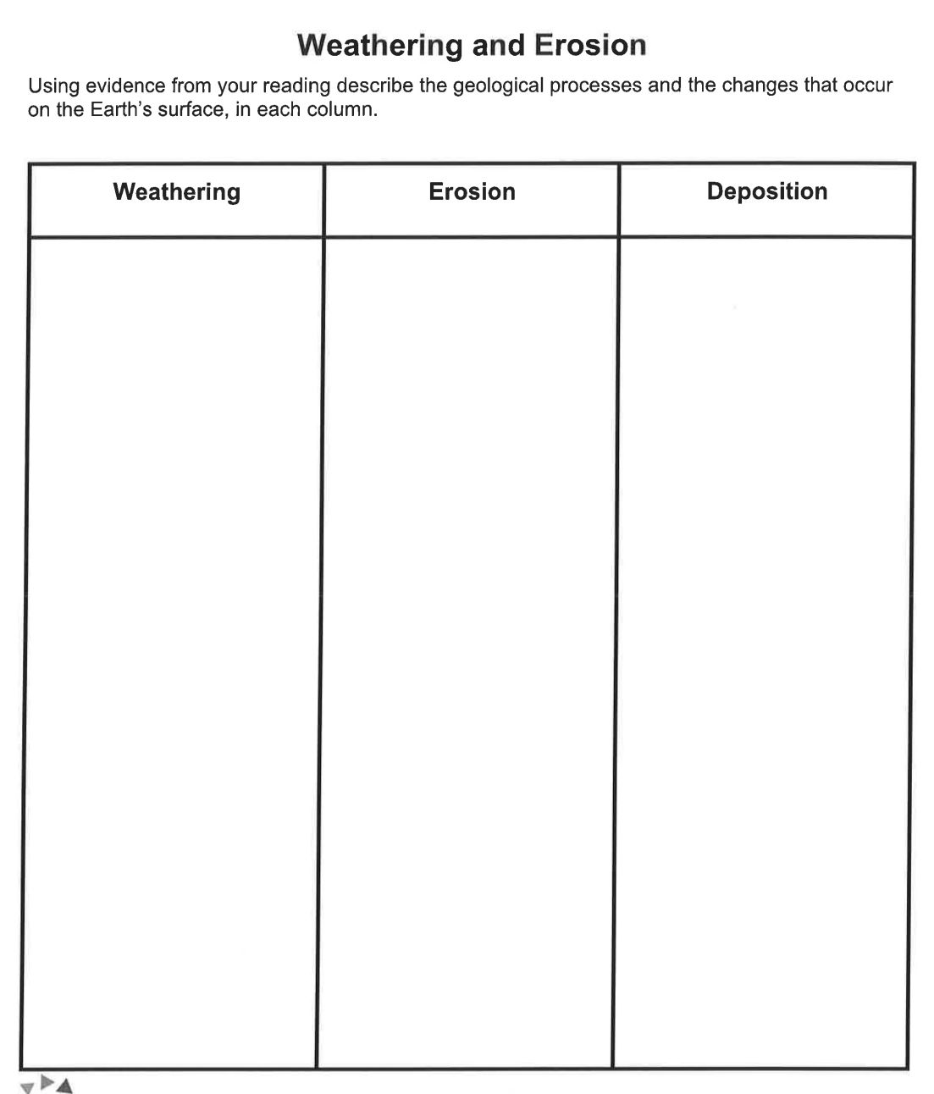

Slide 19
LAUNCH:
DO THE RIGHT THING EVEN WHEN NO ONE IS LOOKING!!!

