Slide 1
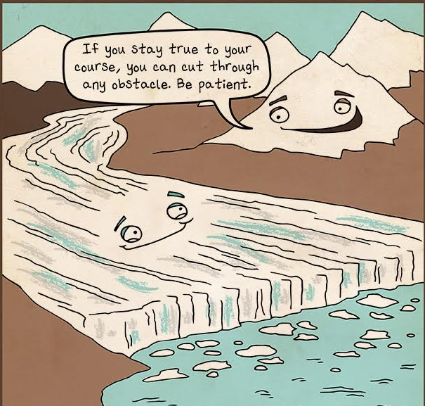
Science Starter: 1. Study for quiz
Tuesday October 30, 2018
Agenda:
11/9—Vocabulary Quiz—Succession and Watersheds
11/13—Unit 3 Part 2 DCA
Learning Target:
I will learn the concepts of weathering, erosion, deposition, and catastrophic events.
Success Criteria:
I will be able to show my mastery of weathering, erosion, deposition, and catastrophic events.

Slide 2
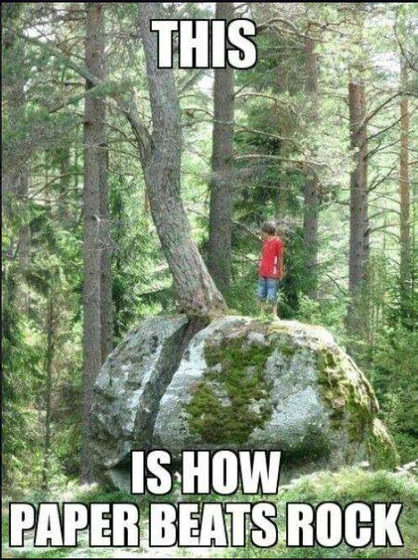
1. Good Things 2. Rater—Check in 3. Weathering, Erosion, Deposition Song 4. Weathering, Erosion, Deposition, and Catastrophic Events Quiz (Turn in White tray on Mrs, Hinds desk. 5. Finish sorting activity from Monday. 6. Texas Gateways—Ecological Succession pg. 21 in the workbook DO THE RIGHT THING EVEN WHEN NO ONE IS LOOKING!

Slide 3
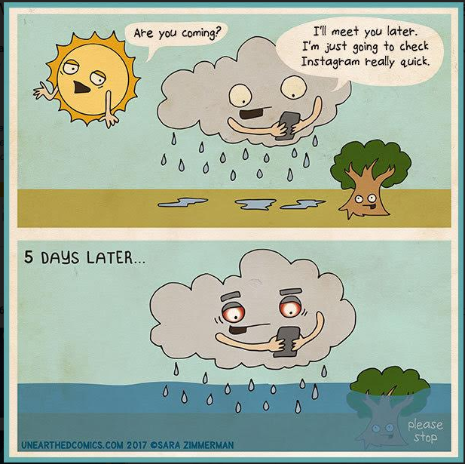
Texas Gateways—Ecological Succession
Engage—Complete Activity
EXPLORE—DOES NOT WORK
Explain—Complete Activity
Elaborate—Complete Activity
Evaluate—Complete Activity

Slide 4
DO THE RIGHT THING EVEN WHEN NO ONE IS LOOKING!!!

