Slide 1
Science Starter: 1. Pick up Plickers card 2. Learning Target/Success Criteria
Tuesday October 23, 2018
Agenda:
10/30—Weathering, Erosion, Deposition, and Catastrophic Events Quiz
11/12—Vocabulary Quizizz
11/13—Unit 3 Part 2 DCA
Learning Target:
I will learn the various ecoregions of Texas.
Science Starter:
I know how to label the ecoregions of Texas.

Slide 2
Plickers

Slide 3
1. Plickers 2. Good Things 3. Rater—Check in 4. TEKS Data Analysis pg. 3 5. Question of the Day…Ice Skating or Roller Skating/Roller blading 6. Ecoregions of Texas Video 7. Ecoregions of Texas Activity 8. DO THE RIGHT THING EVEN WHEN NO ONE IS LOOKING!

Slide 4
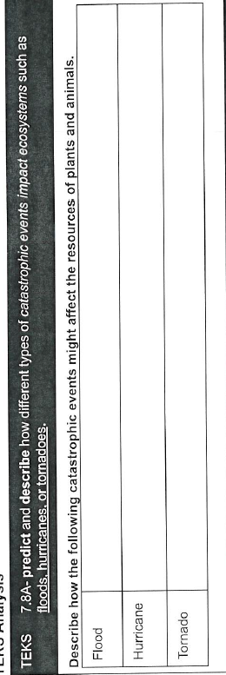
Pg. 3 TEKS Analysis
Pg. 5 Vocabulary
Catastrophic Event, Equilibrium

Slide 5
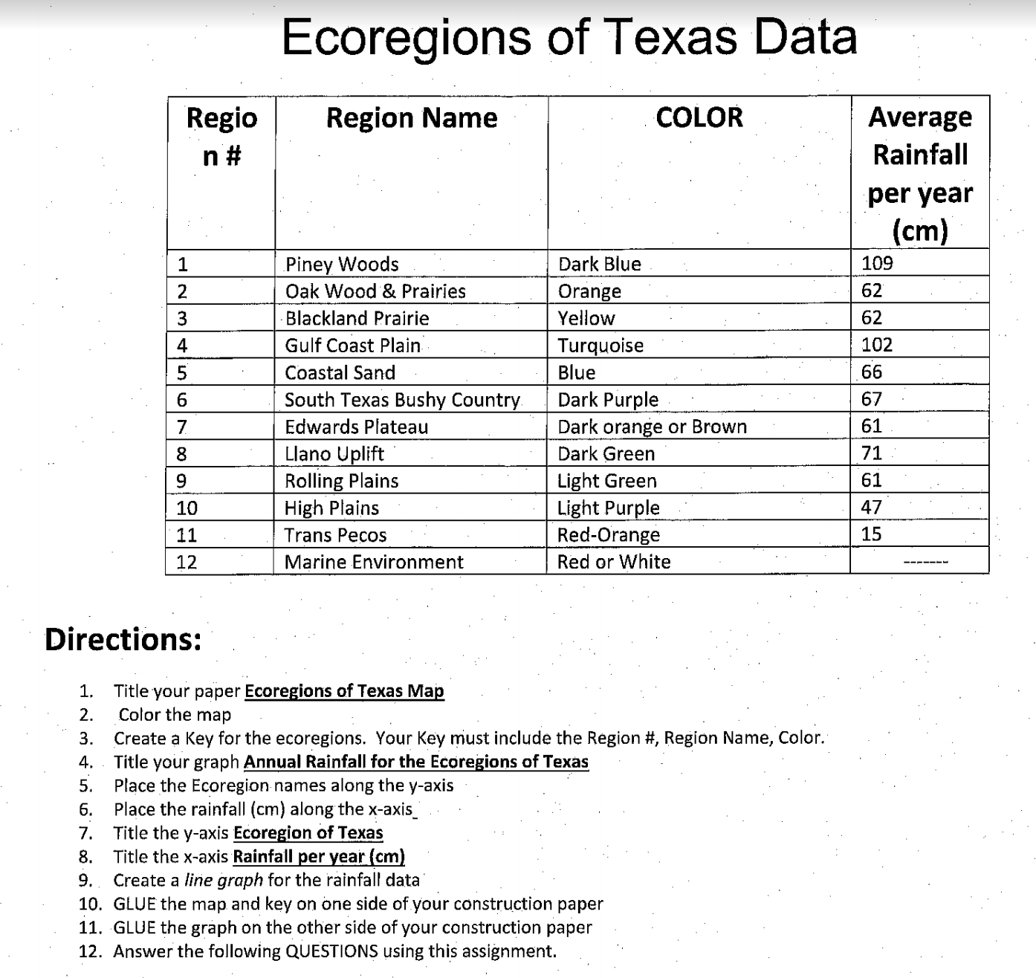
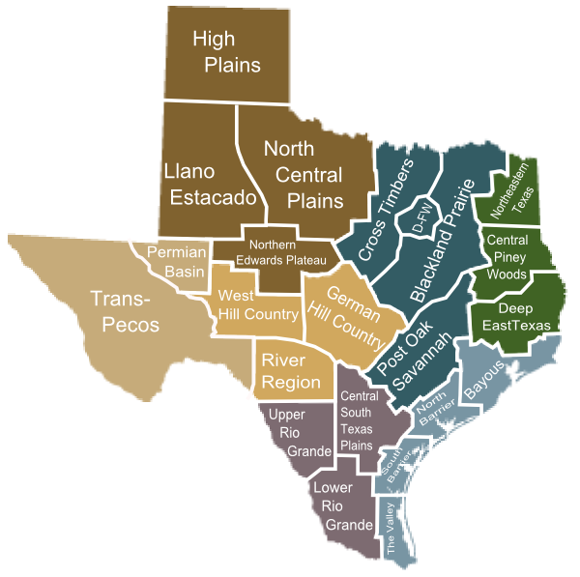
Ecoregions of Texas Handout
Construction Paper
Graph Paper
Lined Paper

Slide 6
DO THE RIGHT THING EVEN WHEN NO ONE IS LOOKING!!!

Slide 7
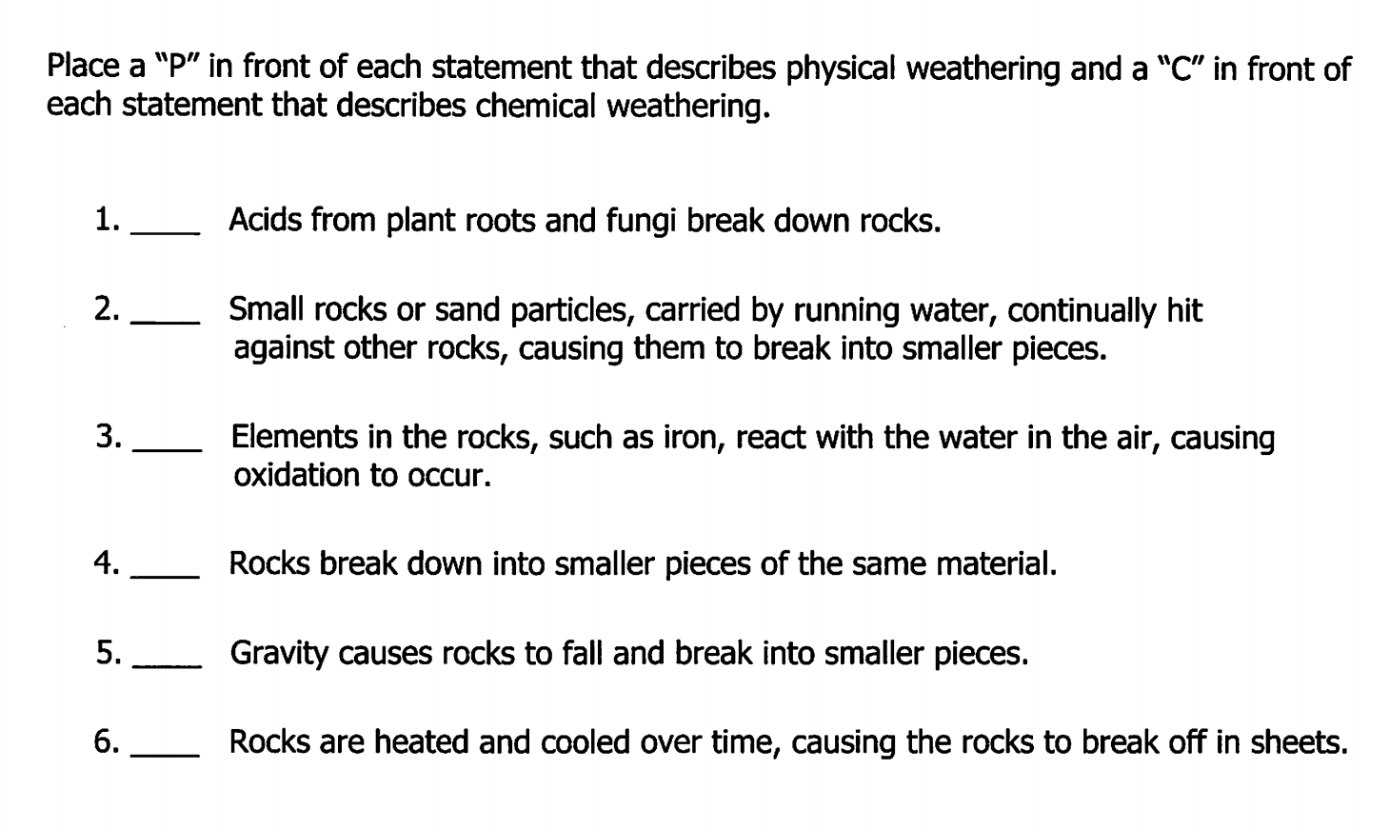
Science Starter: 1. Complete the warm-up 2. Learning Target/Success Criteria
Wednesday October 24, 2018
Agenda:
10/30—Weathering, Erosion, Deposition, and Catastrophic Events Quiz
11/12—Vocabulary Quizizz
11/13—Unit 3 Part 2 DCA
Learning Target:
I will learn the various ecoregions of Texas and their characteristics.
Science Starter:
I know how to describe the amount of precipitation of each ecoregion.

Slide 9
1. Good Things 2. Rater—Check in 3. Vide0—Edwards Plateau 4. Ecoregions of Texas Activity DO THE RIGHT THING EVEN WHEN NO ONE IS LOOKING!

Slide 10
Ecoregions of Texas Handout
Construction Paper
Graph Paper
Lined Paper

Slide 11
DO THE RIGHT THING EVEN WHEN NO ONE IS LOOKING!!!

