Slide 1
Science Starter: Enrichment Group—You will need your laptop and pick up a Gizmo guide Intervention Group—You will need your textbook and Pick up Workbook pages 20-21
Agenda:
10/22-Plickers Quiz
10/30-Quiz Weathering, Erosion, Deposition
11/12-Vocabulary Quizizz
11/13-Unit 3 Part 2
Monday October 15, 2018
Learning Target:
Enrichment: I will learn that the effects of hurricanes to an ecosystem.
Intervention: I will learn about microhabitats, biomes, biodiversity and sustainability.
Success Criteria:
Enrichment: I know how to determine the damage to an ecosystem from a hurricane.
Intervention: I know how to explain microhabitats, biomes, biodiversity and sustainability.

Slide 2
Agenda
1. Question---Dog or cat???
2. Rater/ Good Things
3. Enrichment—
A. Laptop Gizmo
4. Intervention (with Mrs. Hinds)
A. Textbook pgs. 308-322
5. Launch

Slide 3
Enrichment 1. Go to Mrs. Hinds Website and Click on the Gizmo Link 2. Click on Enroll in a class 3. Enter the Class Code 2nd Period—VBKCZBZ9ZP 4. Create an Account (No email Required) 5. Go to the Hurricane Gizmo 6. Follow the paper instructions YOU DO NOT NEED TO WRITE ANYTHING DOWN.
Intervention Group
Begin Reading Pgs. 308-322 in your textbook
Mrs. Hinds will be with your group shortly!!!
Also, you will need the handout!

Slide 4
Enrichment 1. Go to Mrs. Hinds Website and Click on the Gizmo Link 2. Click on Enroll in a class 3. Enter the Class Code 3rd Period—TGZGTHPK3M 4. Create an Account (No email Required) 5. Go to the Hurricane Gizmo 6. Follow the paper instructions YOU DO NOT NEED TO WRITE ANYTHING DOWN.
Intervention Group
Begin Reading Pgs. 308-322 in your textbook
Mrs. Hinds will be with your group shortly!!!
Also, you will need the handout!

Slide 5
Enrichment 1. Go to Mrs. Hinds Website and Click on the Gizmo Link 2. Click on Enroll in a class 3. Enter the Class Code 4TH Period—6JQ9PTHKJD 4. Create an Account (No email Required) 5. Go to the Hurricane Gizmo 6. Follow the paper instructions YOU DO NOT NEED TO WRITE ANYTHING DOWN.
Intervention Group
Begin Reading Pgs. 308-322 in your textbook
Mrs. Hinds will be with your group shortly!!!
Also, you will need the handout!

Slide 6
Enrichment 1. Go to Mrs. Hinds Website and Click on the Gizmo Link 2. Click on Enroll in a class 3. Enter the Class Code 6TH Period—DPCPBDMVMN 4. Create an Account (No email Required) 5. Go to the Hurricane Gizmo 6. Follow the paper instructions YOU DO NOT NEED TO WRITE ANYTHING DOWN.
Intervention Group
Begin Reading Pgs. 308-322 in your textbook
Mrs. Hinds will be with your group shortly!!!
Also, you will need the handout!

Slide 7
Enrichment 1. Go to Mrs. Hinds Website and Click on the Gizmo Link 2. Click on Enroll in a class 3. Enter the Class Code 7TH Period—XBWKR7HMDQ 4. Create an Account (No email Required) 5. Go to the Hurricane Gizmo 6. Follow the paper instructions YOU DO NOT NEED TO WRITE ANYTHING DOWN.
Intervention Group
Begin Reading Pgs. 308-322 in your textbook
Mrs. Hinds will be with your group shortly!!!
Also, you will need the handout!

Slide 8
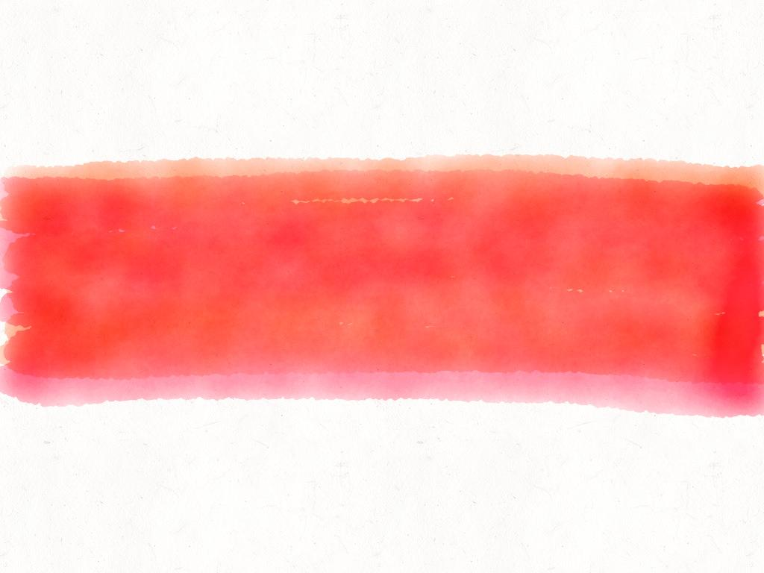
launch
Do the Right Thing Even When No One is Looking!

Slide 9
Science Starter: Pick up a laptop
Agenda:
10/22-Plickers Quiz
10/30-Quiz Weathering, Erosion, Deposition
11/12-Vocabulary Quizizz
11/13-Unit 3 Part 2
Tuesday October 16, 2018
Learning Target:
I will learn about the Focus Friday choices and I will learn about the Brightbytes survey.
Success Criteria:
I know how to select my choices for the Focus Friday Activities.
I know how to complete the Brightbytes technology survey.

Slide 10
Agenda
1. Rater/ Good Things
2. Focus Friday Choices
Check your email…from Mrs. Garinger and make selections
3. Brightbytes Survey
Check your email… from Mrs. Bradford and complete the survey.
4. Circles
5. Launch

Slide 11
Circles
1. What is your favorite pizza topping?
2. What is your favorite movie that makes you laugh?
3. Chick fil a or Whataburger
4. What is your favorite cartoon?

Slide 12
launch
Do the Right Thing Even When No One is Looking!

Slide 13
Science Starter: pick up a weathering, Erosion and Deposition Word search
Agenda:
10/22-Plickers Quiz
10/30-Quiz Weathering, Erosion, Deposition
11/12-Vocabulary Quizizz
11/13-Unit 3 Part 2
Wednesday October 17, 2018
Learning Target:
I will learn vocabulary for weathering, erosion and deposition.
Success Criteria:
I will know the vocabulary for weathering, erosion and deposition.

Slide 14
Agenda
1. Rater/ Good Things
2. Vision and Hearing Screening
3. Word Search
4. Question of the day:
Warm weather or Cold weather
5. Launch

Slide 15
launch
Do the Right Thing Even When No One is Looking!

