Slide 1
Learning Target: I will learn that there is a relationship between organisms and the environment in biomes to include deserts, forests, grasslands, tundra, freshwater or marine. Success Criteria: I know how to describe which organisms are supported in biomes.
Monday October 1, 2018
Attendance | Printer | Rater | Substitute | Time-keeper
Kinsley | Kiki | Malik | Cymone | Wilson
Tyler | Hunter | Kailey | Braedon | Athena
Bella | Joaquin | Grace | Kiana | TJ
Kennedi | Paris | Joshua | Sophia | Legend
Loisgrace | Isaiah | Carlos | Andy | Hwiseong
Science Starter:
Complete Learning Target and Success Criteria on pg. 1
Return all papers
Class Jobs (Changes to substitute/printer)
Agenda:
10/4—Quiz 10/10—Vocabulary Quizzizz
10/8-10/9—No school 10/11—DCA Unit 3

Slide 2
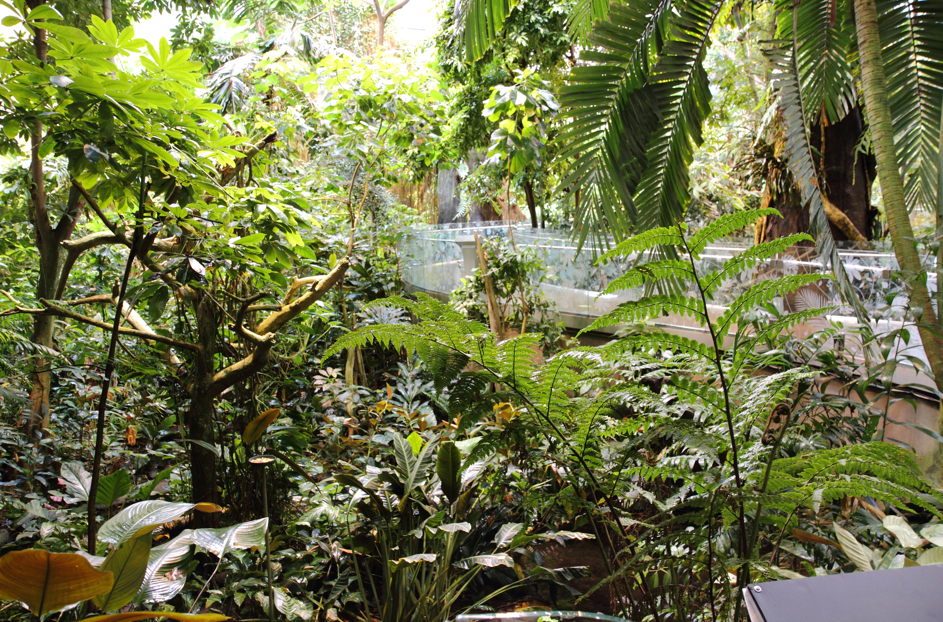
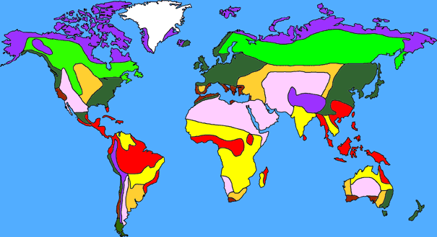
Good things/ Rater
Return all papers
3. Biomes Video/ Biomes Notes pg. 13 in workbook
(4th , 6th, 7th-pg. 12 Microhabitats)
Biomes investigation
Link on my website
Use pgs. 14-15 to complete the biomes chart
You will be able to work on this tomorrow during class.
5. Launch

Slide 3
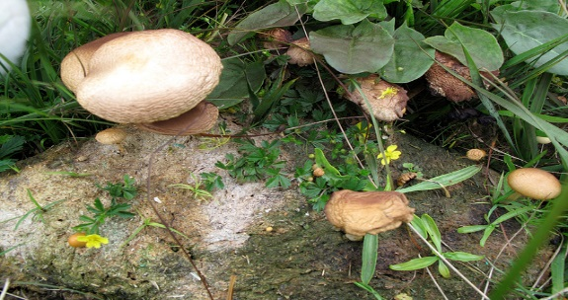
Cornell Notes Pg. 12
Learning Target:
I will learn the relationship between organisms and the environment including microhabitats in schoolyards and biomes, support different varieties of organisms.

Slide 4
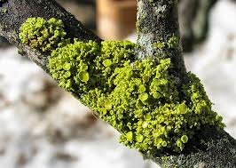
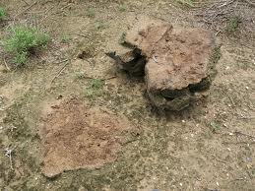
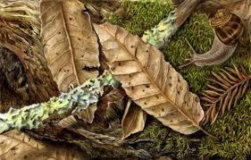
What is a Microhabitat?
A microhabitat is a small specialized habitat within a larger habitat.
Some examples of microhabitats include:
Rotting Logs
Under Rocks
Ant Hill
Aquarium
Puddle
Shade or sunlight
Dry or wet
Non-examples of microhabitats include:
Forest, Ocean, Desert

Slide 5
What is a Microhabitat?
Why do microhabitats support a variety of organisms?
-The temperature, humidity, light and soil may be different from the surrounding habitat resources available & conditions for survival.

Slide 6
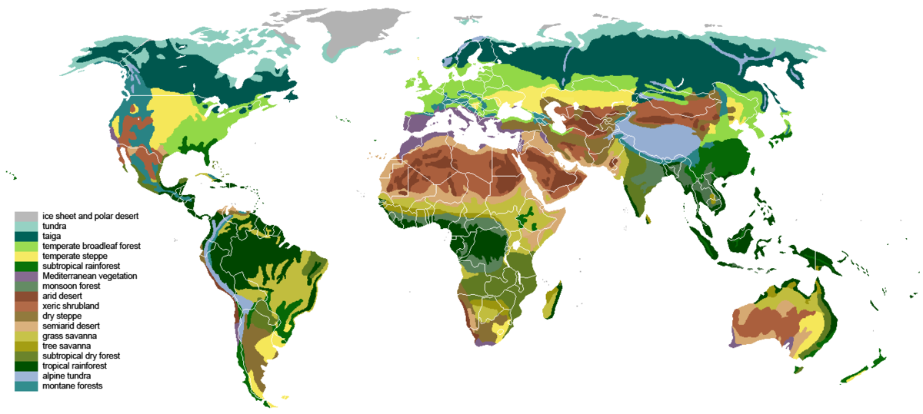
Biomes of the World
What is a BIOME? A group of ecosystems with similar climates and organisms.
Note: This is a very large area...larger than an ecosystem
Tundra
Taiga (Coniferous Forest)
Temperate Deciduous Forest
Grassland (Savanna)
Desert
Tropical Rain Forest
Freshwater Aquatic, Marine (Saltwater) Aquatic

Slide 7
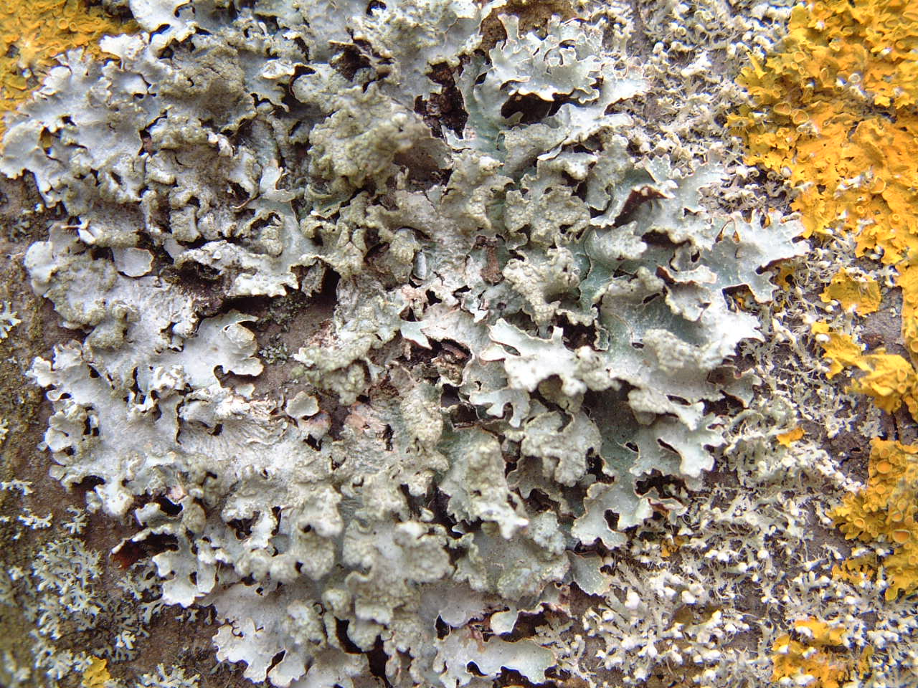
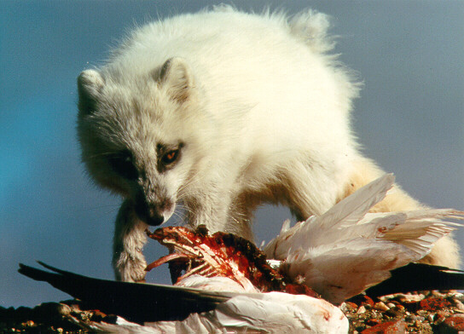
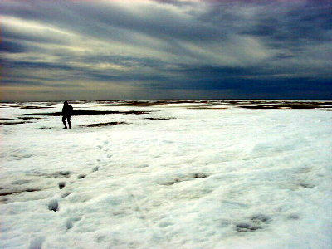
The Tundra Biome
Near the northern
part of Earth.
VERY COLD all year
Treeless, mostly frozen
Little Precipitation
Low biodiversity (variety of living things)

Slide 8
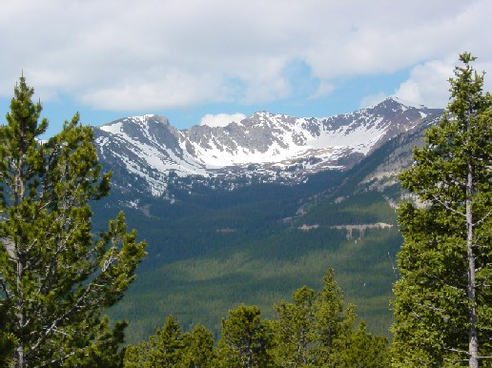
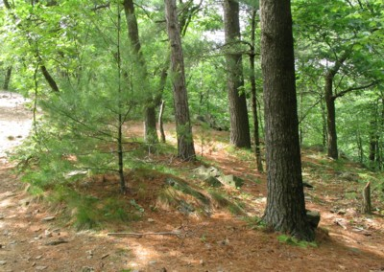
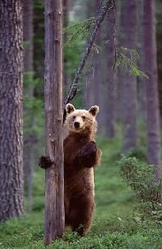
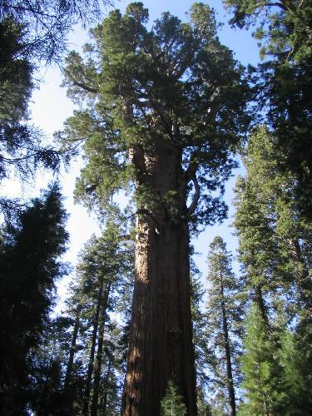
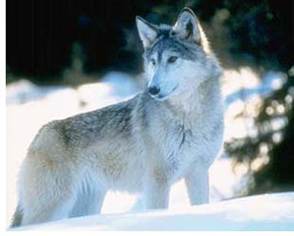
TAIGA/Coniferous Forest Biome
Lots of trees
Medium rain/snow
Long, cold winter
Short summer
Poor soil
Did I mention the trees are big?

Slide 9
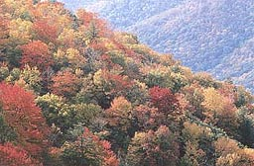
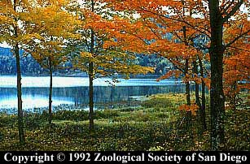
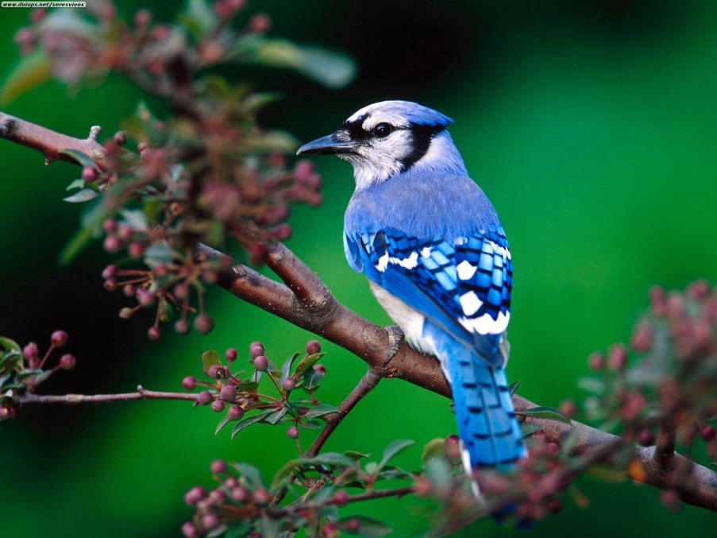
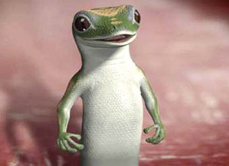
Deciduous Forest Biome
4 real seasons
Good rainfall throughout the year
Good soil for plants
Variety of plant and animal life

Slide 10
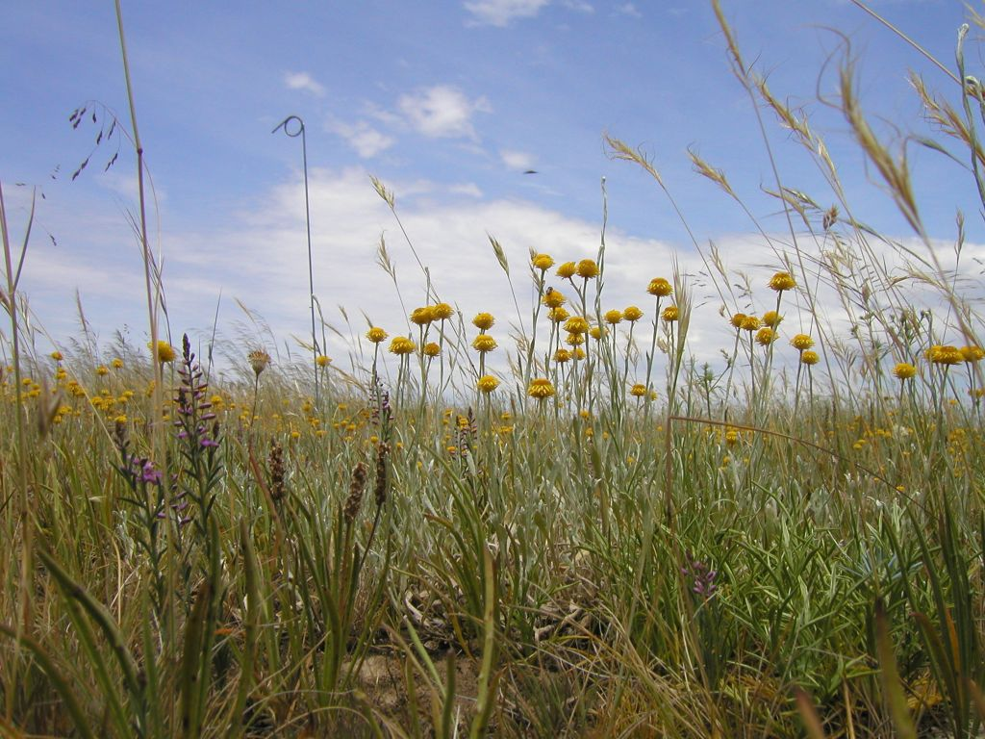
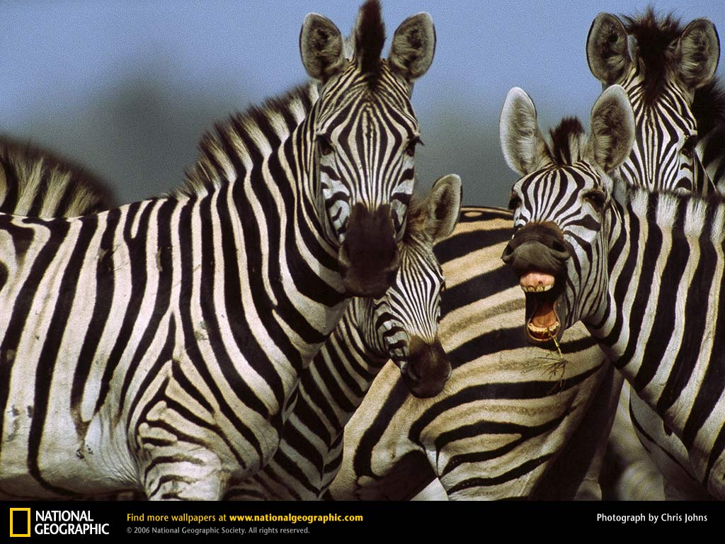
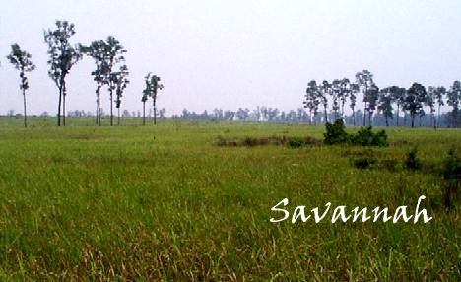
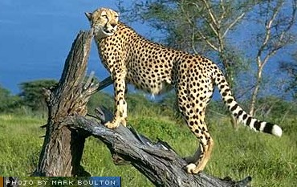
Grassland Biome
Flat, mostly treeless
Dry, often drought-plagued.
Important to us for food crops.
Good soil
Hot summers and cool winters
Not enough rain for thick forests
Features the world’s best runners.

Slide 11
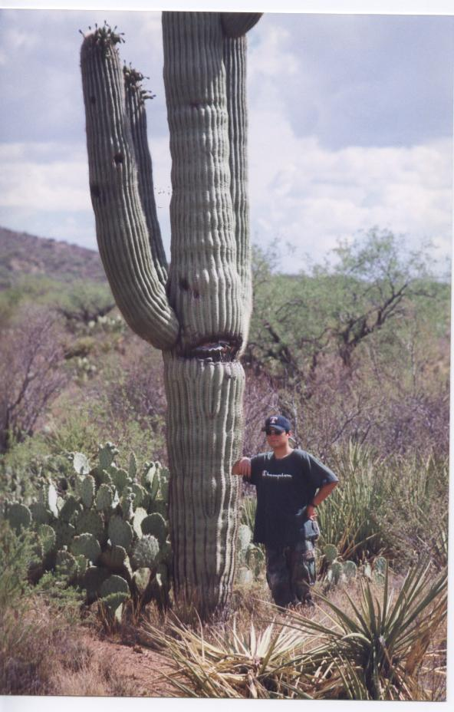
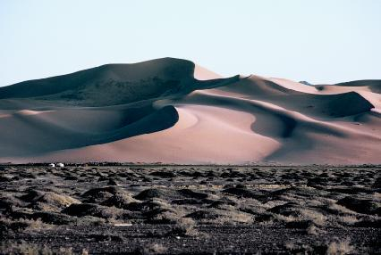
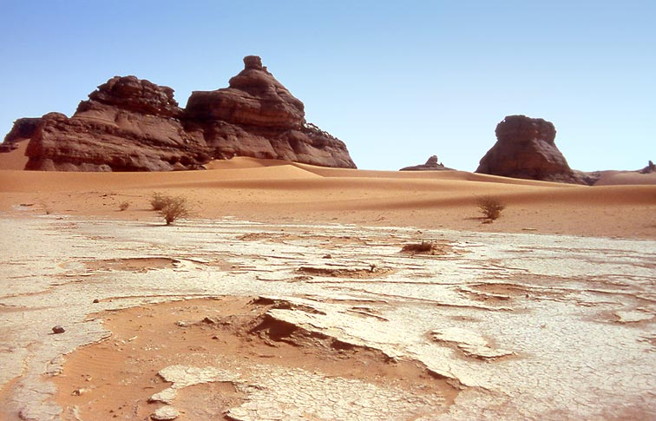
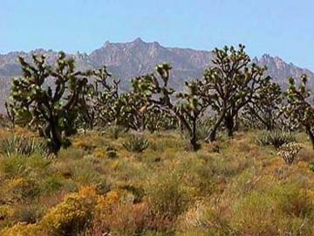
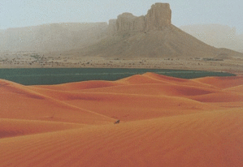
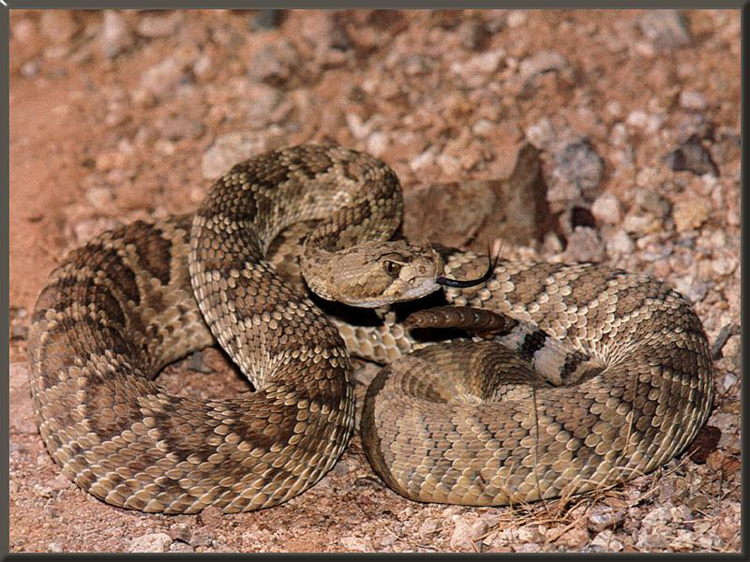
Desert Biome
Really DRY.
Hot days and cold nights
Poor soil (Rocky or sandy soil)
Plants adapted to conserve water
DRY, except for the man-
made lake
DRY
See any rain here? Dry.

Slide 12
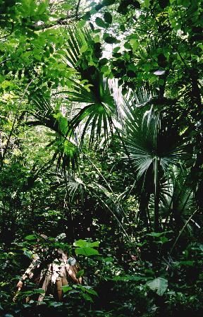
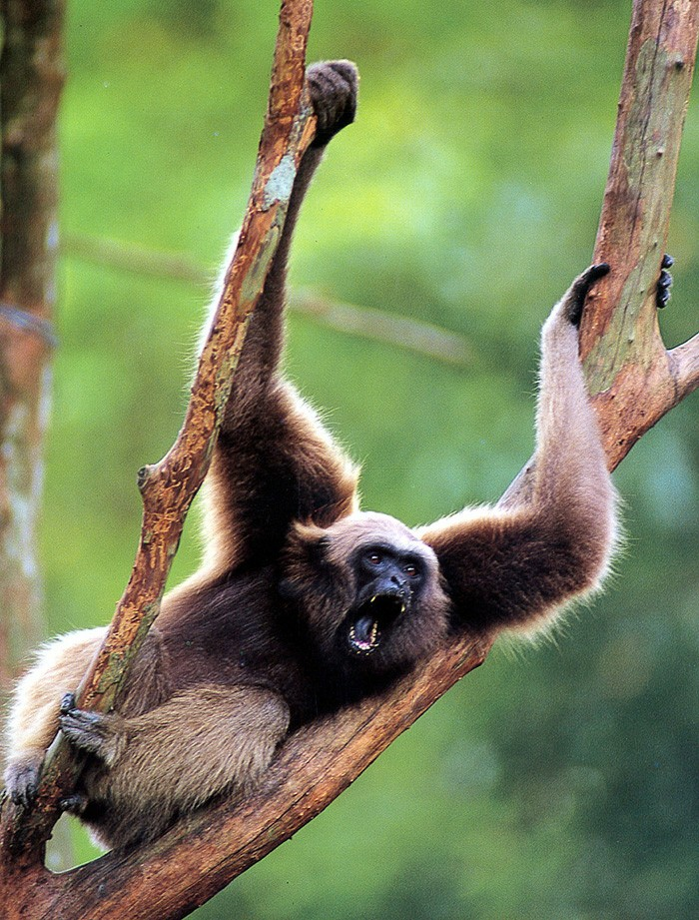
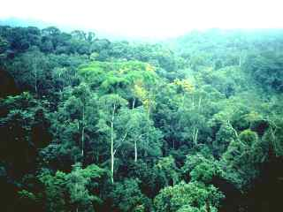
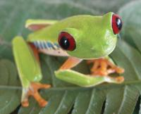
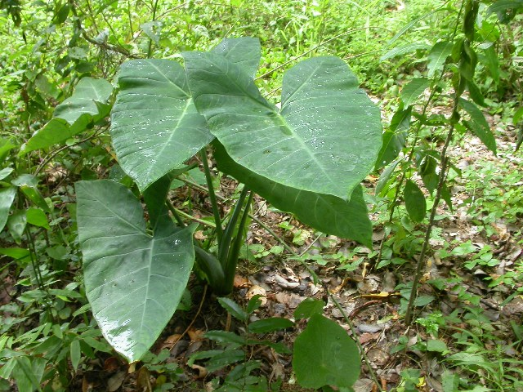
Tropical Rain Forest Biome
Lots of rainfall and high biodiversity
Very warm all year round
Soil is ok
High canopy trees
Lots of animals and plants

Slide 13
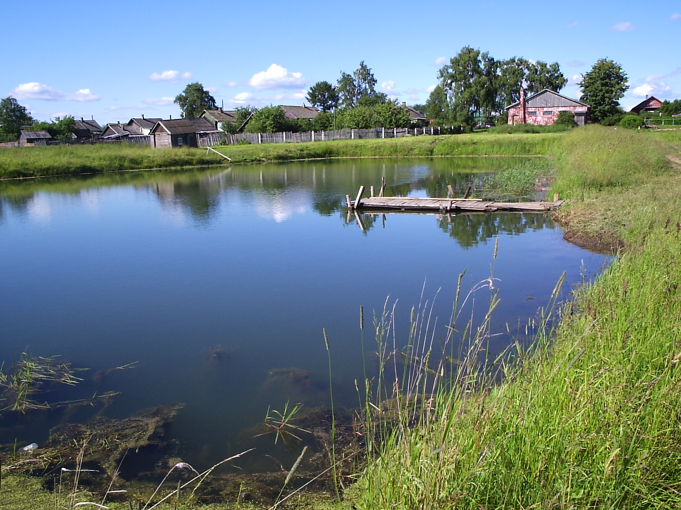
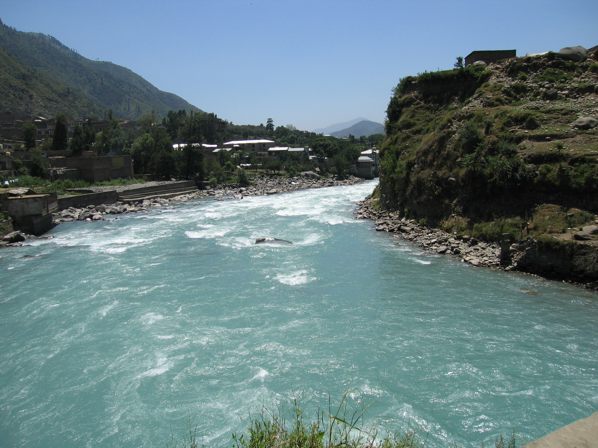
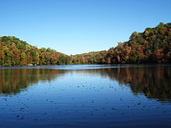
Freshwater Aquatic- Lakes, ponds, rivers

Slide 14
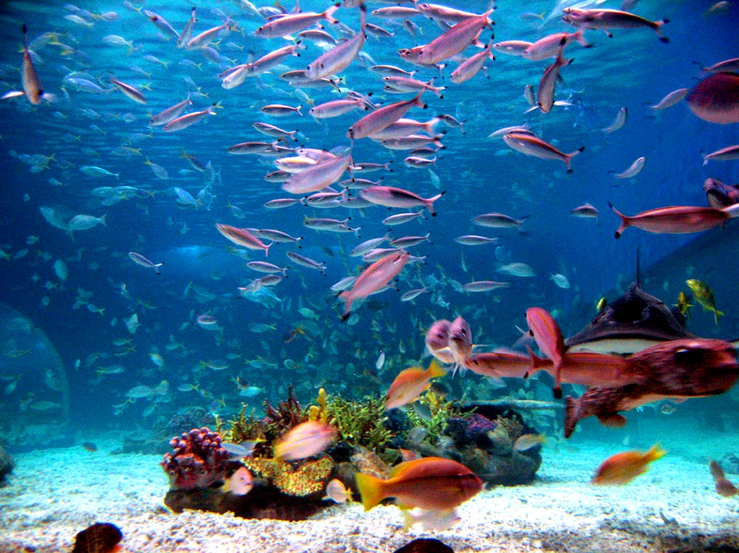
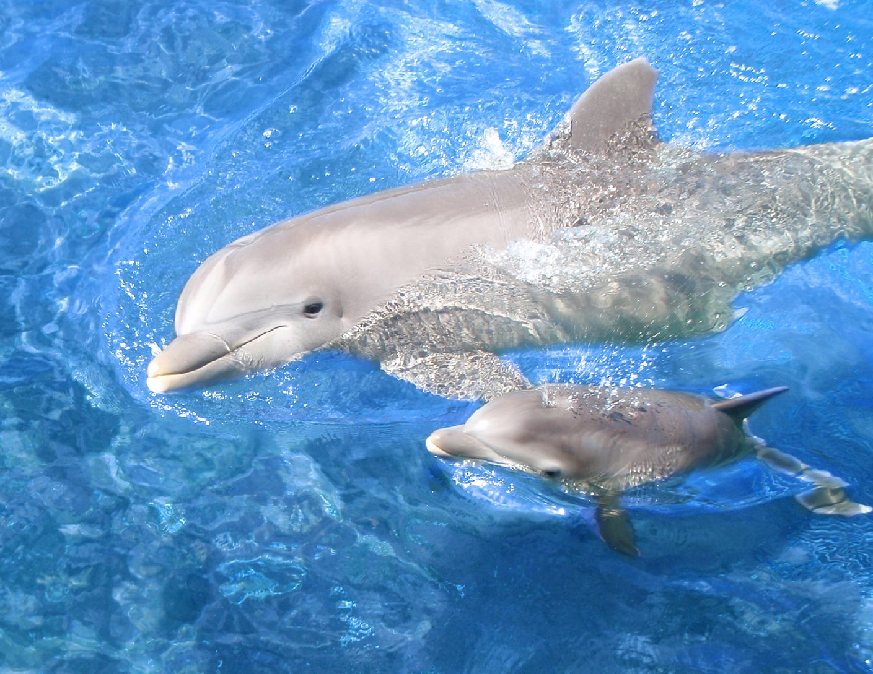
Marine Aquatic-Saltwater

Slide 15
Do the Right Thing Even When No One is Looking

Slide 16
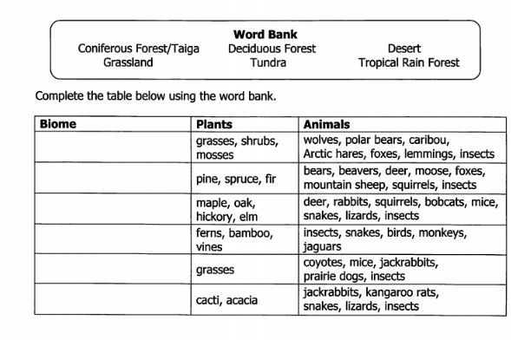
Learning Target: I will learn that there is a relationship between organisms and the environment in biomes to include deserts, forests, grasslands, tundra, freshwater or marine. Success Criteria: I know how to determine which organisms are supported in a variety of biomes.
Monday October 1, 2018
Science Starter:
Microhabitat Warm up
READ learning target and success criteria
(You do not need to rewrite it)
Agenda:
10/4—Quiz 10/10—Vocabulary Quizzizz
10/8-10/9—No school 10/11—DCA Unit 3

Slide 18
Good things/ Rater
2. Biomes investigation continued
Link on my website
Use pgs. 14-15 to complete the biomes chart
Once you have completed the chart then answer the questions on pg. 15
If you do not complete this then it is
Homework.
Early finishers:
See Mrs. Hinds for BIOMES CHART
3. Launch

Slide 19
Do the Right Thing Even When No One is Looking

