Slide 1
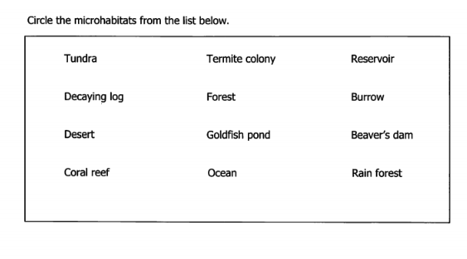
Learning Target: I will learn that microhabitats in school yards include: ant hills, shade, sun, puddle, log, garden, etc. Success Criteria: I know how to show that microhabitats support different varieties of organisms.
Thursday September 27, 2018
Science Starter:
Pick up Microhabitats Warm-up. Keep at your table and we will go over the warm-up. This will be graded!!!
Complete Learning Target and Success Criteria on pg. 1
Agenda:
10/4—Quiz 10/10—Vocabulary Quizzizz
10/8-10/9—No school 10/11—DCA Unit 3

Slide 3
Agenda
1. Good things/ Rater (Nature Walk)
2. We will be heading outside for our nature walk. You will need:
Workbook pgs. 9-10
Pencil
Clipboard with field guide
3. Expectations for Nature Walk:
Walk quietly in hallway.
Follow teacher’s instructions
Only move to the areas designated by teacher.
Nature must stay in NATURE…do not take anything from the natural environment.
4. Reflection/Launch

Slide 4
Do the Right Thing Even When No One is Looking

Slide 5
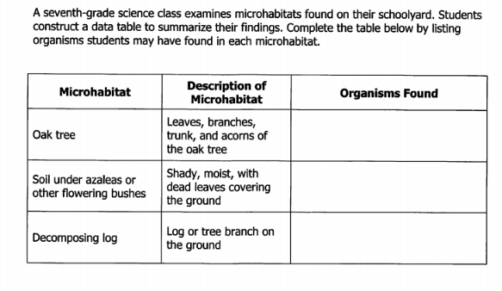
Learning Target: I will learn that the organisms present in a microhabitat are a result of the abiotic factors (resources available or conditions for survival) in the microhabitat. Success Criteria: I know how to identify abiotic factors in a microhabitat.
Friday September 28, 2018
Science Starter:
Pick up Microhabitats Warm-up. Complete the warm-up and turn in for a grade. (Remember our nature walk!)
Sign up for Jobs
Complete Learning Target and Success Criteria on pg. 1
Agenda: 9/28– Hornet Buck Store
10/4—Quiz 10/10—Vocabulary Quizzizz
10/8-10/9—No school 10/11—DCA Unit 3

Slide 6
Hornet Buck STORE
If you have
Mrs. Latham, Mrs. Sides,
Ms. Moyer, Ms. V.,
or Mrs. Dart for math class
then
you will go to the Hornet Buck Store during science today at the last 10 minutes of class.
If you have
Mr.Hargrove or Mrs. Caldwell for math class
then
you will go to the Hornet Buck Store during math class.

Slide 7
1. Good things/ Rater
Do your very best today! I KNOW you will be on your most amazing behavior!
Have a wonderful weekend and I will see you on Monday!
Love, Mrs. Hinds
P.s. I will check in with Mrs. Marquez throughout the day.
2. Graphing Assessment
This is a pre-assessment and will be taken as a daily grade.
This is an independent activity…Please no talking.
Turn in the assessment once you have completed it.
3. After the Graphing Assessment
Turn to pg. 11 in your workbook and complete the “Conclude and Apply” questions 1-3.
If you finish the “Conclude and Apply” questions then you may read pgs. 308-321 in your textbook
4. Biomes Video/ Biomes Notes pg. 13 in workbook (4th Period-pg. 12 Microhabitats)
5. Launch

Slide 8
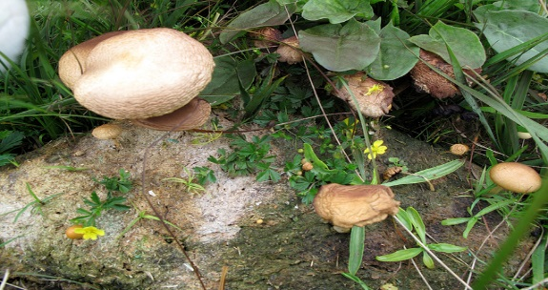
Cornell Notes Pg. 12
Learning Target:
I will learn the relationship between organisms and the environment including microhabitats in schoolyards and biomes, support different varieties of organisms.

Slide 9
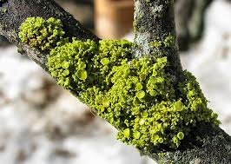
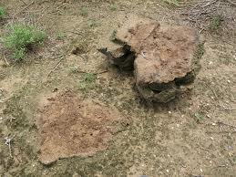
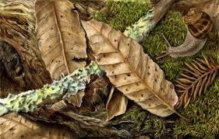
What is a Microhabitat?
A microhabitat is a small specialized habitat within a larger habitat.
Some examples of microhabitats include:
Rotting Logs
Under Rocks
Ant Hill
Aquarium
Puddle
Shade or sunlight
Dry or wet
Non-examples of microhabitats include:
Forest, Ocean, Desert

Slide 10
What is a Microhabitat?
Why do microhabitats support a variety of organisms?
-The temperature, humidity, light and soil may be different from the surrounding habitat resources available & conditions for survival.

Slide 11
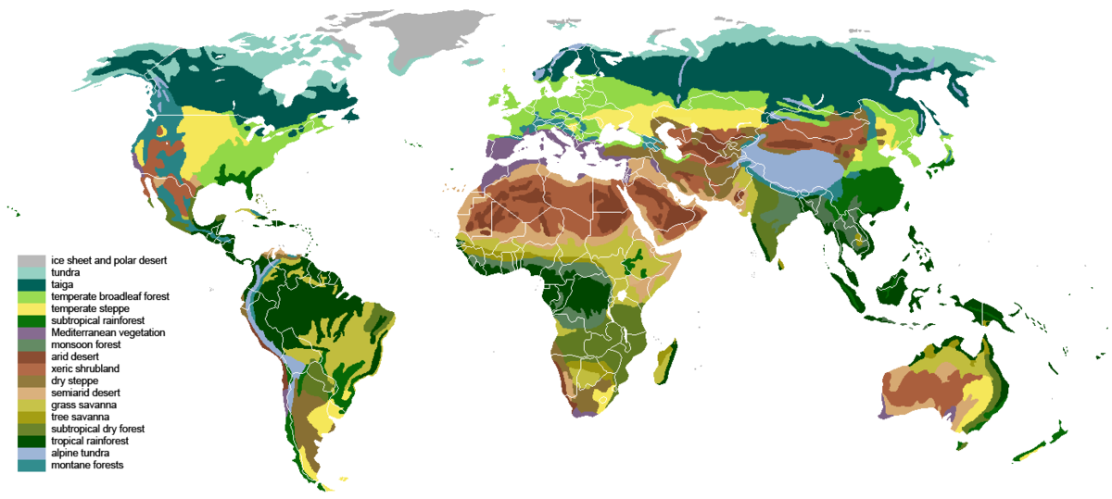
Biomes of the World
What is a BIOME? A group of ecosystems with similar climates and organisms.
Note: This is a very large area...larger than an ecosystem
Tundra
Taiga (Coniferous Forest)
Temperate Deciduous Forest
Grassland (Savanna)
Desert
Tropical Rain Forest
Freshwater Aquatic, Marine (Saltwater) Aquatic

Slide 12
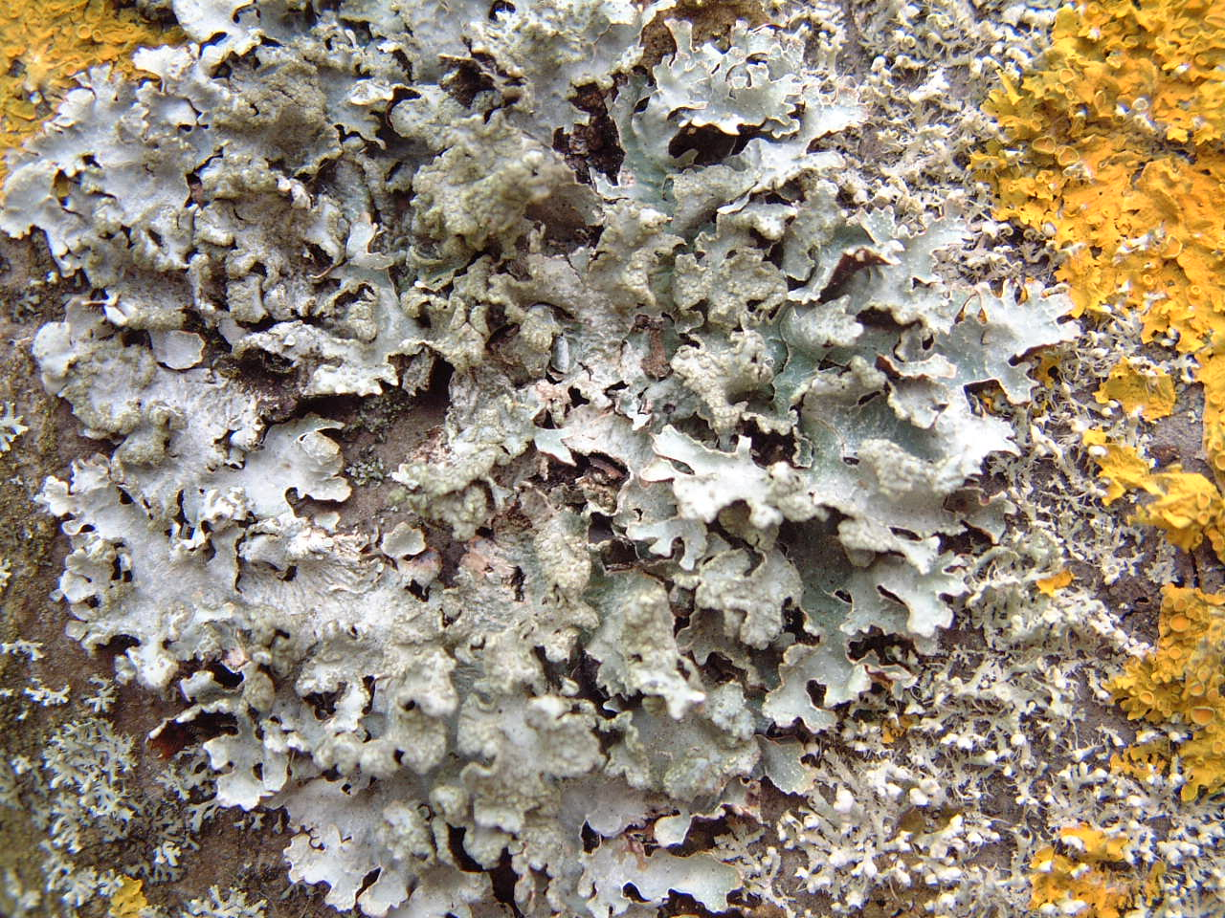
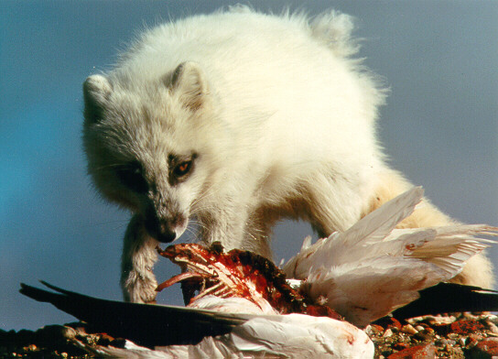
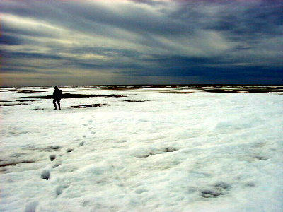
The Tundra Biome
Near the northern
part of Earth.
VERY COLD all year
Treeless, mostly frozen
Little Precipitation
Low biodiversity (variety of living things)

Slide 13
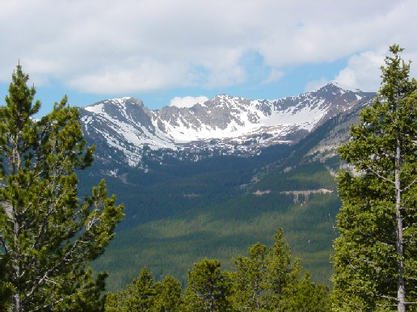
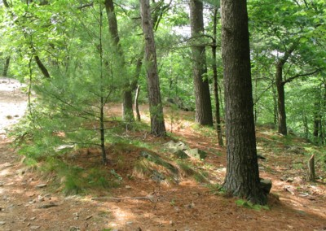
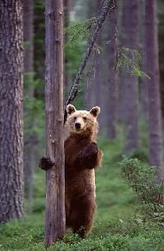
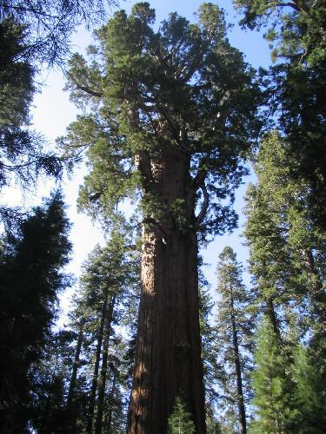
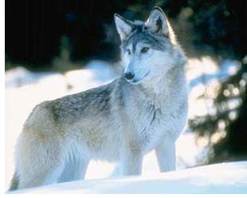
TAIGA/Coniferous Forest Biome
Lots of trees
Medium rain/snow
Long, cold winter
Short summer
Poor soil
Did I mention the trees are big?

Slide 14
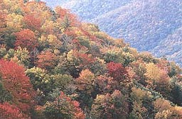
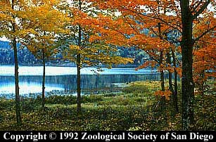
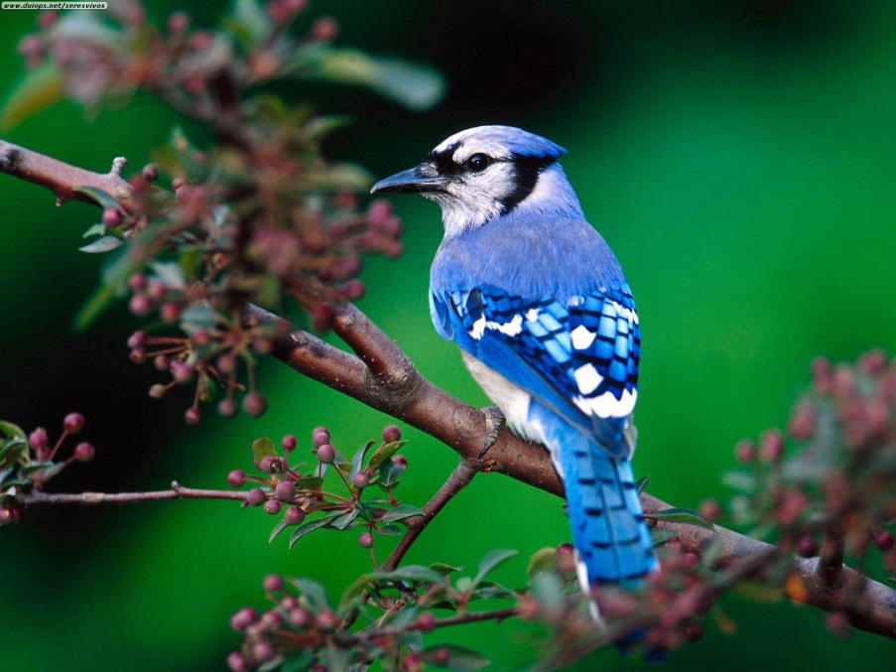
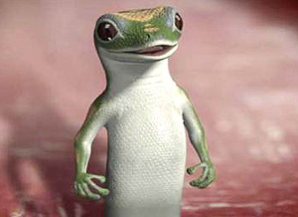
Deciduous Forest Biome
4 real seasons
Good rainfall throughout the year
Good soil for plants
Variety of plant and animal life

Slide 15
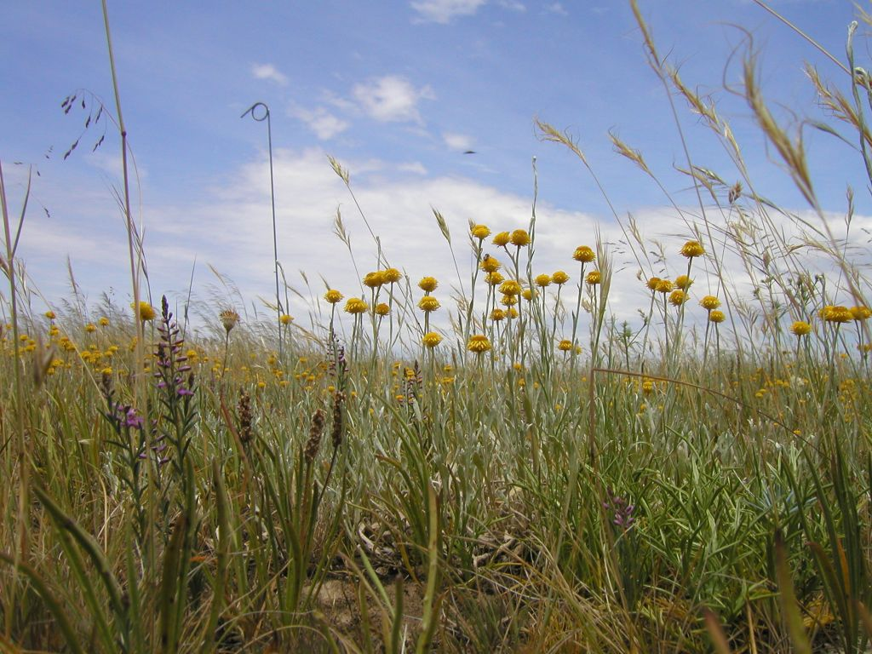
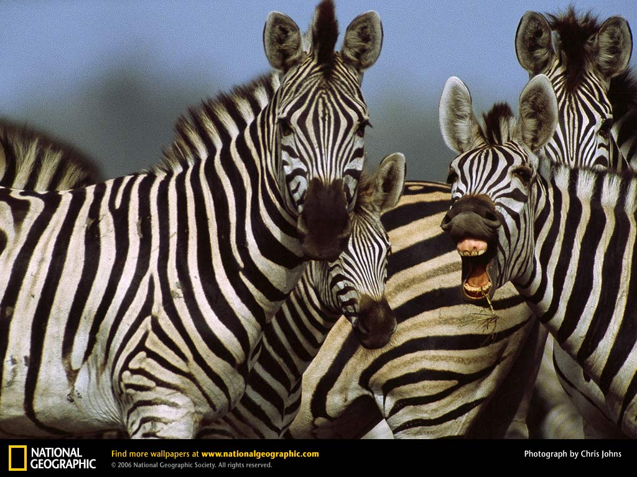
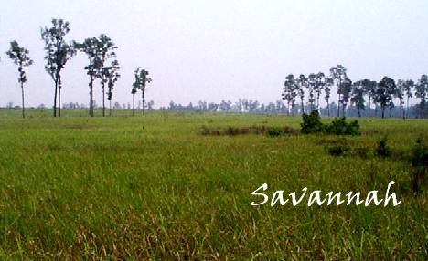
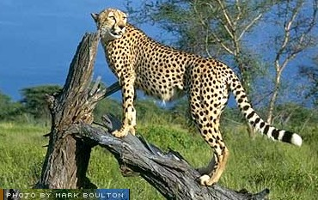
Grassland Biome
Flat, mostly treeless
Dry, often drought-plagued.
Important to us for food crops.
Good soil
Hot summers and cool winters
Not enough rain for thick forests
Features the world’s best runners.

Slide 16
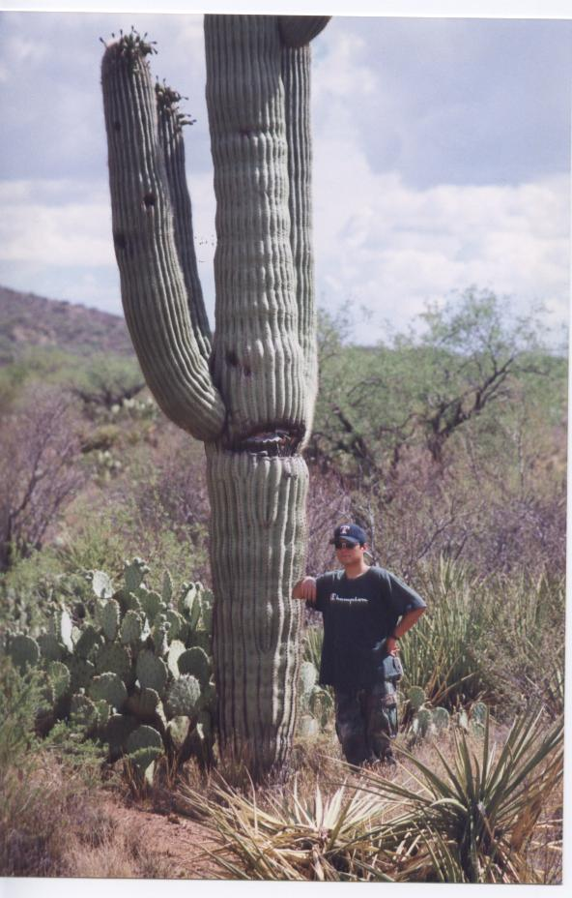
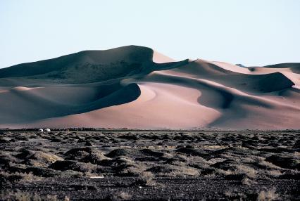
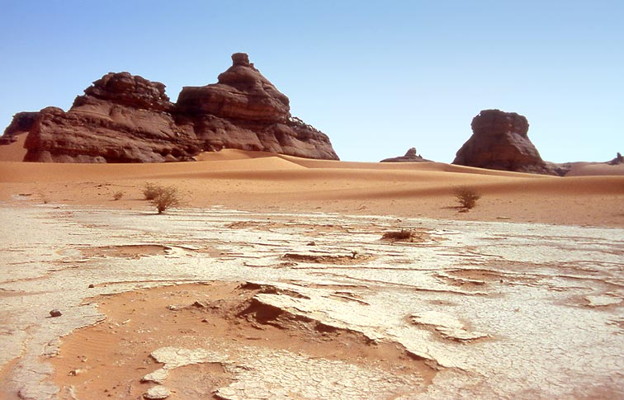
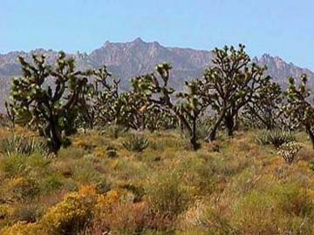
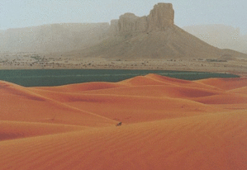
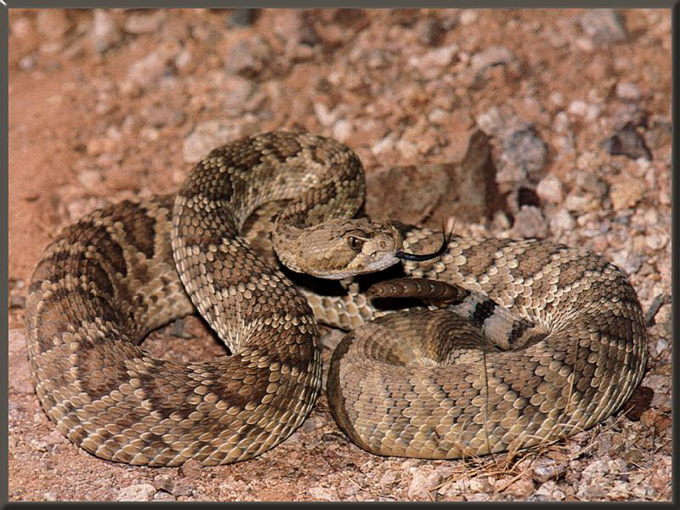
Desert Biome
Really DRY.
Hot days and cold nights
Poor soil (Rocky or sandy soil)
Plants adapted to conserve water
DRY, except for the man-
made lake
DRY
See any rain here? Dry.

Slide 17
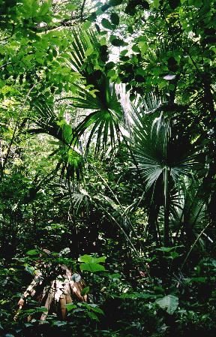
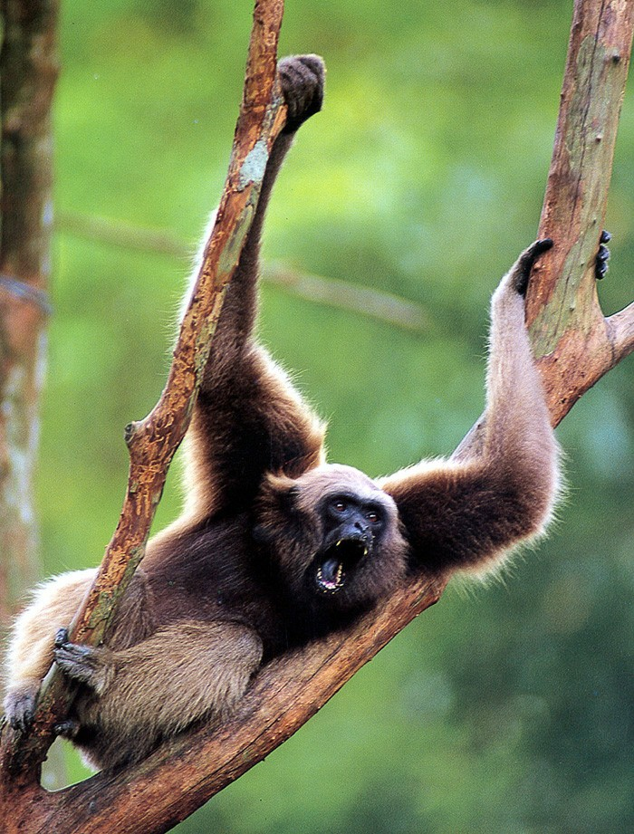
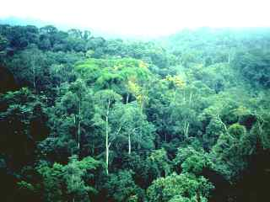
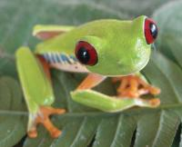
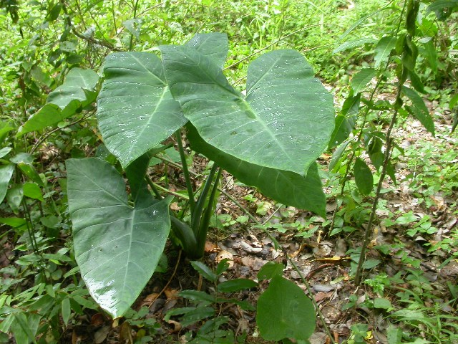
Tropical Rain Forest Biome
Lots of rainfall and high biodiversity
Very warm all year round
Soil is ok
High canopy trees
Lots of animals and plants

Slide 18
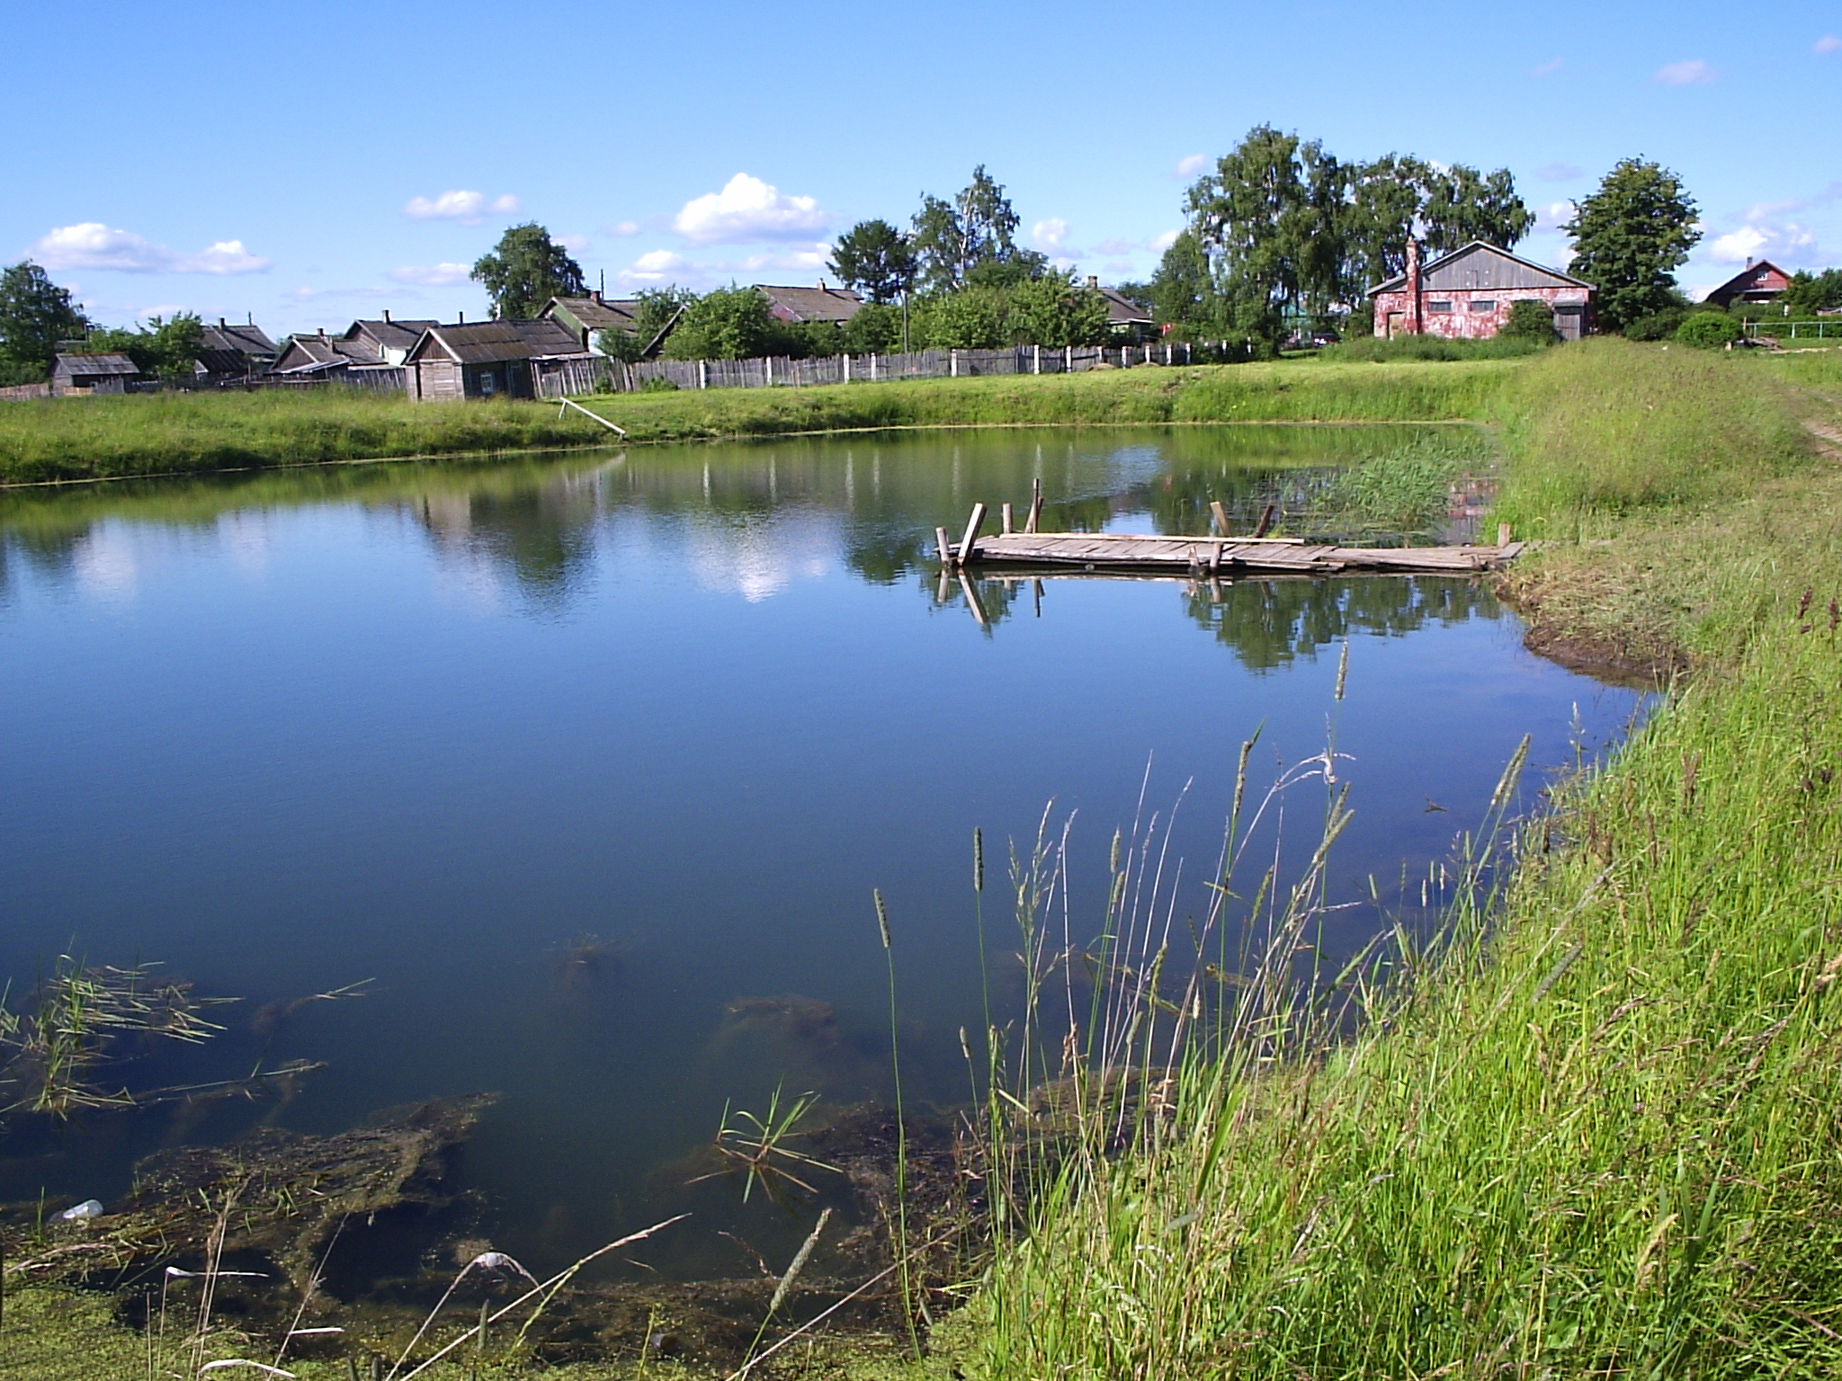
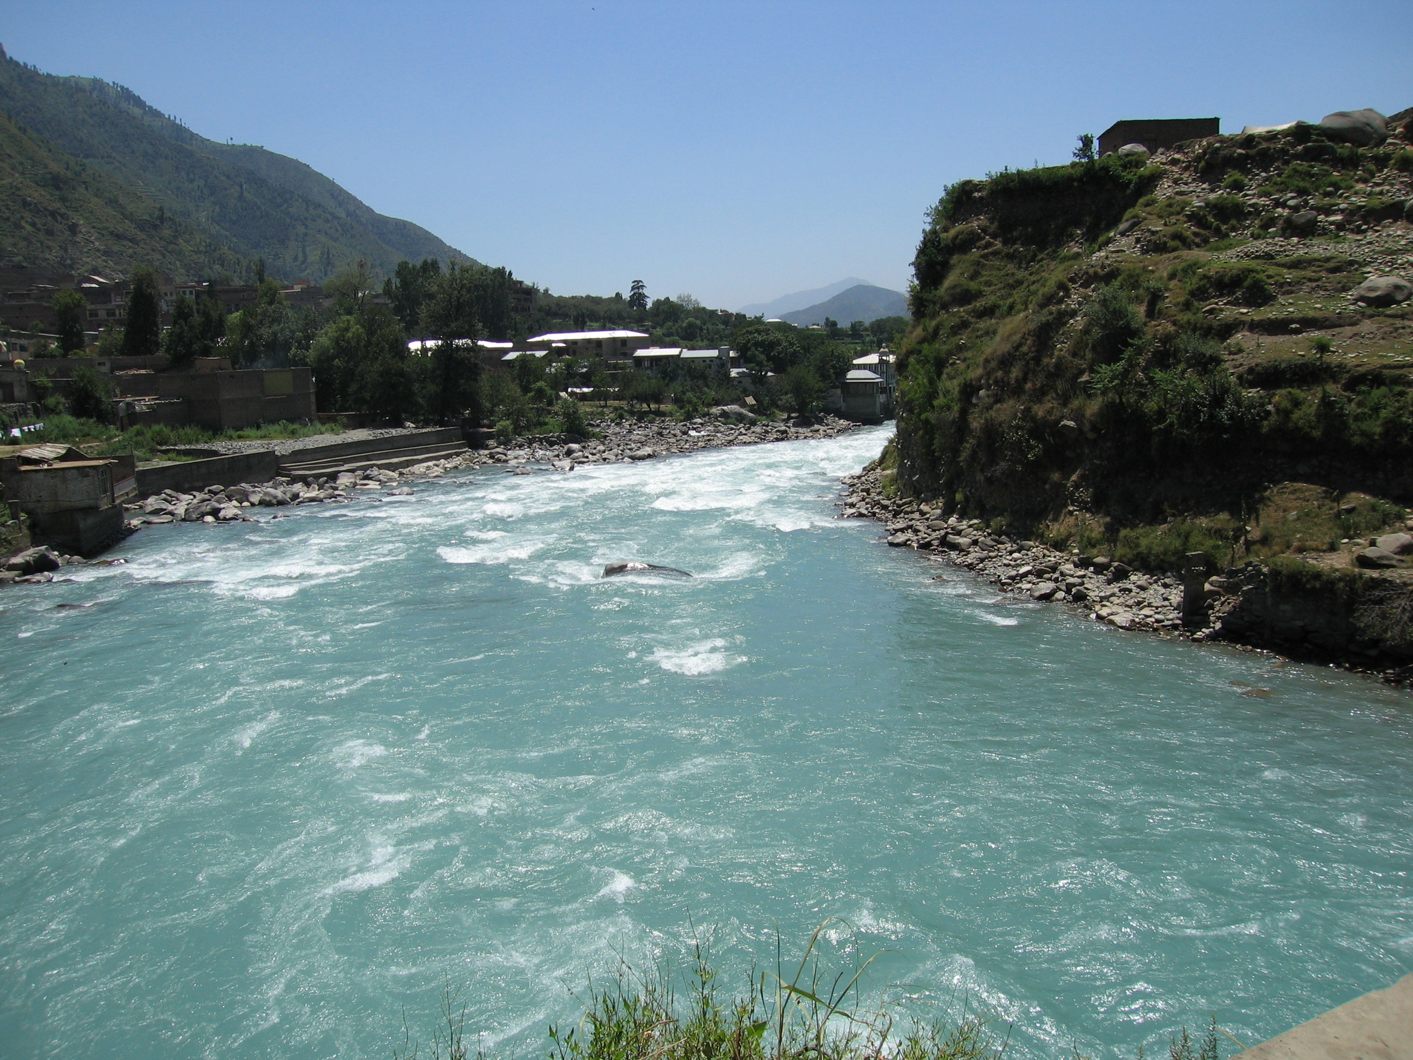
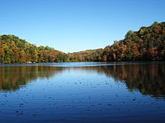
Freshwater Aquatic- Lakes, ponds, rivers

Slide 19
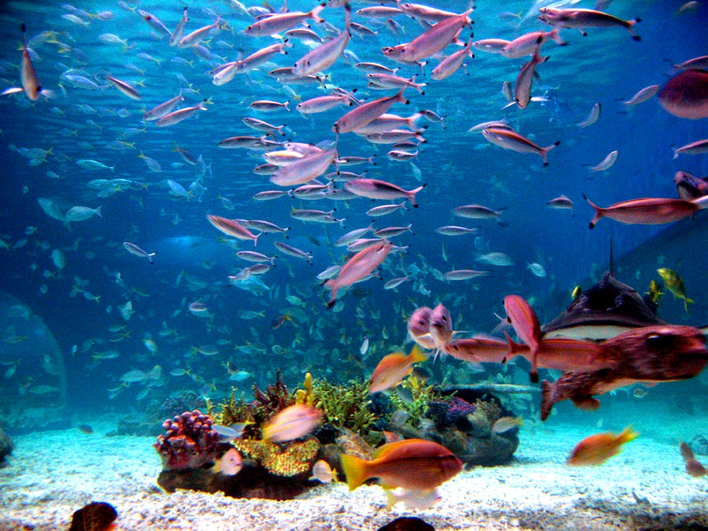
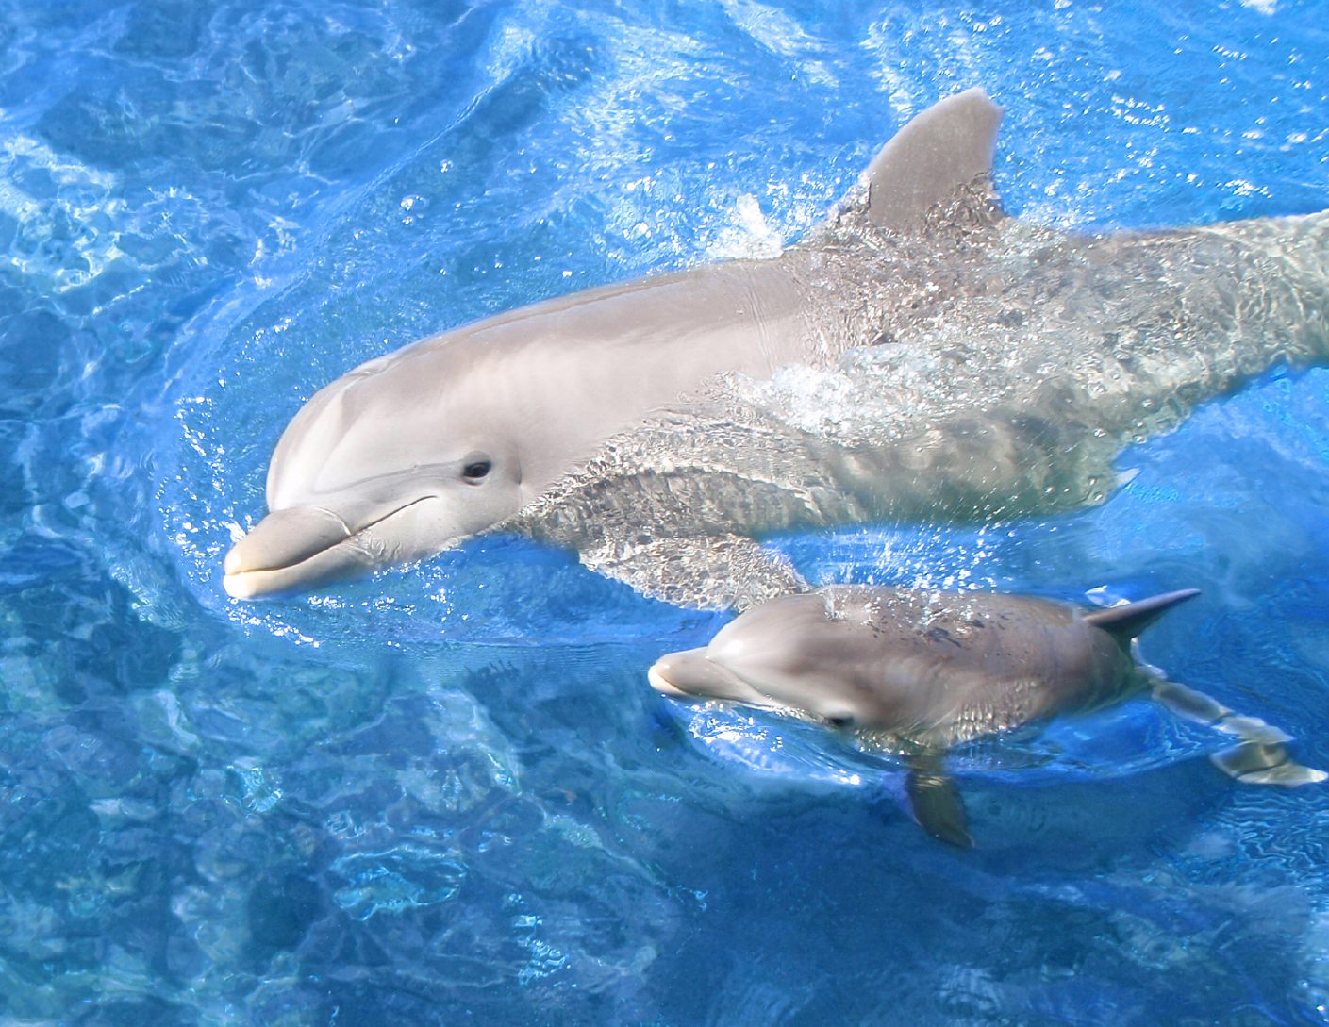
Marine Aquatic-Saltwater

Slide 20
Do the Right Thing Even When No One is Looking

