Slide 1
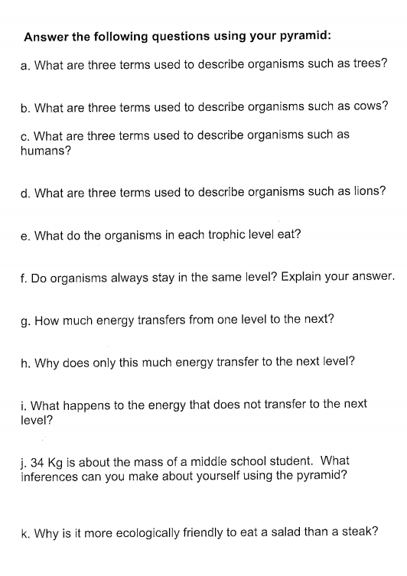
Science Starter:
Part 1: Finish and turn in Energy Pyramid (15 minutes)
Part 2: Work on the Energy Pyramid Questions
Part 3: Work on Food Web
(Construction paper)
Part 4: Work on Unfinished Work
Learning Target: I will learn that energy pyramids show how the amount of energy available in each step of a food chain changes.
Success Criteria: I can demonstrate the relationship among ecological components by organizing them into energy pyramids.
Wednesday, September 19 2018
Agenda: 9/20--Vocabulary Quizzizz
9/21--DCA Matter and Energy in a Ecosystem
ALL WORK DUE BY FRIDAY AT 3:40!!!

Slide 2
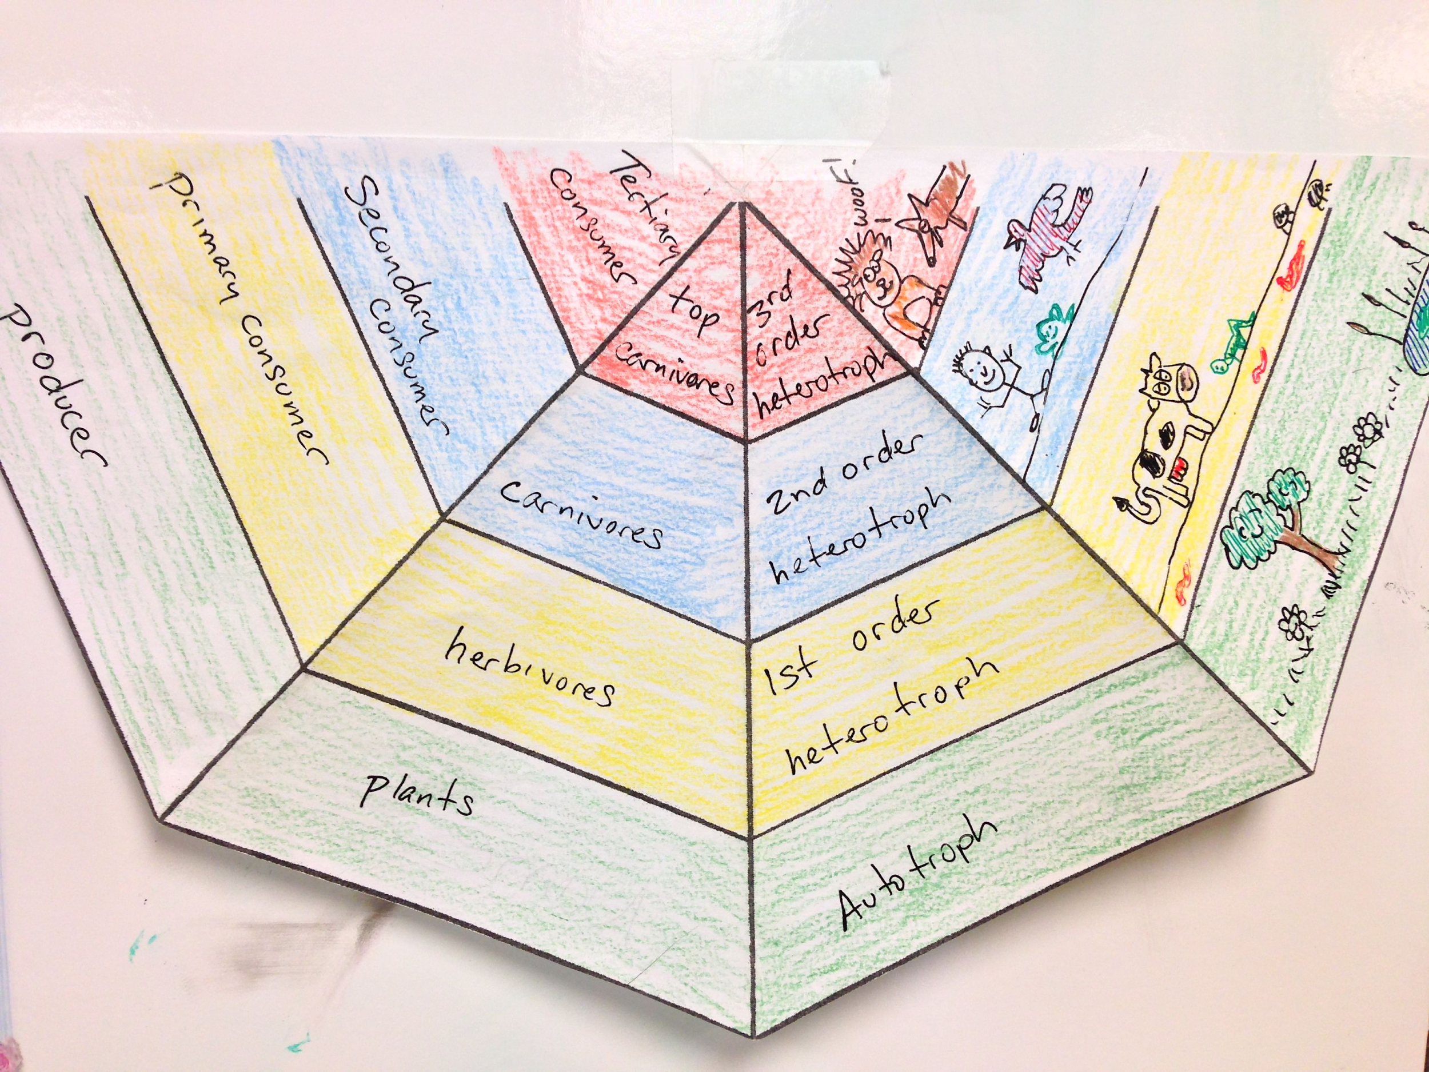
Energy Pyramid Directions--SKIP STEP 10
After you build your pyramid, answer the questions in your workbook

Slide 3
AGENDA
Good Things/Rater
Corrections for Photosynthesis Test can be completed at home or tutorials. DUE Friday!
REMINDER--
Vocabulary Quizzizz--Thursday
Unit 2 DCA--Friday
Class Review Activity
Launch

Slide 4
Launch:
Do the Right Thing, Even When No One is Looking!

