Slide 1
Science Starter:
Part 1: Warm-Up Question--Energy Pyramid
(TURN IN THE WHITE BASKET)
Part 2: Have your workbook out and complete the learning target and success criteria for today.
Learning Target: I will learn that energy pyramids show how the amount of energy available in each step of a food chain changes.
Success Criteria: I can demonstrate the relationship among ecological components by organizing them into energy pyramids.
Agenda:
9/20--Vocabulary Quizzizz
9/21--DCA Matter and Energy in a Ecosystem
ALL WORK DUE BY FRIDAY AT 3:40!!!
Tuesday, September 18, 2018

Slide 2
AGENDA
Good Things/Rater
REMINDER--The bell does not dismiss you...We must LAUNCH to leave! :)
Energy Pyramid Foldable
Reflection Question
Launch

Slide 3
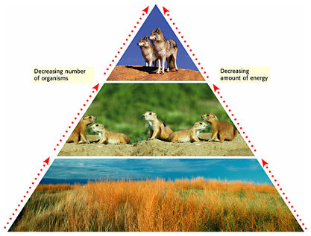
REVIEW
What kind of organisms are at the bottom of the food chain?
Consumers that eat producers (herbivores) make up the next trophic level.
Consumers that eat other consumers (carnivores) make up the next trophic level.
Less energy is available for consumers at each higher trophic level.
Only 10% of energy available at one trophic level transfers to the next

Slide 4
Energy Pyramid Foldable
MATERIALS:
Pyramid form
Energy Pyramid Directions (in your workbook)
Colored Pencils
Scotch Tape
1

Slide 5
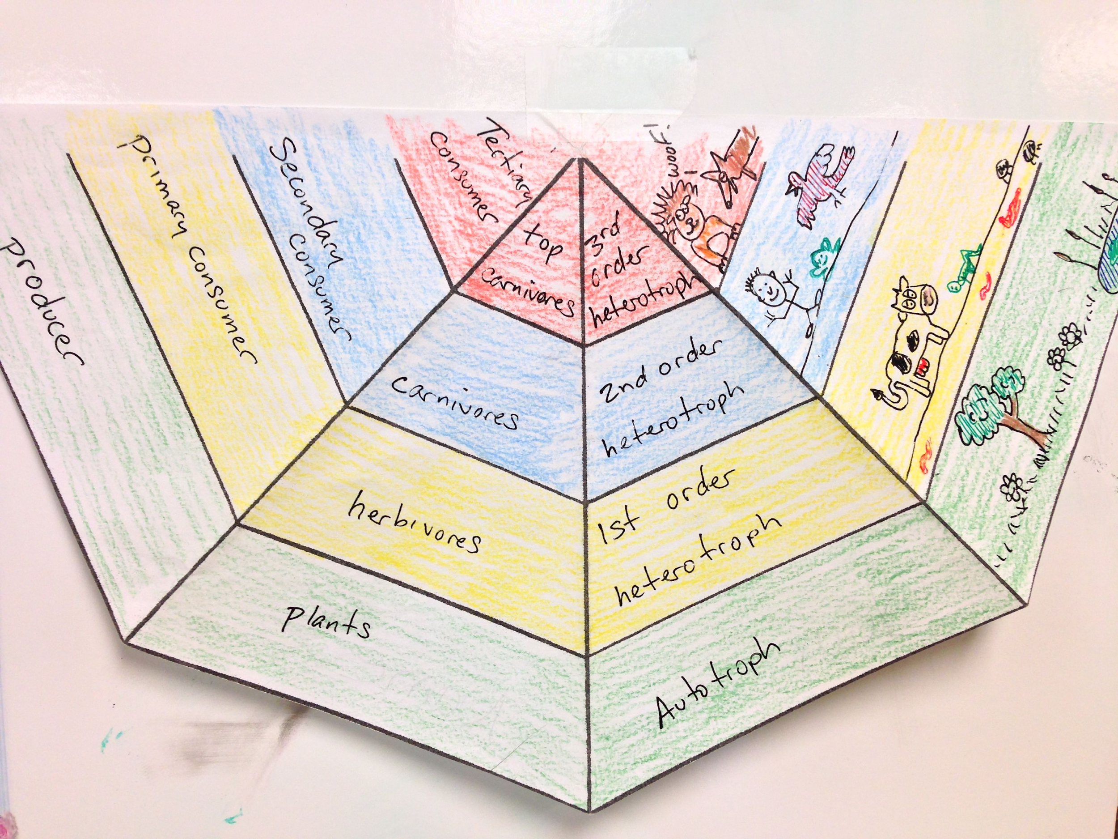
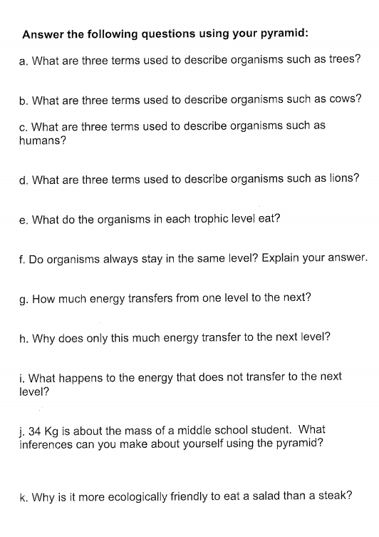
Energy Pyramid Directions
After you build your pyramid, answer the questions in your workbook

Slide 6
Reflection Question
Why only 10% of energy is available at each successive trophic level?
Launch:
Do the Right Thing, Even When No One is Looking!

