Slide 1
Science Starter:
Complete the learning target and success criteria on the cornell notes page.
Friday, September 14, 2018
Agenda: 9/20--Vocabulary Quizzizz
9/21--Unit 2 DCA Matter and Energy
Learning Target: I will learn that energy pyramids show that only 10% of the energy stored by producers becomes part of the biomass in the bodies of the first level consumers.
Success Criteria: I can use energy pyramids to show the amount of energy available in each step of a food chain.

Slide 2
AGENDA
Return Papers
Good Things/Rater
Finish Food Webs
Plickers
Energy Pyramid Video
Energy Pyramid Notes
Energy Flow in an Ecosystem Activity
Soda Pop Demonstration
Complete Ticket Out the Door!
Launch

Slide 3
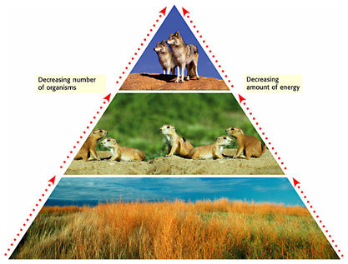
Energy Pyramids
So far, we have learned that:
Food chains and food webs show how energy moves in an ecosystem
However, they do not show how the AMOUNT of energy in an ecosystem changes.
Scientists use a model called an energy pyramid to show how the amount of energy available in each step of a food chain changes..

Slide 4
Energy Pyramids
Producers, such as plants, make up the trophic level at the bottom of pyramid
Consumers that eat producers, such as lemming, make up the next trophic level
Trophic level 3
(1 % of energy available)
Consumers such as predators that eat other consumers make up the highest trophic level
Secondary Consumer
Notice that less energy is available for consumers at each trophic level
Remember, organisms use some energy they get from food for life processes, and also some energy is changed to thermal energy and is transferred to the environment
Trophic level 2
(10 % of energy available)
Primary Consumer
Trophic level 1
(100 % of energy available)
Producers
Only about 10% of energy available at one trophic level transfers to the next trophic level

Slide 5
Let’s Review this New Information
Scientists use a model called an energy pyramid to show how the amount of energy available in each step of a food chain.
90% of energy is lost as heat
Trophic level 3
(1 % of energy available)
At each level of a food chain, about 90% of the energy is lost in the form of heat to the environment
The total energy passed from one level to the next is only about 1/10th of energy received from the previous organism
90% of energy is lost as heat
Secondary Consumer
Trophic level 2
(10 % of energy available)
Primary Consumer
90% of energy is lost as heat
As you move up the pyramid, there is less energy available
Animals at the top of pyramid need more food to meet energy needs
Trophic level 1
(100 % of energy available)
Producers
Each organism is ONLY transferring 1/10th of the energy it received to the next organism

Slide 6
Energy Flow in an Ecosystem
Student Instruction Page
Glue the double diagram of a food chain into lined sheet of paper
You will have 5 minutes to record an estimate of the % of energy that is passed at each step (During this step, try your best, we will go over this; you can use your notes)

Slide 7
Soda Pop Demonstration
Materials:
1 liter bottle of soda → wIll represent the Sun
4 graduated cylinders
1 eye dropper
4 Volunteers → each will represent an organism in our food chain
The Sun has 1L (1000mL) of soda (ENERGY) to give, if the plant only gets 1/10th of that, how much soda does it receive?
1000 x .10 = 100mL
Plant student receives 100 mL of energy
If the mouse only gets 1/10th of what the plant got, how much soda does it receive?
100 x .10 = 10mL
Mouse student receives 10 mL of energy
If the hawk only gets 1/10th of what the mouse got, how much soda does it receive?
10 x .10 = 1mL
Hawk student receives 1 mL of energy
The hawk dies and is decomposed by the mushroom If they mushroom only gets 1/10th of what the hawk got, how much soda does it receive?
1 x .10 = .1 mL
Mushroom student receives .1 mL of energy

Slide 8
Energy Flow in an Ecosystem--Exit Ticket
Launch:
Do the Right Thing, Even When No One is Looking!

