Slide 1
Learning Target: I will learn that radiant energy
is transformed through photosynthesis into
chemical energy.
Success Criteria: I will explain how plants absorb
radiant energy and use it to power chemical
reactions.
Thursday September 6, 2018
Science Starter
Part 1: Pick up Workbook
Part 2: Copy the learning target and success criteria in
your workbook

Slide 2
Agenda
Good Things
Photosynthesis Notes
Activity: Photosynthesis Foldable
Reflection Question
Launch

Slide 3
Plants are made of plant cells that are box-like and are surrounded by a cell wall to support & protect plants (differ from animal cells).
Why do plants carry out photosynthesis?
Plants make their own food, and leaves are the major food-producing organs of plants
Photosynthesis is how plants make their own food
This means that leaves are the sites of Photosynthesis → A series of chemical reactions that convert light energy, H₂0, and CO₂ into the food-energy molecule glucose (simple sugar) & give off O₂
Plants do not breathe with lungs, but do undergo respiration, taking in carbon dioxide (CO₂) & expelling oxygen (O₂)
Notes:
Plants need food, but they cannot eat as people do.
Respiration is opposite of Humans: Taken in O2 and expel CO2

Slide 4
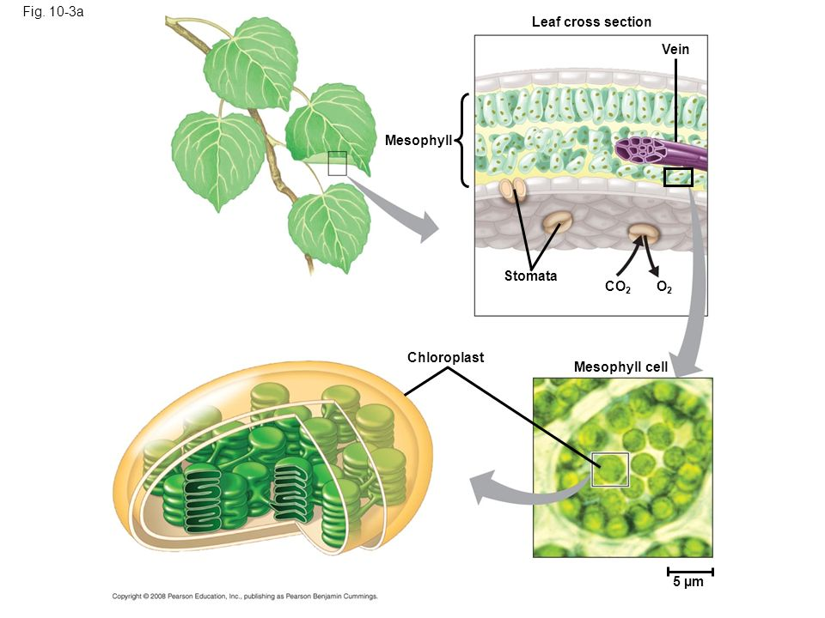
Photosynthesis
A Closer Look
Chloroplasts are only found in plant cells
Photosynthesis occurs inside the chloroplasts of mesophyll cells
I am here because I love to give presentations.
You can find me at:
@username
Photosynthesis can take place in any plant part that has chloroplasts
Notes:
Chloroplasts are special organelles unique to plant cells.

Slide 5
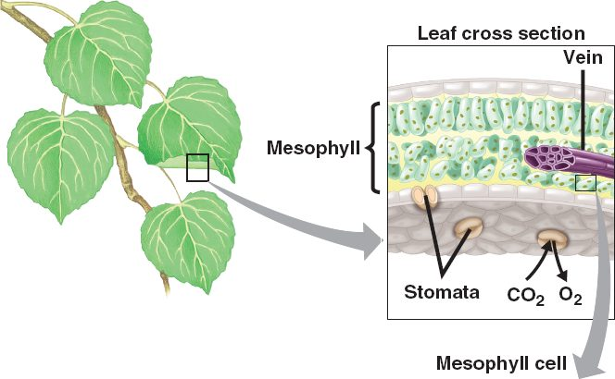
Leaves and Photosynthesis
Mesophyll cells are located near the top surface of leaf
Mesophyll cells capture energy from sunlight & use it to convert CO₂ to glucose and O₂
The stoma allows CO2 to move into leaf & O₂ to move out
Notes:
How does the structure of a leaf allow the leaf to gather light?
What are these cells, and what do they do?
What is this opening (Stoma) and how does it help the leaf carry out photosynthesis?

Slide 6
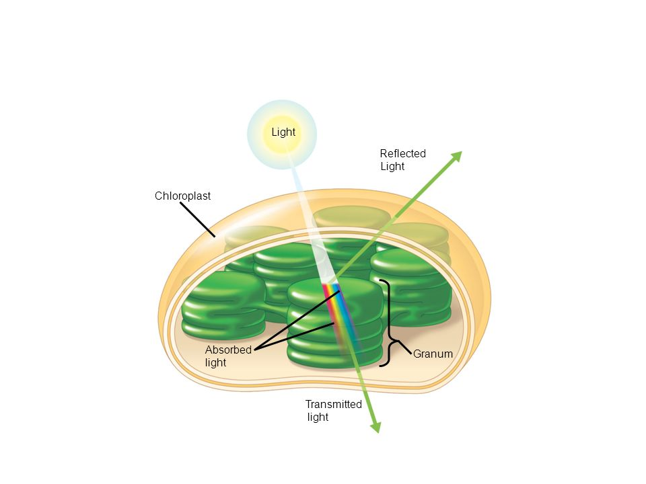
Capturing Light Energy & Making Sugars
A form of radiant energy
Chloroplasts contain the green pigment chlorophyll that can absorb and reflect light
Chlorophyll molecules trap energy from the sun & use it to transform CO₂ and H₂0 into glucose
Oxygen is released into the atmosphere
Most plants appear to be green because chlorophyll reflects green light
Notes:
How do plants capture light energy?

Slide 7
Let’s Summarize
CO₂ + H₂O
Radiant Energy (from sunlight)
Glucose (sugar) + O₂
+
Plants need 3 Major items for photosynthesis to work:
Carbon dioxide
Water
Radiant energy from sunlight
These 3 items combine together to produce glucose (a sugar used as a food source for the plant) and oxygen.
This process occurs in chloroplasts of each plant cell

Slide 8
Activity: Photosynthesis Foldable
Cut and paste the cell & chloroplast in a lined sheet of paper as flip flaps (use tape)
Write information from your notes under each flip flap
Cut out the plant & sun gluing down into your paper
Label all the parts of photosynthesis (needs & byproducts) with arrows around the diagram
After you’re finished, respond to the writing prompt (paste this prompt on the same piece of paper)

Slide 9
Reflection Question
Why is Photosynthesis Important?
LAUNCH:
Do the right thing even when no one is LOOKING.

