Slide 1
Materials: workbook, agenda, pencil, red pen
September 4, 2018
Copy on pg. 2 of your workbook
Learning Target:
I will identify the TEKS I mastered on the DCA and Unit 1 Test.
Success Criteria:
I can evaluate my scores on the Unit 1 DCA.
AGENDA: 9/5—Back to School Night 6pm
9/6– ALL corrections DUE
Science Starter:
Turn to pg. 24 in your workbook for DCA Analysis

Slide 2
Agenda
1. Job Assignments.
2. Good Things
3. Corrections (Vocabulary, DCA, ADI Slides)
3. Return tests (YOU MAY NOT KEEP THE TEST)
4. Data Analysis
5. Corrections/Graphing
6. Launch

Slide 3
2nd Period— Attendance Assistant– Liz T. Printer/Computer Assistant—Mason J. Rater Assistant- Substitute Assistant- Time Keeper Assistant-Logan H.
3rd Period— Attendance Assistant– Printer/Computer Assistant— Rater Assistant- Substitute Assistant- Time Keeper Assistant-

Slide 4
4th Period— Attendance Assistant– Printer/Computer Assistant— Rater Assistant- Substitute Assistant- Time Keeper Assistant-
6th Period— Attendance Assistant– Printer/Computer Assistant— Rater Assistant- Substitute Assistant- Time Keeper Assistant-

Slide 5
7th Period— Attendance Assistant– Printer/Computer Assistant— Rater Assistant- Substitute Assistant- Time Keeper Assistant-

Slide 6
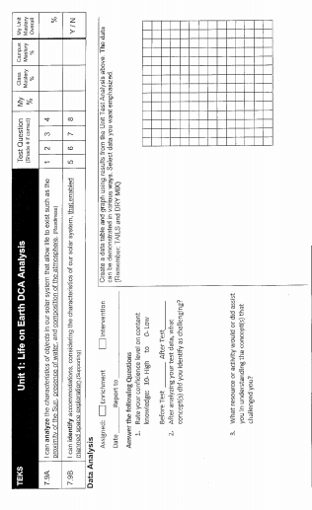

Slide 7
DCA SCHOOL DATA
DCA CLASS DATA
2nd Period—87%
3rd Period—81.21%
4th Period—83%
6th Period—84.96%
7th Period—82.78%

Slide 8
Unit 1 Campus Common Assessment
2nd Period—76.6%, 3rd Period—67.47%, 4th Period—72.82%, 6th Period—83.28%, 7th Period—76.86%

Slide 10
Review the DCA and Test 1. You must use a pen for the review. 2. Shade on pg. 24 if you answered a question correct on the DCA. 3. Intervention Groups/Enrichment Groups 4. Graphing lesson

Slide 12
Launch: Do the Right Thing Even When No One is Looking.
Exit Ticket:
Return your Test

