Slide 1
Science Starters
Part 1: Pick up Workbook
Part 2– Turn in: Lab Fee, Safety Contract, Syllabus, Information Sheet
Part 3—Write name (first and last), week (Aug.20-Aug. 24), period on your workbook, We will learn our student # for science tomorrow!!!
Part 4—Copy the learning target and success criteria in your workbook.
2nd, 3rd, 7th Periods
August 20, 2018
Agenda: Forms due 8/24, DCA Life on Earth 8/31
Learning Target: I will learn that objects in our solar system allow life to exist on Earth.
Success Criteria: I can identify the needs of living things.

Slide 2
Science Starters
Part 1: Pick up Workbook/ Sign Social Contract
Part 2– Turn in: Lab Fee, Safety Contract, Syllabus, Information Sheet
Part 3—Write name (first and last), week (Aug.20-Aug. 24), period on your workbook, We will learn our student # for science tomorrow!!!
Part 4—Copy the learning target and success criteria in your workbook pg 1.
4th, 6th Periods
August 20, 2018
Agenda: Forms due 8/24, DCA Life on Earth 8/31
Learning Target: I will learn that objects in our solar system allow life to exist on Earth.
Success Criteria: I can identify the needs of living things.

Slide 3

Agenda:
Good Things
Jobs—Rater
Put your workbook in your binder and take the staple out. (Keep workbook in science section of binder.)
Pg. 23—Change Test date to Friday Aug. 31
What is Life? Pg. 9
Amoeba Sisters “What is Life?”
Cornell Notes during Amoeba Sisters
Reflection Questions
? Is it always easy to identify something as being alive? Why?
? If you see mold on food, do you think of it as being alive? Why?

Slide 4
What is Life? Activity pg. 9
With your table partner examine the objects at your table. List characteristics associated with life.
Now with a group of four examine your objects and list characteristics associated with life.
Record your list on your paper and on a sticky note.
Bring sticky note to the board.
Complete the activity on pg. 9.
Class discussion.

Slide 5
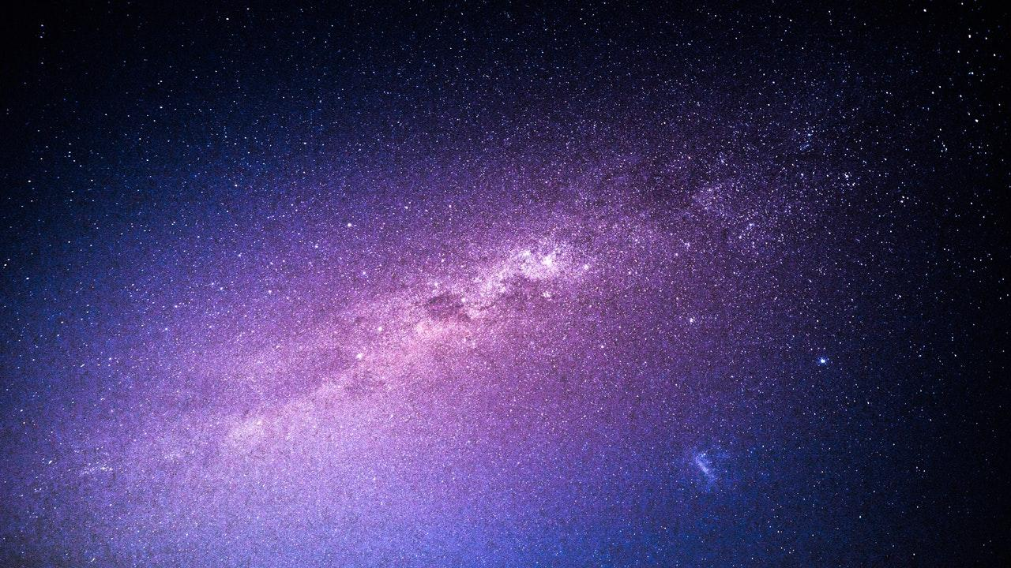
Amoeba Sisters & Cornell Notes
a. Pgs. 3-4 of workbook
Complete learning target and success criteria (you may abbreviate)
Essential ?—Analyze the characteristics of objects in our solar system that allow life to exist on Earth.
Notes
Complete Summary

Slide 6

Reflection Questions
Is it always easy to identify something as being alive? Why?
If you see mold on food, do you think of it as being alive? Why?

Slide 7

LAUNCH:
DO THE RIGHT THING
EVEN
WHEN NO ONE IS LOOKING!

Slide 8
Advisory
Second Step
Circles—Class meeting
Tutoring/Ice Breaker
Binder Check/Tutoring
DEAR (Hatchet)

