Slide 1
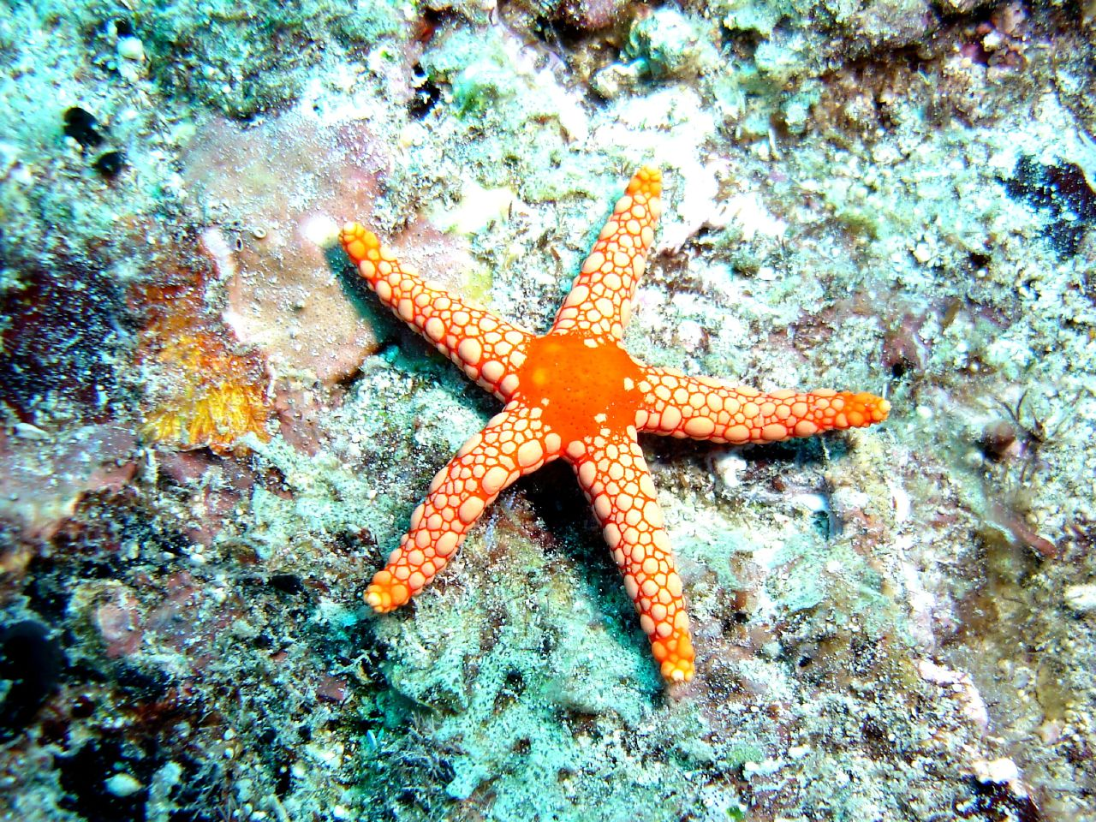
Science Starter:
Continue working on the vocabulary foldable. (Due Wednesday)
Tuesday November 27, 2018
Learning Target:
I will learn what asexual reproduction means, how many parents are involved, and the type of offspring produced.
Success Criteria:
I know how to define asexual reproduction.
Agenda:
11/28--Vocabulary Foldable Due
11/30--Corrections due
11/30-- Asexual vs. Sexual Reproduction Mini Quiz

Slide 2
Vocabulary Foldable
Unit 4 Genetics Vocabulary
You may use Google Classroom--Quizlet
You may use my website--Quizlet
Early Finishers--You may play the Quizlet Vocabulary Game.

Slide 3
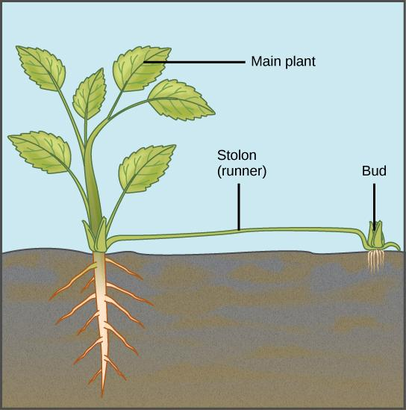
VOCABULARY FOLDABLE
(DUE WEDNESDAY)
1. Good Things
2. Social Contract Rater
3. Asexual Reproduction Notes
4. Sexual Reproduction Notes
4. Asexual & Sexual Reproduction Video
5. Launch

Slide 4
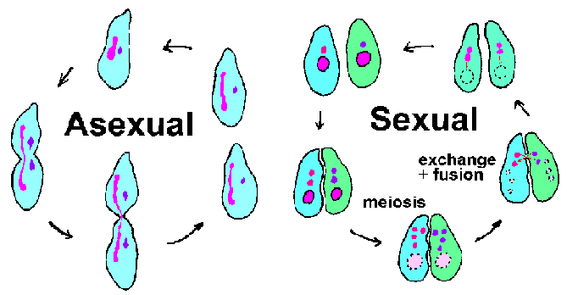
Asexual vs. Sexual Reproduction

Slide 5
What’s the Difference!
Asexual Reproduction
involves only 1 parent
offspring genetically identical to parent
involves regular body cells
its quick
Sexual Reproduction
involves 2 parents
offspring genetic mix of both parents
involves specialized sex cells
its slow

Slide 6
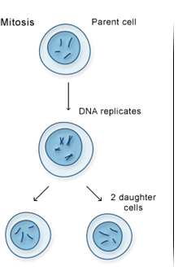
Asexual Reproduction
Requires only one parent
Offspring have 100% of the same chromosomes as the parent.
In other words, the offspring are exact “clones” of the parent.
Most unicellular organisms
reproduce this way.
Mitosis (process of dividing)
Movie

Slide 7
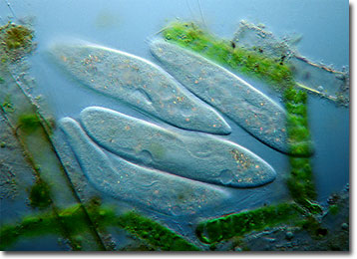
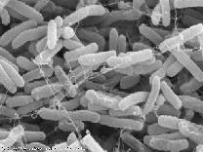
Asexual Reproduction
Binary Fission
Bacteria, Amoeba
Paramecium, and
Starfish
Binary fission is a form of asexual reproduction where every organelle is copied and the organism divides in two.

Slide 8
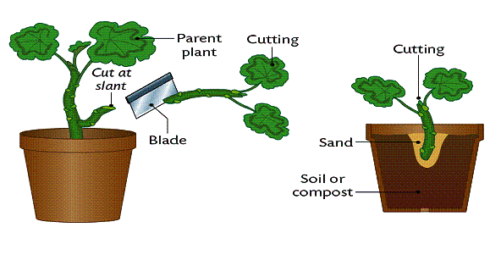
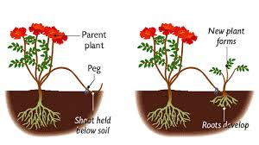
Asexual Reproduction
Vegetative Propagation
“plant cuttings”
ex. Linden(tree), spider plants, cactus and daffodils
Vegetative reproduction is a type of asexual reproduction in plants that relies on multi-cellular structures formed by the parent plant. It has long been exploited in horticulture and agriculture, with various methods employed to multiply stocks of plants.

Slide 9
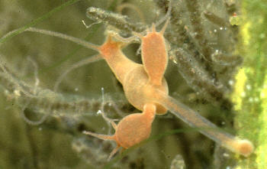
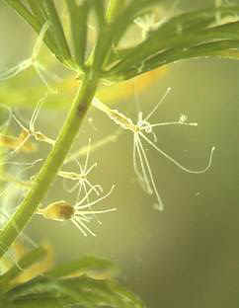
Asexual Reproduction
Budding
ex. Hydra, daffodil, mushroom, and sea sponge
Movie
Budding is a means of asexual reproduction whereby a new individual develops from an outgrowth of a parent, splits off, and lives independently.

Slide 10
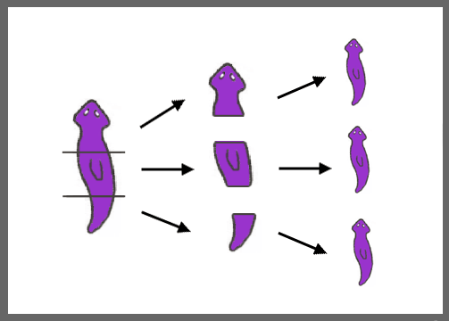
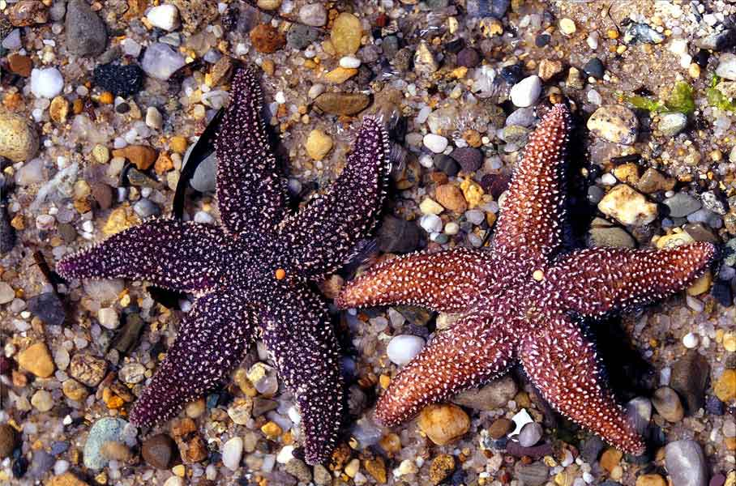
Asexual Reproduction
Fragmentation
ex. Starfish, and Planaria
movie
Fragmentation is a means of asexual reproduction whereby a single parent breaks into parts that regenerate into whole new individuals.

Slide 11
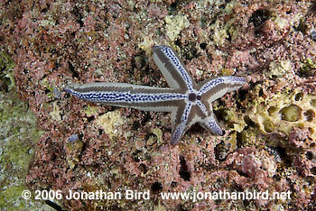
Asexual Reproduction
Regeneration
ex. Starfish
Regeneration occurs when a body part has broken off and the organism grows a new one.

Slide 12
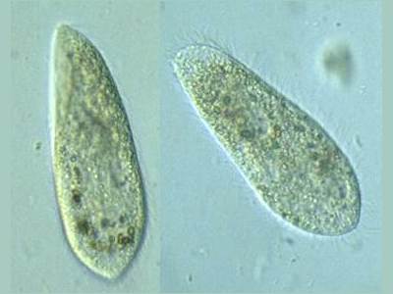
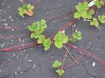
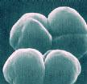
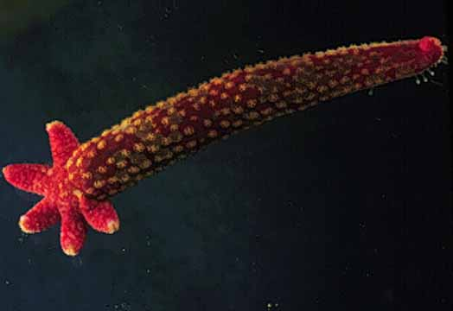
Asexual Reproduction
Examples of organisms that reproduce asexually
Hydra
Cactus
Starfish
Sponge
Bacteria
Paramecium
Amoeba
Yeast
Daffodil
Linden
Mushroom

Slide 13
Launch
Do the Right Thing
Even When
No One is Looking!

Slide 14
Science Starter:
Turn in Vocabulary Foldable
Handout--Types of Asexual Reproduction
Cut out terms and pictures
Keep definitions in order and glue to red paper
Use notes to match terms, definitions and pictures
Wednesday November 28, 2018
Learning Target:
I will learn what sexual reproduction means, # of parents involved, and the type of offspring produced.
Success Criteria:
I know how to define sexual reproduction.
Agenda:
11/30--Corrections due
11/30-- Asexual vs. Sexual Reproduction Mini Quiz

Slide 15
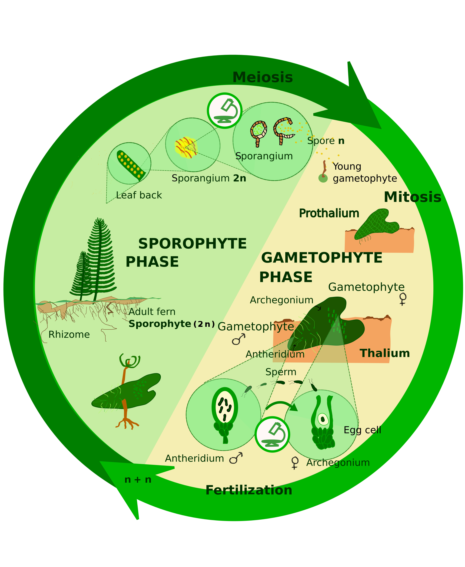
1. Good Things
2. Social Contract Rater
3. Sexual Reproduction Notes
4. Asexual & Sexual Reproduction Video
5. Launch

Slide 16
Day 2
Sexual Reproduction

Slide 17
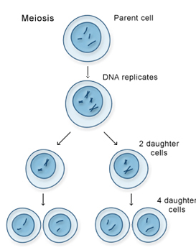
Sexual Reproduction
Requires two parents that each share ½ of the genetic information.
Offspring share the characteristics of each parent.
Meiosis (division process)

Slide 18
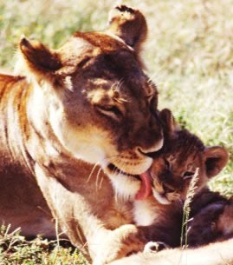
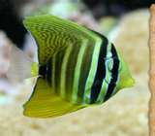
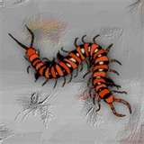
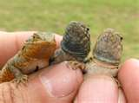
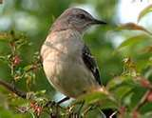
Sexual Reproduction
All the members of the Animal Kingdom
Fish
Mammals
Amphibians
Birds
Reptiles
Insects
Crustaceans

Slide 19
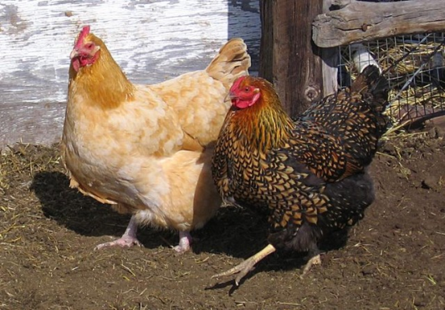
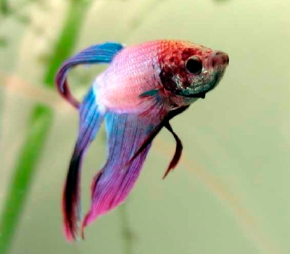
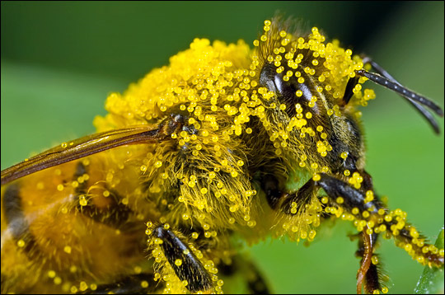
Sexual Reproduction
Animal Kingdom: Happens 2 ways
Internally (inside)
The egg is fertilized by sperm inside the female
ex. Mammals, birds, reptiles, insects, spiders
Externally (outside)
The egg is fertilized by sperm outside the female
The female lays the eggs and then the male fertilizes them.
Fish and some amphibians (Toads and
frogs)
Plants and fungi (pollen and spores)
Type of Union: Fertilization

Slide 20
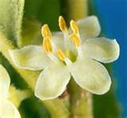
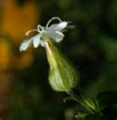
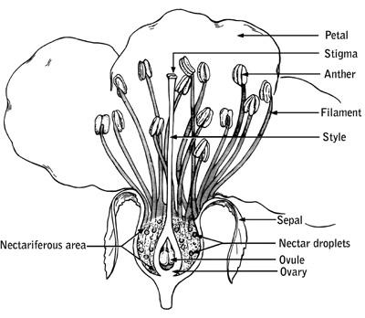
Sexual Reproduction
Plant Kingdom
Flowers are the reproductive organs of plants
Some flowers have both male and
female reproductive organs on
the same flower.
Type of Union:
Pollination
Male flower with stamen and pollen
Female flower
with pistil and ovary

Slide 21
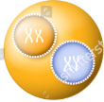
Sexual Reproduction Summary
 | Male Gamete | Female Gamete | Type of Union | Result of Union | Final Result
Plants | pollen | ovule (egg) | pollination | single cell zygote | multi-cell embryo (in seed)
Animals | sperm | egg | fertilization | single cell zygote w/ 50% of genetic material from each parent | multi-cell embryo

Slide 22
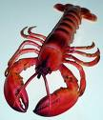
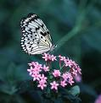
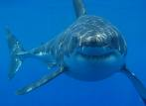
Sexual Reproduction
Examples of organisms that reproduce sexually
Chickens
Iguanas
Lobsters
Sharks
Humans
Butterflies
Sunflowers
Jellyfish
Lizards
chipmunks
Beetles
Mallard ducks
Seal

Slide 23
Which is Better? It depends!
Asexual Reproduction
advantages
does not require special cells or a lot of energy
can produce offspring quickly
in a stable environment creates large, thriving population
disadvantages
limited ability to adapt
face massive die-off if environment changes
Sexual Reproduction
advantages
lots of variation within a species
able to live in a variety of environmental settings
able to adapt to changes in the environment
disadvantages
needs time & energy
produce small populations

Slide 24
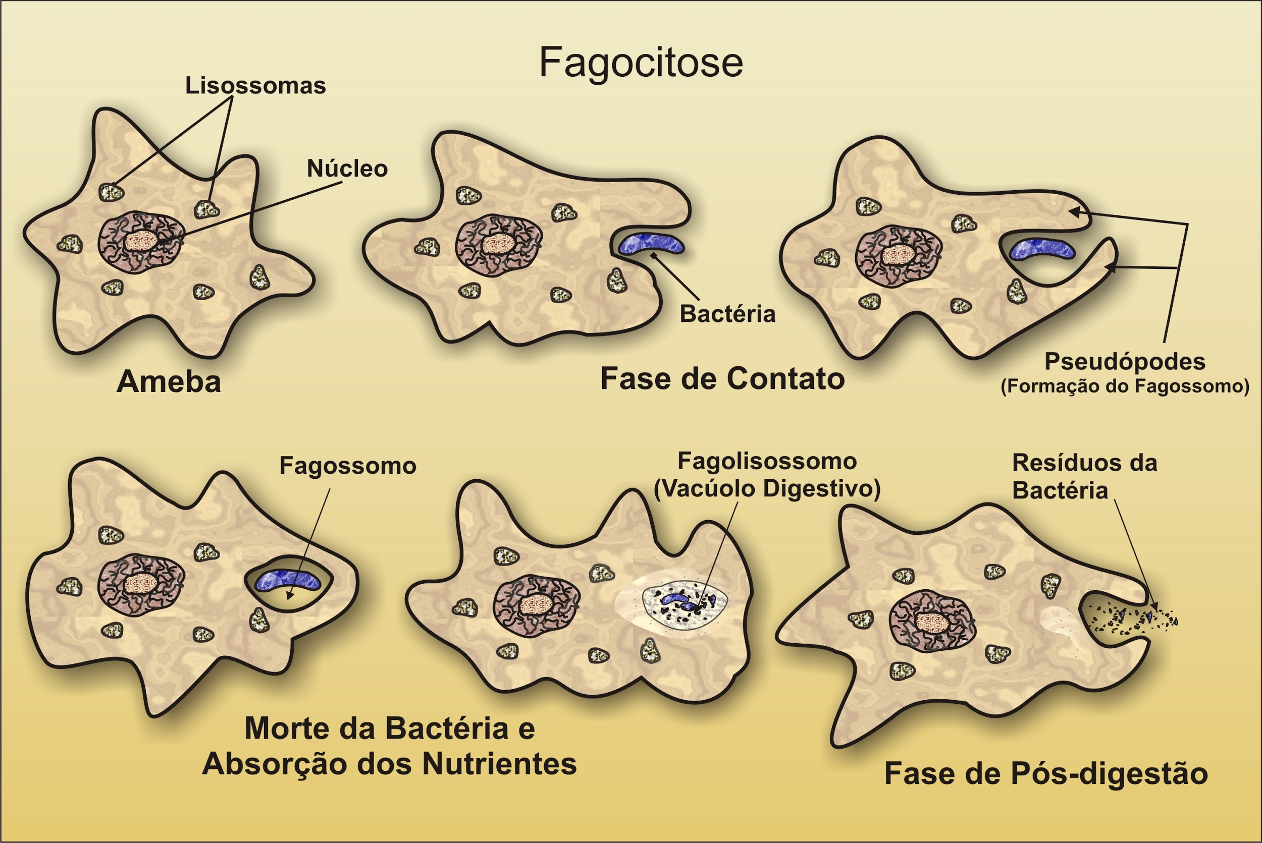
Amoeba Sisters Video and Notes Page

Slide 25
Launch
Do the Right Thing
Even When
No One is Looking!

Slide 26
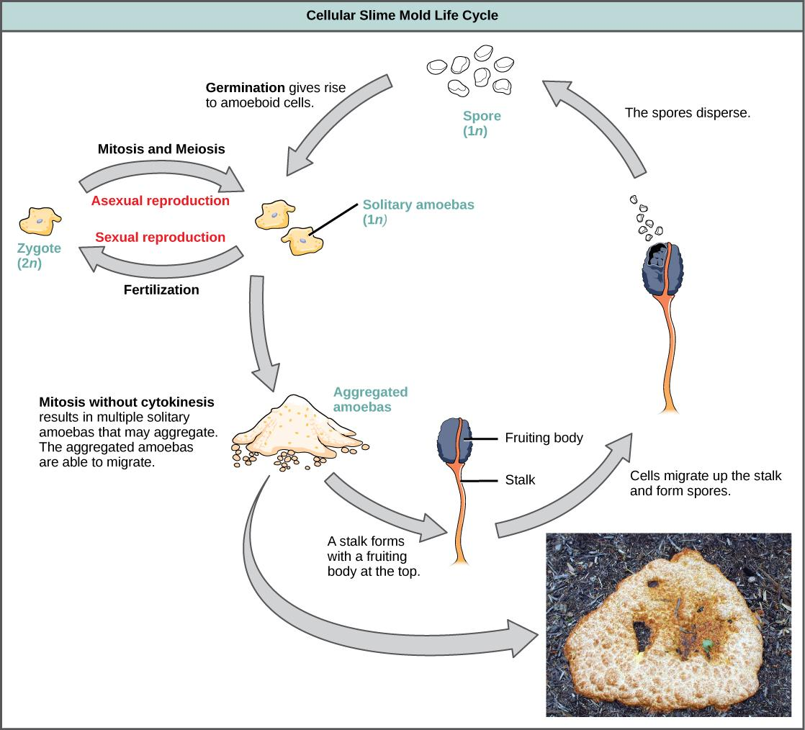
Science Starter:
Finish Amoeba Sisters Video Notes Page (turn in for a grade)
Thursday November 29, 2018
Learning Target:
I will compare asexual reproduction and sexual reproduction.
Success Criteria:
I know how to determine if an organism reproduces asexually or sexually.
Agenda:
11/29--Amoeba Sisters Video Notes Due
11/30--Corrections due
11/30-- Asexual vs. Sexual Reproduction Mini Quiz

Slide 27
1. Good Things
2. Social Contract Rater
3. Question of the day:
What is your favorite animal?
4. Venn Diagram Comparing Asexual and Sexual Reproduction
5. Asexual & Sexual Reproduction Video
5. Launch

Slide 28
Venn Diagram Handout--
You may work with a partner
Asexual Reproduction
Sexual Reproduction
Both
Types of reproduction in living organisms
Pass DNA from parent to offspring
Organisms to include: Amoeba, Bacteria, Bee, Beetle, Cactus, Chipmunk, Lizard, Daffodil, Hydra,Jellyfish, Lindens, Mallards, Mushroom, Paramecium, Petunia, Seal, Sponge, Starfish, Toad, Turkey.

Slide 29
Summarize
Write three paragraphs with at least 3 sentences each describing the advantages of asexual and sexual reproduction, as well as explaining the important differences between them.
Paragraph 1: Advantages to asexual reproduction are...
Paragraph 2: Advantages sexual reproduction are…
Paragraph 3: The important differences between…
***Use a clean line sheet of paper. Place your name on your sheet before turning it into the white tray.

Slide 30
Launch
Do the Right Thing
Even When
No One is Looking!

Slide 31
Science Starter:
Study for Asexual vs. Sexual Reproduction Quiz
Friday November 30, 2018
Learning Target:
I will contrast asexual reproduction and sexual reproduction.
Success Criteria:
I know how to determine if an organism reproduces asexually or sexually.

Slide 32
1. Good Things
2. Social Contract Rater
3. Turn in the following:
Asexual Reproduction Notes
Sexual Reproduction Notes
Venn Diagram Comparing Asexual and Sexual Reproduction
4. Quiz over Asexual and Sexual Reproduction
Mark each statement as either Asexual or Sexual Reproduction
Turn in the Quiz and pick up the Fun Bugs Activity.
5. Fun Bug Activity--Follow the instructions on the page
6. Launch

Slide 33
Launch
Do the Right Thing
Even When
No One is Looking!

