Slide 1
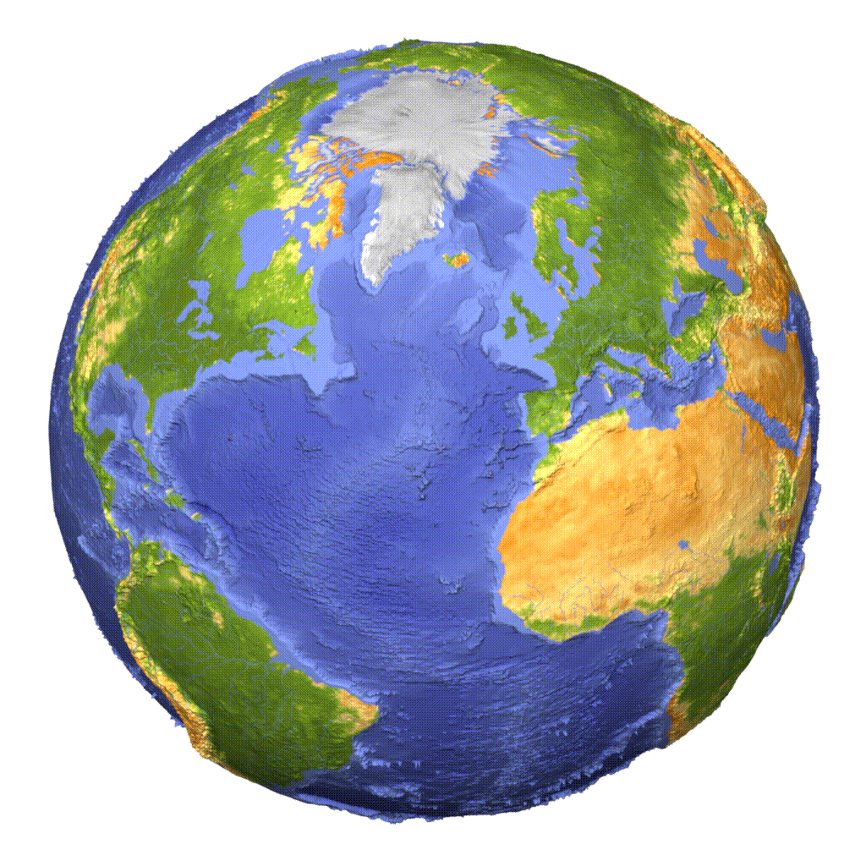
Habitable world

Slide 2
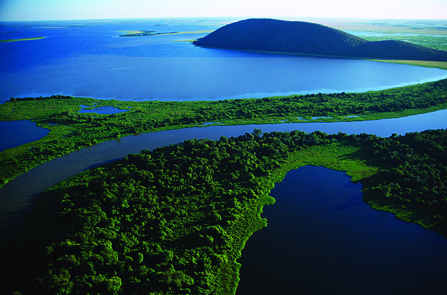
Requirements for life
Every living thing has the same basic needs to survive on Earth:
Water
Moderate temperature
oxygen
Nutrients
Atmosphere
Energy

Slide 3
Water
Every living thing must have water
We can live up to 30 days without food
We can live for only 3 days without water
Earth is the only planet with surface water
Mars once had surface water and still has ice in its polar ice caps.
Mars & some moons have deposits of underground ice, which might melt to produce water
Europa (Jupiter’s moon), has a vast oceans beneath its outer shell of ice.

Slide 4
Moderate temperature
Earth’s proximity to the sun determines its temperature
Life is limited to a temperature range of 15-115 degrees celcius
Proteins, and genetic material begin to break down at temperatures above this limit
Chemicals in living cells react too slowly in temperatures below this limit

Slide 5
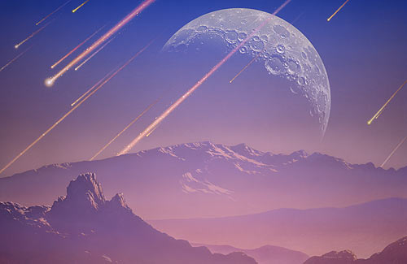
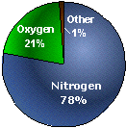
Atmosphere
Earth’s atmosphere is 78% nitrogen and 21% oxygen
The atmosphere is held in place by gravity
It insulates the planet
It protects from meteorite impacts
It protects from harmful radiation
Provides chemicals needed for life such as nitrogen and carbon dioxide

Slide 6
Atmosphere cont.
Small planets and moons don’t have enough gravity to hold an atmosphere, so there is no protective shield
Of the solid planets & moons, only Earth, Venus, & Titan (Saturn’s moon) have significant atmospheres. Mars’ atmosphere is about 1/100th that of Earth’s, too small for significant insulation or shielding.

Slide 7
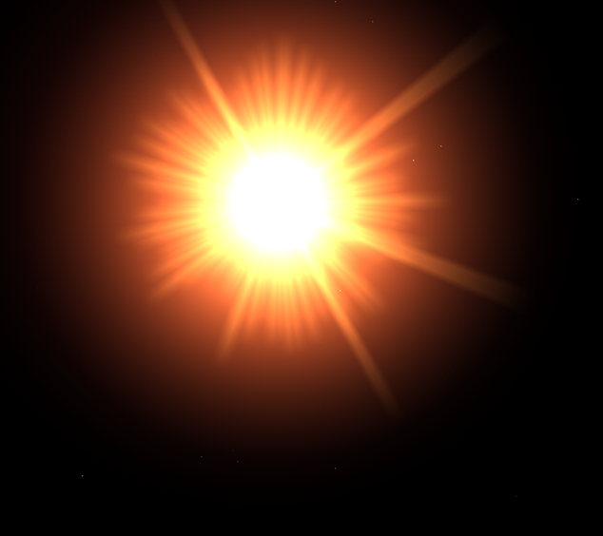
Energy
Light energy from the sun or chemical energy is needed for life processes
The sun provides the energy needed for plant growth
When there is too little sunlight or too few chemicals that provide energy to cells, organisms die
The inner planets get too much sunlight for life
The outer planets get too little

Slide 8
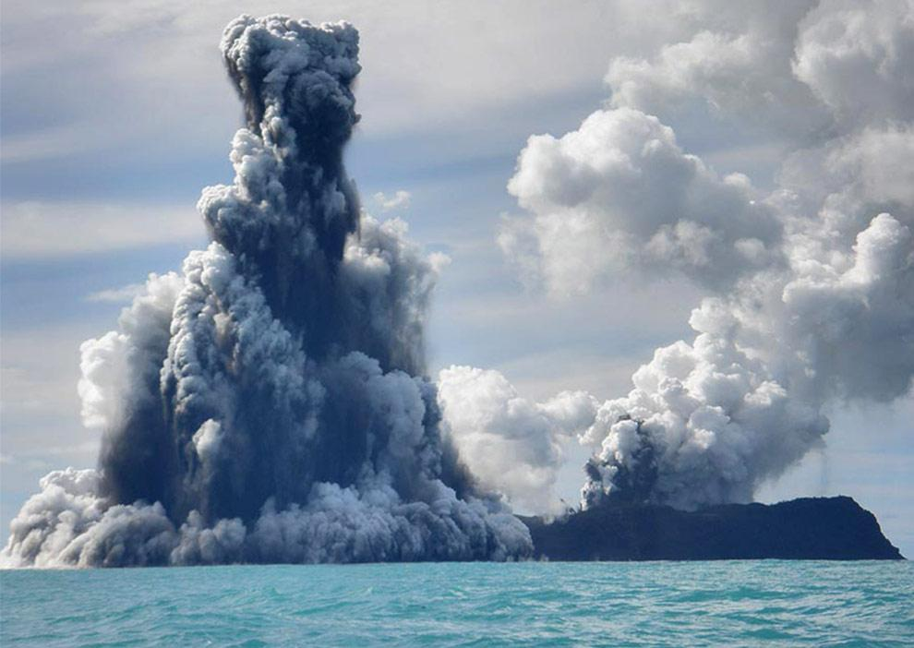
Nutrients
Nutrients are the chemicals needed to make proteins and carbohydrates for growth
These nutrients are cycled in the earth
Planets without systems to deliver nutrients to its organisms (e.g., a water cycle or volcanic activity) cannot support life.
When nutrients are spread so thin that they are hard to obtain, such as on a gas planet, life cannot exist.

Slide 9
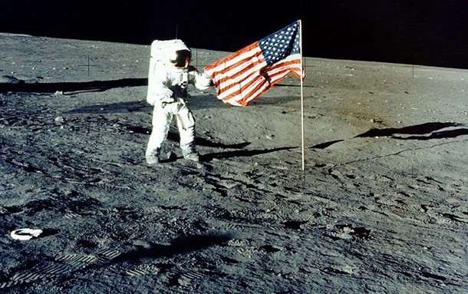
Accommodations for manned space explorations
The first human being to travel into space was Yuri Gagarin (USSR, 1961), followed a month later by the US astronaut Alan Shepard.

Slide 10
Challenges to living in space
No oxygen
No air pressure
No water
Very low gravity (microgravity)
Can sound travel? NOPE! ☺

Slide 11
Space Suit
Space Suits:
Provide oxygen
Help maintain air pressure
Protection from radiation
Protection from extreme temperature
Protection from impacts space dust

Slide 12
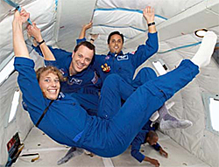
Microgravity
Because of microgravity:
Muscles can atrophy when not used for long periods of time
Bone lose calcium
Remedy: daily exercise

Slide 13
Other issues
Psychological Issues:
Stress and Anxiety
Depression
Insomnia

Slide 14
Review
What are the ingredients needed for life?
Which planet once had surface water and now has deposits of underground ice
What determines Earth’s temperature
In what ways does our atmosphere make Earth habitable?
What are some challenges to living in space
What are accommodations for dealing with those challenges?

