Slide 1
Science Starter: 1. Pick up Ecoregions assignment! 2. Check the no name no fame box if you did not receive your paper.
Monday October 29, 2018
Agenda:
10/30—Weathering, Erosion, Deposition, and Catastrophic Events Quiz
11/12—Vocabulary Quizizz
11/13—Unit 3 Part 2 DCA
Learning Target:
I will learn the types of catastrophic events and the effect on the ecosystems.
Success Criteria:
I know how to describe the effects of catastrophic events and the effect on the ecosystems.

Slide 2
1. Good Things 2. Rater—Check in 3. Catastrophic events videos pg. 20 4. Catastrophic events graphic organizer (extra handout/construction paper) DO THE RIGHT THING EVEN WHEN NO ONE IS LOOKING!

Slide 3
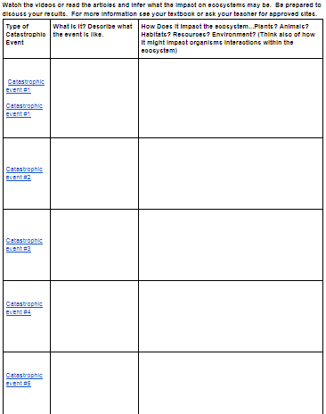

Slide 4
Catastrophic Event #1 (Flood)
Catastrophic Event #1 (Flood)
Catastrophic Event #2 (Hurricane)
Catastrophic Event #3 (Drought)
Catastrophic Event #4 (Tornado)
Catastrophic Event #5 (Wildfires)

Slide 5
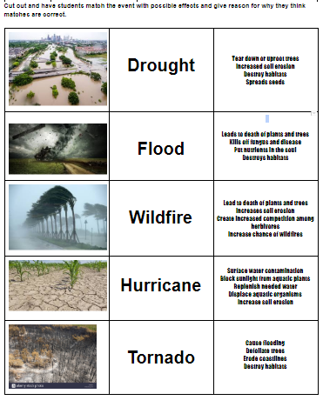

Slide 6
Catastrophic Events Prezi

Slide 7
DO THE RIGHT THING EVEN WHEN NO ONE IS LOOKING!!!

Slide 8
Science Starter: 1. Study for quiz on Weathering, Erosion, Deposition, and Catastrophic Events
Monday October 29, 2018
Agenda:
10/30—Weathering, Erosion, Deposition, and Catastrophic Events Quiz
11/12—Vocabulary Quizizz
11/13—Unit 3 Part 2 DCA
Learning Target:
I will learn the concepts of weathering, erosion, deposition, and catastrophic events.
Success Criteria:
I will be able to show my mastery of weathering, erosion, deposition, and catastrophic events.

Slide 9
1. Good Things 2. Rater—Check in 3. Weathering, Erosion, Deposition, and Catastrophic Events Quiz 4. Texas Gateways—Ecological Succession pg. 21 in the workbook DO THE RIGHT THING EVEN WHEN NO ONE IS LOOKING!

Slide 10
Texas Gateways—Ecological Succession
Engage—Complete Activity
EXPLORE—DOES NOT WORK
Explain—Complete Activity
Elaborate—Complete Activity
Evaluate—Complete Activity

Slide 11
DO THE RIGHT THING EVEN WHEN NO ONE IS LOOKING!!!

