Slide 1
Science Starter: 1. be ready to answer Question of the day—What are you going to be for Halloween? (School appropriate answers) 2. Complete your learning target and success criteria
Wednesday October 31, 2018
Learning Target:
I will learn how to describe the types of succession.
Success Criteria
I know how to distinguish the difference between primary succession and secondary succession.

Slide 2
1. Good Things
2. Rater Check In
3. TEKS Analysis pg. 4--7.10C
4. Vocabulary Pages
pg. 6—lichen, primary succession
pg. 7—secondary succession
5. Video—Introduction to Succession
6. Texas Gateways—Ecological Succession pg. 21 (Explain—Watch the video and read the section to complete the notes on pg. 21)
7. DO THE RIGHT THING EVEN WHEN NO ONE IS LOOKING

Slide 3
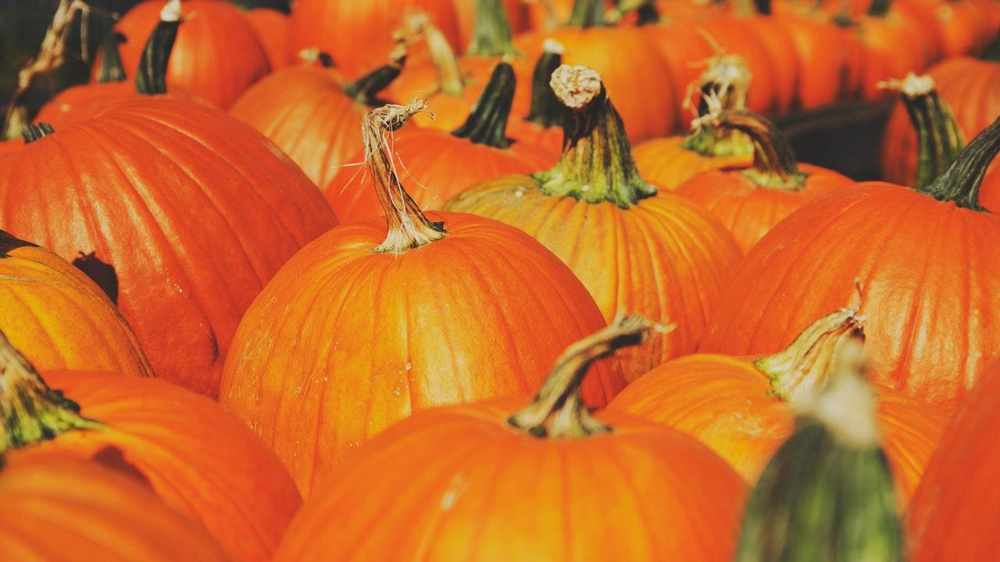
Pg. 6—Lichen
Primary Succession
Pg. 7—Secondary Succession

Slide 4
Ecological Succession
Video—Ecological Succession
Texas Gateways—Ecological Succession
Engage—Wildfire (Read the article & look at the Bastrop Fire pictures…you do not need to write anything)
Explore—Ecological Succession (Read the article however the link to the activity does not work)
Explain—Primary and Secondary Succession (Watch the video and read the article. Complete the notes on pg. 21. Complete the online vocabulary quiz.)
Elaborate—Garden Succession (Read the article and complete the online sequencing activity.)
Evaluate—Ecological Succession (Complete the online Venn Diagram)

Slide 5
Do the Right Thing
Even When No One is Looking!

