Slide 1
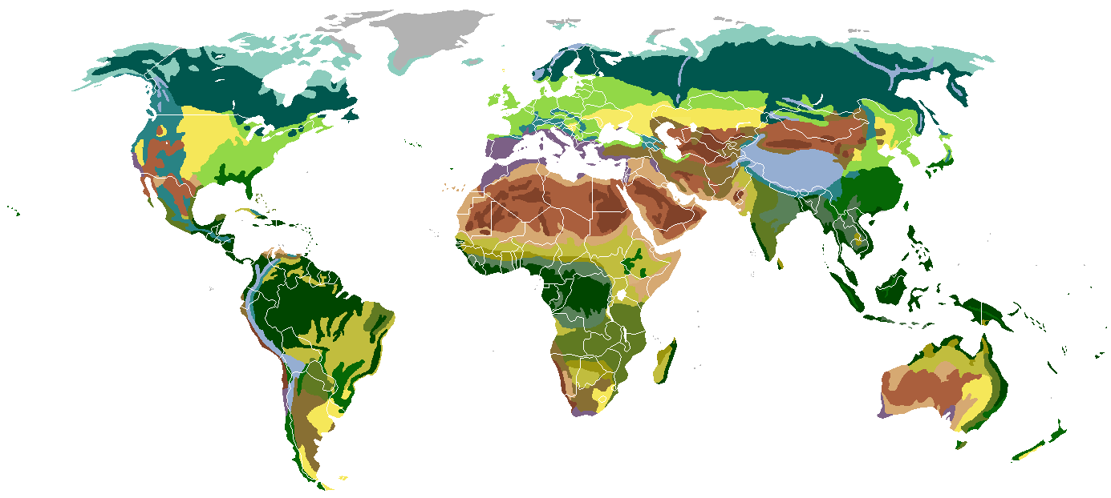
Science Starter:
Part 1: Warm-Up Question
Part 2: Have your workbook out and complete the learning target and success criteria for today!
Learning Target: I will understand microhabitats, biomes, biodiversity and sustainability within this unit and prepare for my DCA.
Success Criteria: I can describe how organisms are supported in microhabitats and biomes through biodiversity and sustainability.
Wednesday, October 10, 2018
 | Attendance | Computer Printer | Rater | Substitute | Time- Keeper
2nd | Aidan | Logan | Kiki | Vianna | Joel
3rd | Braedon | Gavin | Keaghen | Cheyenne | Trevion
4th | Janelle | Israa | Noah | Aniyah | Eduardo
6th | Kimberly | Shanelle | Brock | Baraka | Andrew
7th | Milania | Jessica H. | Tyler | Luis | Alex

Slide 2
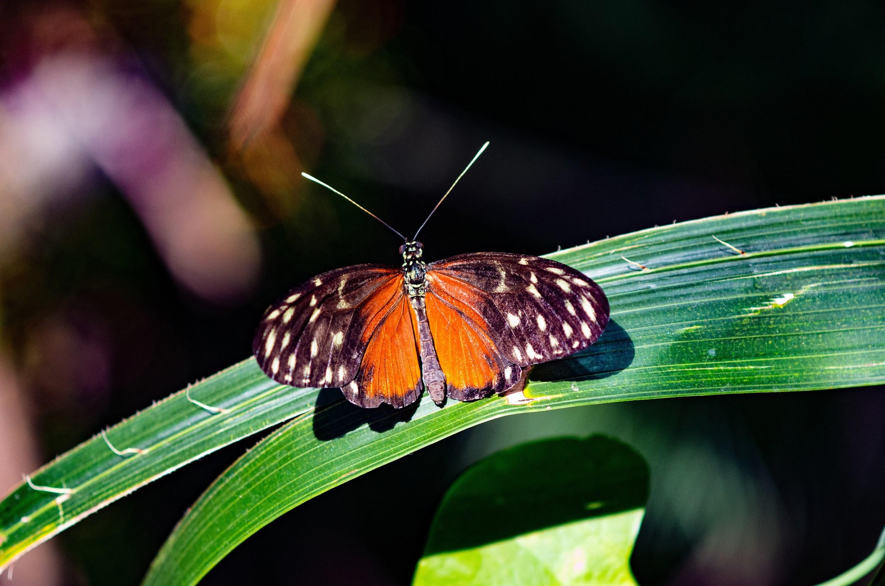
AGENDA
Reminders:
Unit 3, Part 1 DCA Tomorrow!
Good Things/Rater
Vocabulary Quizizz
(As many times as you like)
4. Return Papers
5. Unit 3 DCA Review Activity
6. Launch

Slide 3
LAUNCH
Do The Right Thing Even When No One Is Looking!

Slide 4
Science Starter:
Part 1: Have your review out and study for the DCA.
Learning Target: I will demonstrate my mastery of the TEKS over microhabitats, biomes, biodiversity and the relationship with sustainability.
Success Criteria: I know how to answer questions relating to microhabitats, biomes, biodiversity and the relationship with sustainability.
Thursday, October 11, 2018

Slide 5
Good Things/Rater
Questions before the DCA
DCA is on the computer
(link is on my website)
4. After the test, you may read quietly. If you need something to read then I can find something for you!
5. Launch

Slide 6
LAUNCH
Do The Right Thing Even When No One Is Looking!

Slide 7
Science Starter:
Turn to page 24 in your workbook
Learning Target: I will learn how to graph my Unit 3 Part 1 DCA data using TAILS and DRY MIX.
Success Criteria: I know how to create a bar graph using my DCA data and my bar graph uses TAILS and DRY MIX>
Friday, October 12, 2018

Slide 8
AGENDA
Good Things/Rater
Return Tests
Go over Test and compare test data
2 minute Connection
Question
5. Complete graph and turn in
6. Launch

Slide 9
Science Starter:
Turn to page 24 in your workbook
Learning Target: I will learn how to graph my Unit 3 Part 1 DCA data using TAILS and DRY MIX.
Success Criteria: I know how to create a bar graph using my DCA data and my bar graph uses TAILS and DRY MIX>
Friday, October 12, 2018

