Slide 1
Science Starter:
Have your workbook out and complete the learning target and success criteria for today.
AGENDA:
9/12--Return Graded Papers
9/13--Photosynthesis Quiz
9/20--Vocabulary Quizzizz
Wednesday,September 12, 2018
Learning Target: I will learn how energy moves in ecosystems.
Success Criteria: I can show the transfer of energy in an ecosystem using food chains and food webs as models.

Slide 2
AGENDA
Good Things/Social Contract Rater
Food Chains Video
Food Chains and Food Web Notes
Ticket Out the Door! (YES, needs to be turned in)
Reflection Question
Launch

Slide 3
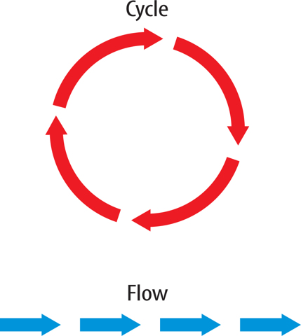
How Does Energy Move In Ecosystems?
How do the movements of matter and energy differ?
What type of material do you think moves through a cycle pattern? A flow pattern?
Energy moves in a flow, while matter moves in a cycle.
Energy DOES NOT CYCLE within a living system.
ENERGY FLOWS
Notes:
Example: Water Cycle; matter moves through a cycle
Energy flows

Slide 4
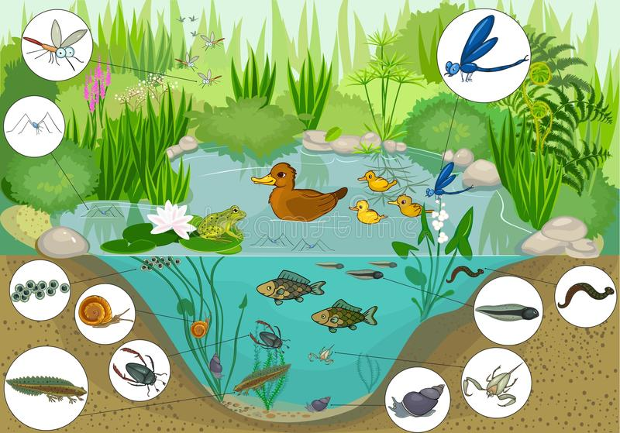
ECOSYSTEMS
Each movement by a living thing requires energy
The main source of energy for most life on Earth is the Sun
Energy FLOWS in one direction, energy does NOT return to the Sun.
Energy flow begins with the Sun and moves from one organism to another
What happens to the energy an organism receives?
Notes:
Picture: Pond Ecosystem → When you see a picture of an ecosystem, it often looks quiet and peaceful. However, ecosystems are actually full of movement.
Answer: Most is used to fuel the organism’s life processes. Some energy is released to the environment as heat.

Slide 5
PRODUCERS
CONSUMERS
Living things that make their own food from materials found in the environment
Most are photosynthetic
Examples:
Grasses, trees, plants, and algae
Do not produce their own energy-rich food
Get energy they need by consuming other organisms
REMEMBER: Energy flows and begins with the Sun and photosynthesis in a plant (PRODUCER)

Slide 6
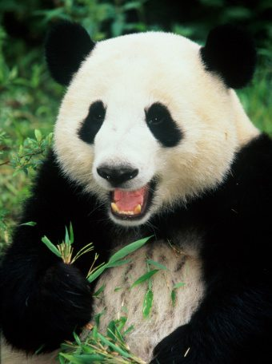
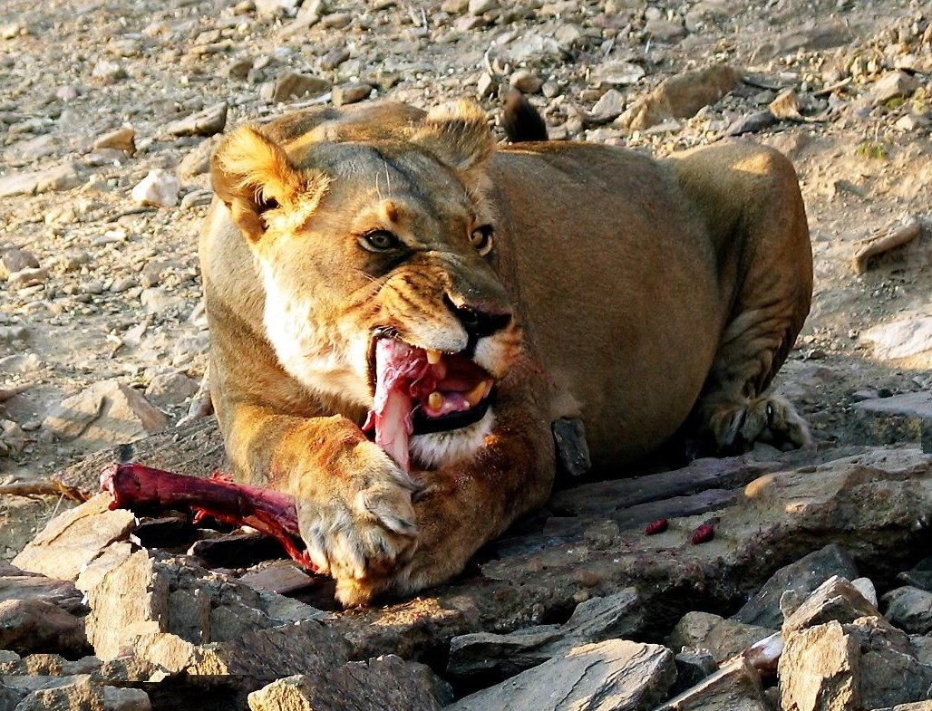
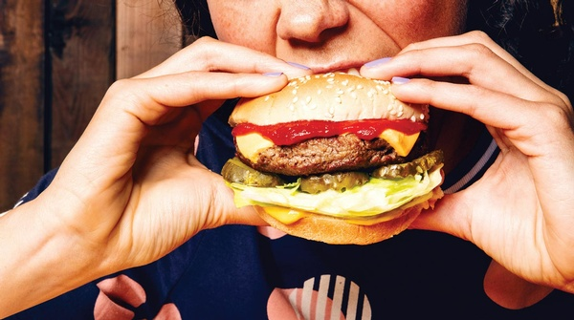
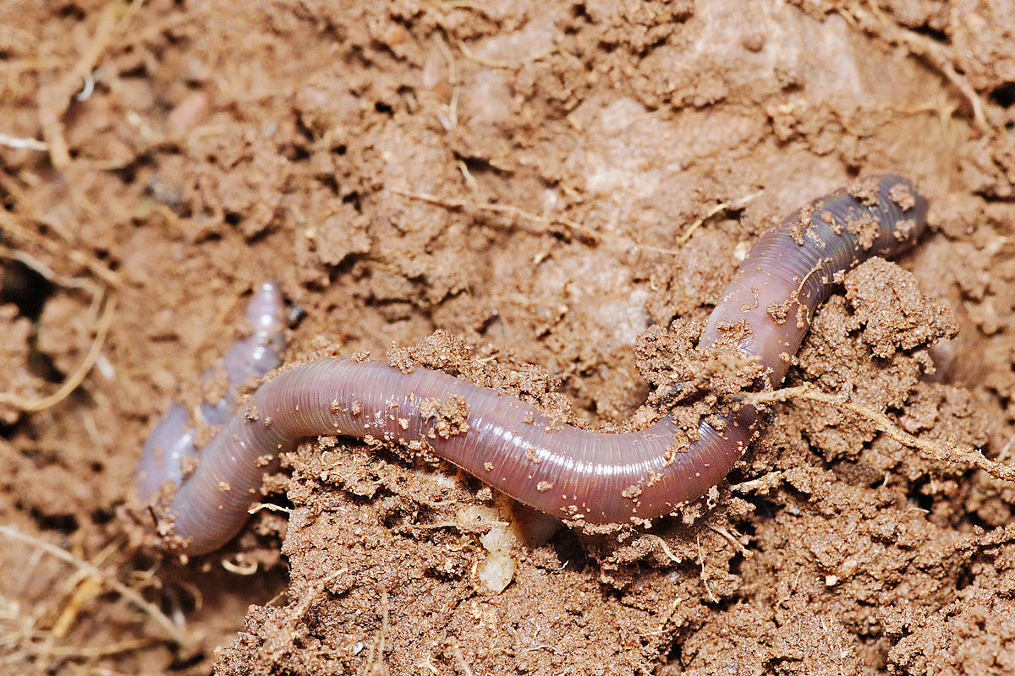
Types of Consumers
Type of Consumer | What it Does
Herbivore | Feeds only on producers
Carnivore | Eats other animals
Omnivore | Eats producers and other consumers
Decomposer | Feeds on the remains of organisms and helps decompose them

Slide 7
Now that we know energy FLOWS through ecosystems, let’s follow it!
Modeling Energy in Ecosystems
Organisms use some energy for life processes and store some energy in their bodies as chemical energy
When consumers eat these organisms, this chemical energy moves into the bodies of consumers
With each transfer of energy from organism to organism, some energy changes to thermal energy. Bodies of consumers emit this energy & enters environment
plant/producer→ herbivore/primary consumer→ carnivore/omnivore/secondary consumer→ carnivore/tertiary consumer
Scientists use models to study this FLOW of energy The models we will study:
Food Chains
Food Webs

Slide 8
Food Chains
A food chain is a model that shows how energy flows in an ecosystem through feeding relationships.
Energy flows from producers to consumers
Arrows point to who is eating
(plant is eaten by herbivore)
Can vary in length
Usually decomposers are left out

Slide 9
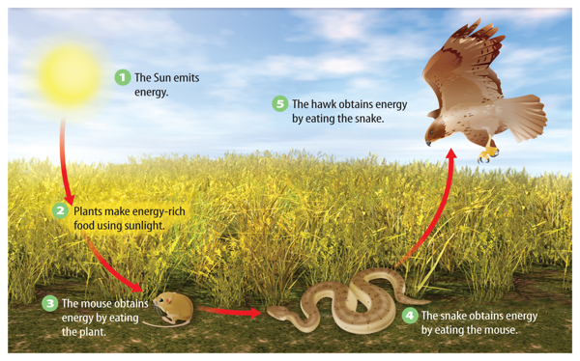
Each arrow can be read as “energy transfers into”
Arrows point to who is eating
Why is there no arrow pointing away from the hawk?
The hawk is at the end of this food chain because no organism preys on hawks.

Slide 10
Imagine you have a jigsaw puzzle of a rainforest. Each piece of the puzzle shows only one small part of the forest. A food chain is like one piece of an ecosystem jigsaw puzzle.
A jigsaw puzzle piece of a food chain is helpful when studying certain parts of an ecosystem, but it does not show the whole picture.

Slide 11
In this Food Chain:
The mouse might also eat:
Seeds of several producers (corn, berries, grass)
The snake might also eat:
Frogs, crickets, lizards or earthworms
The hawk might also hunt:
Mice, Squirrels, rabbits & fish
Scientists use a model of energy transfer called a Food Web to show how food chains in a community are interconnected.
Notes:
Let’s go back to our previous food chain.

Slide 12
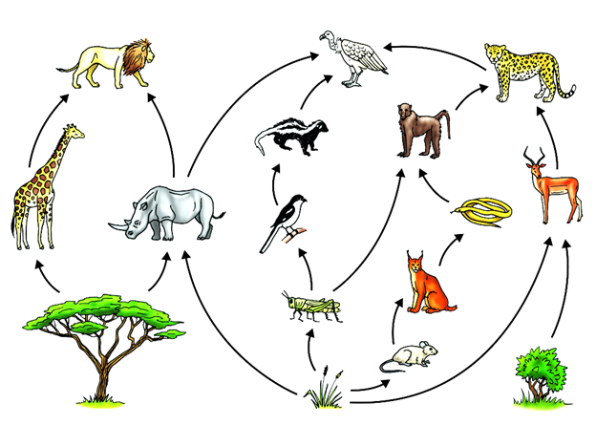
FOOD WEBS
You can think of a food web as many overlapping food chains
Like in a food chain, arrows show how energy flows in a food web

Slide 13
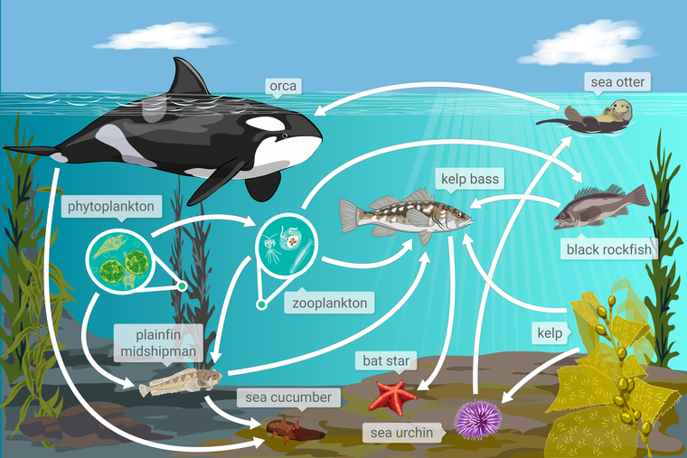
FOOD WEBS
You can think of a food web as many overlapping food chains
Like in a food chain, arrows show how energy flows in a food web

Slide 14
Exit Ticket
Build a food chain
LAUNCH:
Do The Right Thing, Even When No One is Looking!

