Slide 1
We are SOOOO PROUD OF YOU ALL!!! You may choose 1 snack item from the desk! Yes, you may eat in class today only. Please make sure to throw away your garbage! Also, please do not eat in any other classes or we will not be able enjoy snack reward again! Thank you and CONGRATS!
Monday September 24, 2018
Period | Attendance | Printer/ Computer | Rater | Substitute | Time Keeper
2nd | Scotty | Joel | Logan |  | Malik
3rd | Hunter | Braedon | Caitlyn B. |  | Keaghen
4th | Eva | Janelle | Kiana | Israa | Abby
6th | David A. | Adiaha | Autumn | Baraka | David R.
7th | Jess O. | Alex | Luke | Sayl | Jessica H.

Slide 2
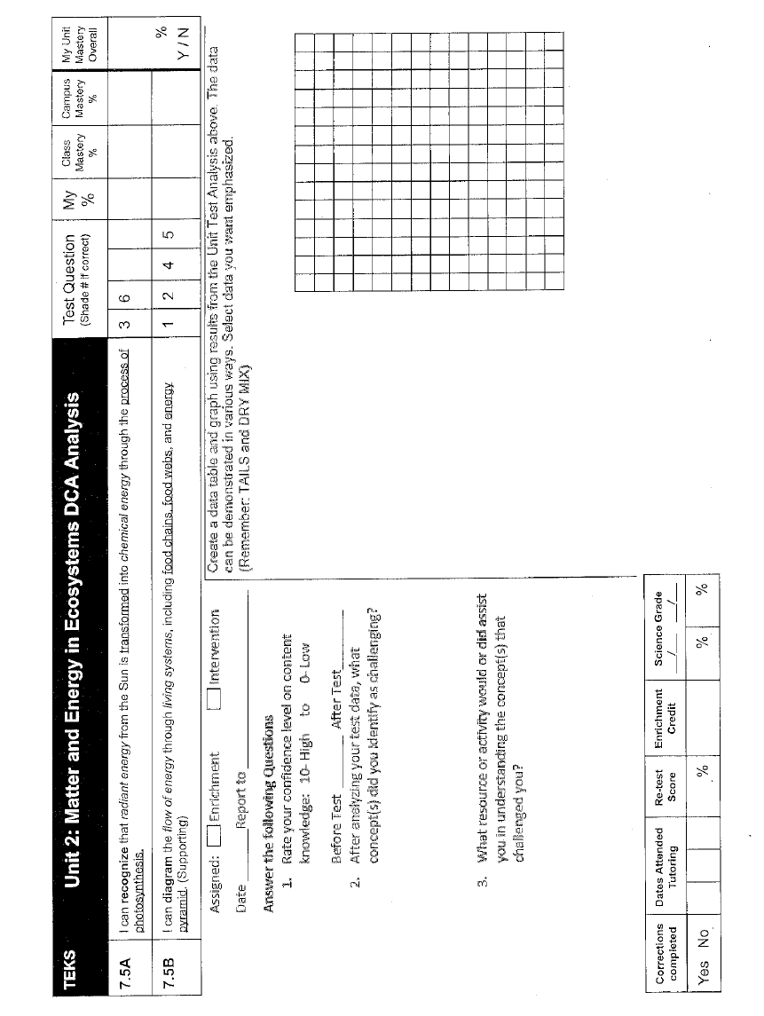
Agenda
Good things
Rater (Social Contract Reminders)
Return all graded papers
You will need the back page of your workbook for Data. (Will be turned in)
All work can be recycled or kept in your binder or you may bring it home!
DCA analysis and DATA graphing
Quick video on TAILS
Turn in graphing page…yes this will be graded!
Launch

Slide 3
DATA By Teacher, Class and TEK
7.5B
2nd period averages: 26 84.59% 94.6% 100% 87.17%
Learning Standards
Process TEKS--Skills

Slide 4
98.79
93.55
9/25 Mrs. Hinds’s Class
Unit 2 DCA Data Analysis
My Score
4
3
2
1
7.5A 7.5B
(2 questions) (4 questions)
TEKS TESTED

Slide 5
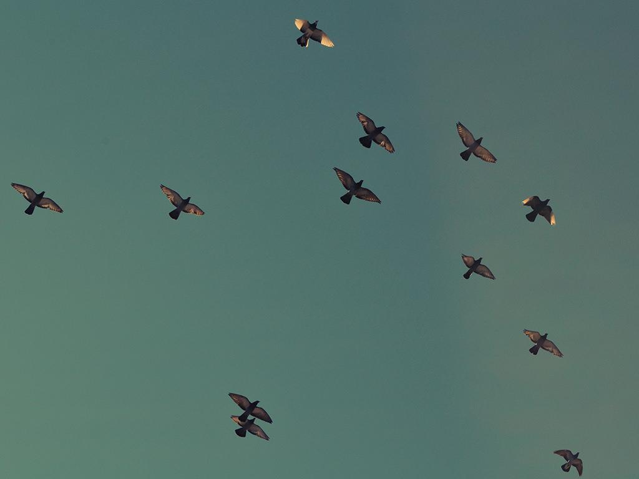
Launch:
DO THE RIGHT THING
EVEN WHEN
NO ONE IS LOOKING

Slide 6
Enrichment Group Learning Target: I will learn the characteristics that make up a microhabitat. Success Criteria: I can identify a microhabitat.
Tuesday September 25, 2018
Intervention Group Learning Target: I will review photosynthesis, food chains, food webs and energy pyramids. Success Criteria: I can demonstrate how energy flows in a food web, food chain, and energy pyramid
Science Starter:
Enrichment—Pick up the microhabitat page
Intervention—Pick up the Energy Flow in Ecosystems page
Agenda:
Buck Store—Friday Sept 28
(Mr. Hargrove’s room or during Science)

Slide 7
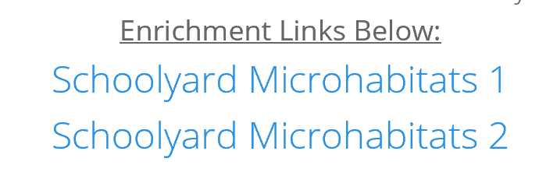
Agenda
Good things
Enrichment group:
You will need a computer.
Log on and go to Mrs. Hinds Website
On home page
Follow the directions
on the worksheet
Intervention group:
You will need the Energy Flow Worksheet
4. Everyone will turn in their work today.
5. Launch

Slide 8
Launch:
DO THE RIGHT THING
EVEN WHEN
NO ONE IS LOOKING

