Slide 1
Learning Target: Explain variation within a population by comparing behaviors (migration) that enhance the organisms chance of survival. Science Starter: Migration is the movement of animals from one region to another. Why do animals MIGRATE?

Slide 2
Photo by Serge Melki - Creative Commons Attribution License https://www.flickr.com/photos/67958110@N00
Created with Haiku Deck

Slide 3
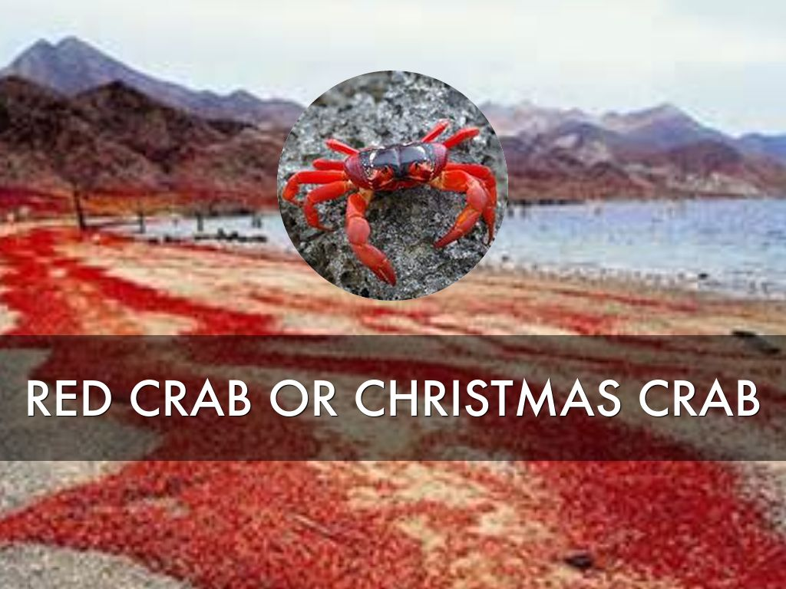

Slide 4
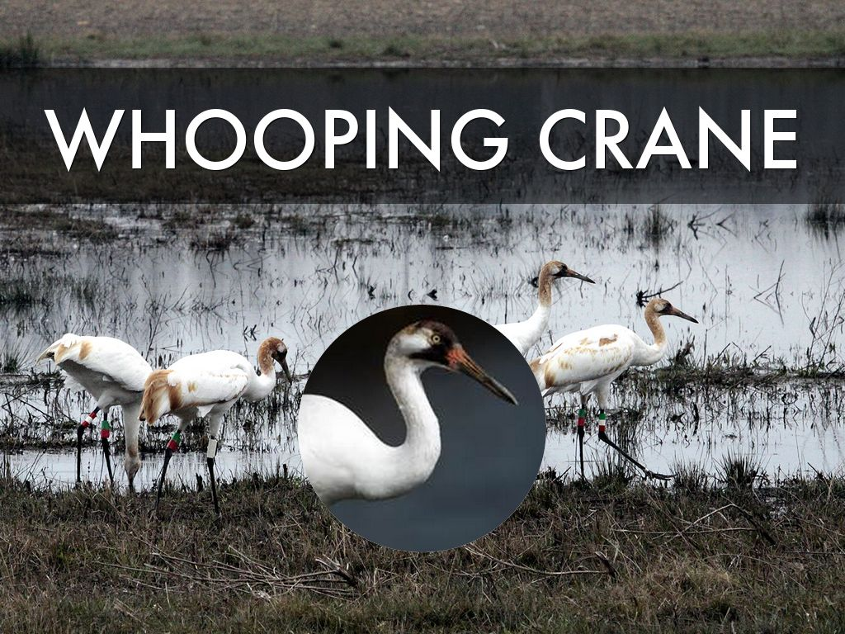
Photo by USFWS/Southeast - Creative Commons Attribution License https://www.flickr.com/photos/41464593@N02
Created with Haiku Deck

Slide 5
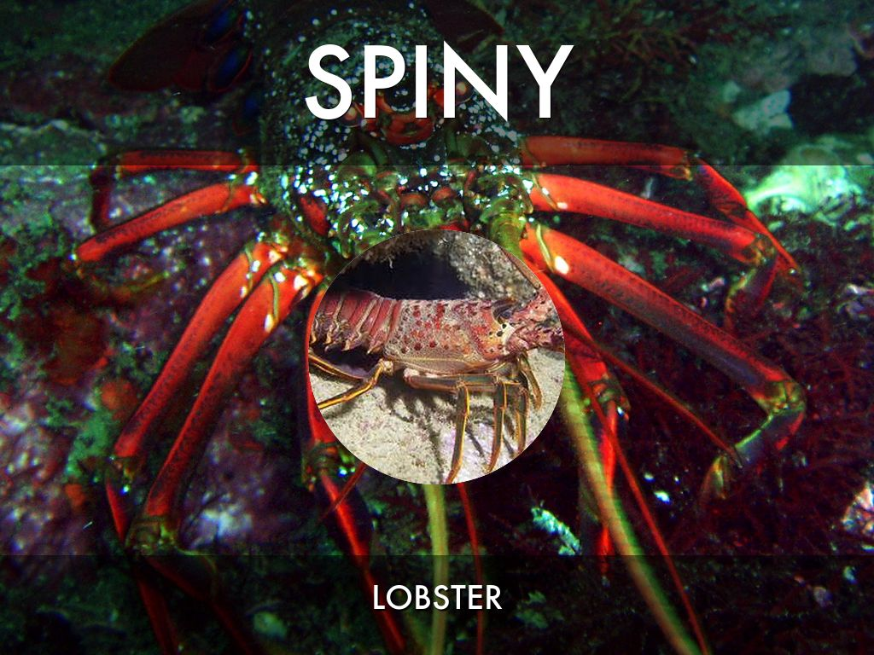
Photo by Nemo's great uncle - Creative Commons Attribution-NonCommercial-ShareAlike License https://www.flickr.com/photos/71453924@N00
Created with Haiku Deck

Slide 6
Photo by grandmasandy+chuck - Creative Commons Attribution-NonCommercial License https://www.flickr.com/photos/27784972@N07
Created with Haiku Deck

Slide 7
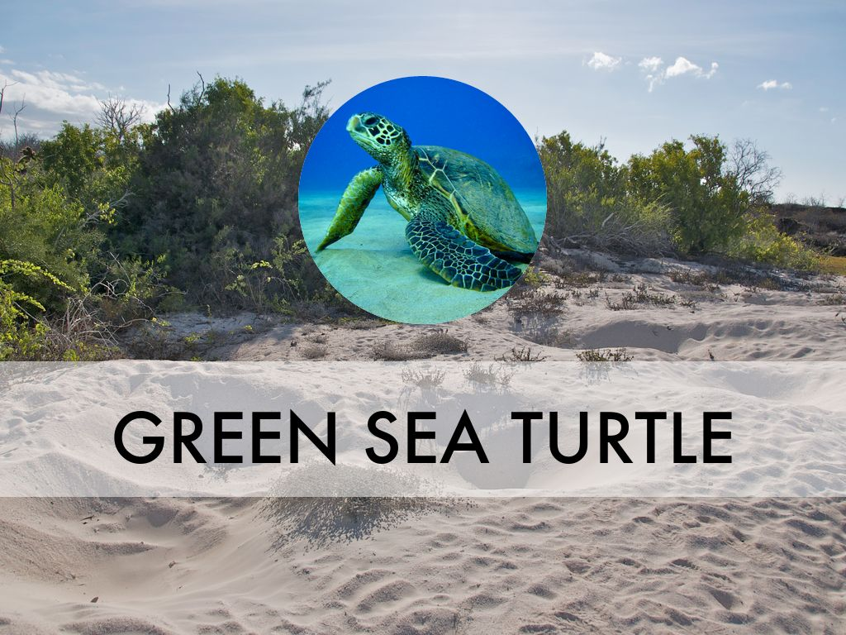
Photo by A.Davey - Creative Commons Attribution License https://www.flickr.com/photos/40595948@N00
Created with Haiku Deck

Slide 8
Photo by D-Stanley - Creative Commons Attribution License https://www.flickr.com/photos/79721788@N00
Created with Haiku Deck

Slide 9
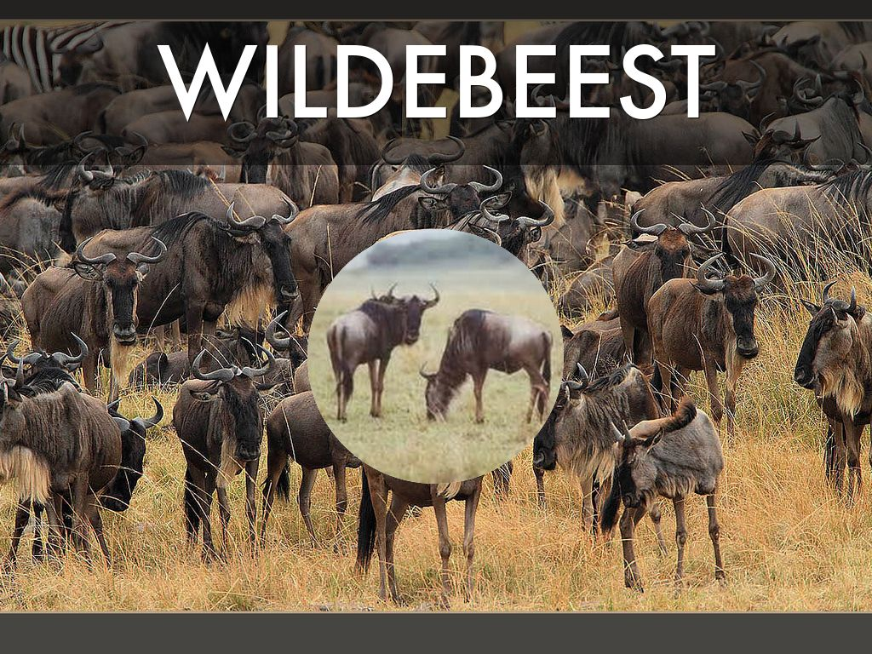
Photo by Rainbirder - Creative Commons Attribution-NonCommercial-ShareAlike License https://www.flickr.com/photos/50079771@N08
Created with Haiku Deck

Slide 10
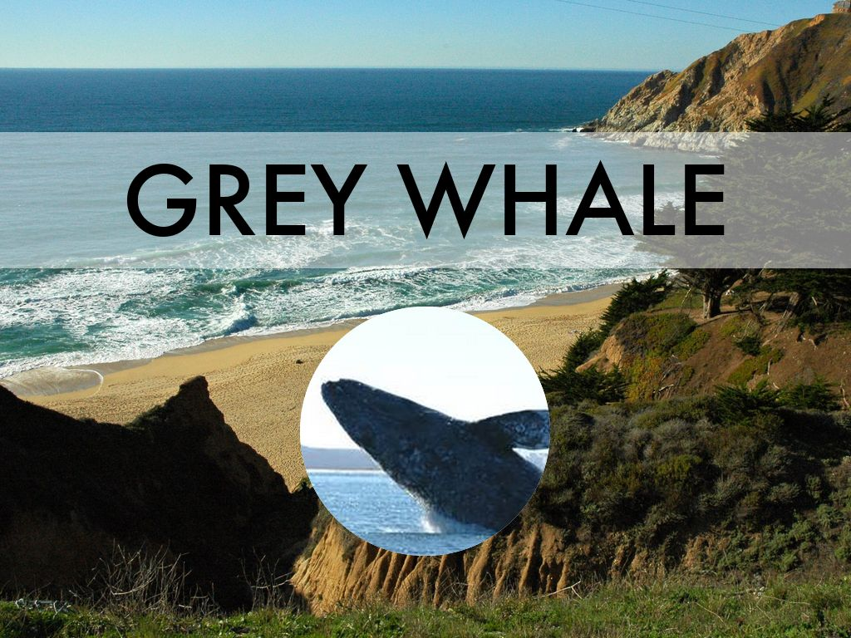
Photo by Wonderlane - Creative Commons Attribution License https://www.flickr.com/photos/71401718@N00
Created with Haiku Deck

Slide 11
Photo by Jim Carson - Creative Commons Attribution-NonCommercial-ShareAlike License https://www.flickr.com/photos/44124442504@N01
Created with Haiku Deck

Slide 12
Photo by Rainbirder - Creative Commons Attribution-NonCommercial-ShareAlike License https://www.flickr.com/photos/50079771@N08
Created with Haiku Deck

