Slide 1
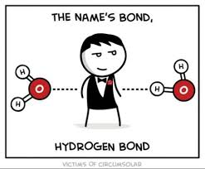
Learning Target: 1. Identify that organic compounds contains carbon and other elements such as: hydrogen, oxygen, nitrogen, phosphorus, or sulfur. 2. Recognize that radiant energy from the Sun is transformed into chemical energy through the process of photosynthesis.
Monday September 18. 2017
Science Starter:
1. Begin chart on pg. 6 of the Matter and Energy in Ecosystems Workbook.

Slide 2
Workbook Pg. 6

Slide 3
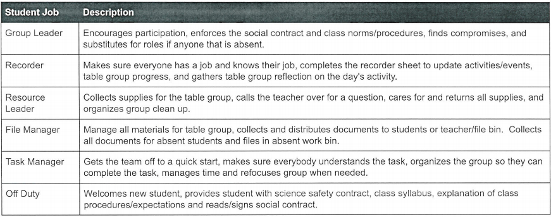
Daily Agenda
Good Things- Welcome Back!!!
Tokens and Table Points and Table Jobs

Slide 4
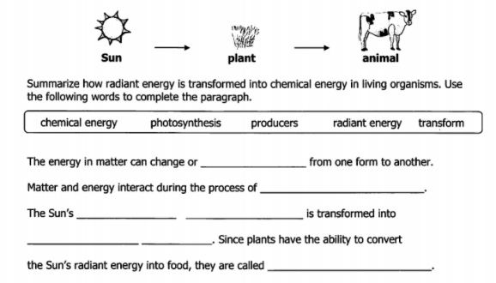
1. Photosynthesis Video
Pg. 16 in Matter and Energy Workbook Notes
Pg. 13– Reading on Photosynthesis
Exit ticket– This will be graded.

