Slide 1
Do not Copy in Workbook Intervention Group--Learning Target: I will demonstrate mastery of the Life on Earth TEKS. Intervention Group--Success Criteria I can explain WAGON and the accommodations needed for living in space.
September 5, 2018
Do not Copy in Workbook Enrichment Group--Learning Target: I will learn to focus a compound microscope by viewing slides. Enrichment Group--Success Criteria I can use a compound microscope to view pond water on slides.
Don’t forget your class job!!!
Agenda:
9/5—Open House 6pm
9/6—Corrections
9/21—Matter & Energy DCA
Materials: pencil, workbook, laptop

Slide 2
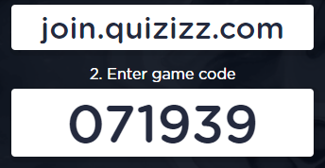
1. Good Things 2. Enrichment Group a. Watch the videos on Google Classroom How to use a compound microscope? How to make a wet mount slide? b. Once you have completed the videos, then you may begin using the compound microscopes. 3. Intervention Group a. You will need your workbook to work with Mrs. Hinds. 4. Missing Work a. Quizzizz—Vocabulary b. ADI Slides

Slide 3
Enrichment Groups
1. Google Classroom Videos
(Microscope & Pond Water)
2. View Slides under the microscope
A. Draw what you see when viewing the slides under the microscope on a sheet of lined paper.
3. Wet Mount Slide
A. See Mrs. Marquez to make a pond water wet mount slide
B. View the slide under the microscope
C. Draw what you see when viewing the slides under the microscope on a sheet of lined paper.

Slide 4
Launch
Do the Right Thing
Even When No One
is LOOKING!!!

