Slide 1
Welcome to 7th Grade
This is going to be the best year yet! GO HORNETS!!!

Slide 2
2 Truths and a Lie
Mrs. Hinds
I hold a Royal Title.
I love to camp.
I almost went to space with the “Teacher in Space Program with NASA.

Slide 3
Your TURN:
With your table group play the game: 2 Truths and a Lie
You will have 5 minutes to play with your table group.
Then we will share as a class for an additional 5 minutes.
We have some required housekeeping items from district and the front office.
Any remaining class time and we will continue with the game.

Slide 4
Hopewell,
Where you are:
Hopeful (Home, Hornets)
Important
Valued
Encouraged

Slide 5
TIME: 8:20-9:45 1st Day Counts
Supplies, Hallway Expectations and REQUIRED Technology/Cyberbullying Video
Collect any community supplies that have arrived today.
Collect any community supplies that have arrived. Ex: Kleenex boxes which don’t fit in lockers well.
Hallway Expectations:
Backpacks are allowed and will be placed in a designated place in the classroom. Look for backpack parking lots in your classes or teachers will explain where to put your backpacks.
(Lockers are only assigned by request.)
On days we have assemblies or pep rallies, students will leave their things in lockers or classrooms and go to lockers at dismissal. No items in gym.
Students may NOT have cell phones out in the hallways at any time. If we see it, it will be confiscated.
Go GREEN model --expectations during passing periods.

Slide 6
Go GREEN for hallways
Giving Your Best: Walk quietly without disturbing other classes. Keep your hands and feet to yourself. No running
Respectful: Close lockers quietly. Walk with a purpose and on the right side of the hall. Treat others as you want to be treated.
Expectations are High: Follow expectations when adults are watching or not. “One or none” with music in halls. Use appropriate language. Report any inappropriate behavior to the office immediately.
Eager to Learn: Ask for help when needed. Students are to remain in class the first and last 10 minutes of class.
New Start Each Day: Show pride in your school by keeping it clean. Always act with integrity.
The goal of the information in this class is to address common middle school issues and being aware of what you say and do. Students start using technology almost immediately at school so we want to make sure they use it responsibly.

Slide 7
GO GREEN, Computer Usage, Cyberbullying
What does GO GREEN mean?
Computer Usage at School
Cyberbullying
Go GREEN--https://docs.google.com/presentation/d/1NGGdTuevDi10-XyEh040Bt3iW9PA71uBWURcGhEwglc/edit?usp=sharing
Computer Usage--https://prezi.com/z1iyzsuy0vgy/round-rock-isd-acceptable-use-presentation/?utm_campaign=share&utm_medium=copy
Cyberbullying--https://drive.google.com/file/d/0B8Uel0J38hqRa1ZVU1Z5X3cxdGM/view

Slide 8
Time Permitting-What does responsible use of the internet really mean?
“Social Networking” – This video presents what Facebook is like if it was in real life = weird!
http://www.youtube.com/watch?v=xY8HOzmbLTM
“Cyber Bullying” (mean girl in the kitchen)
http://www.youtube.com/watch?v=pmD8OKl8vVM
Do you really know who you’re talking to?
http://www.youtube.com/watch?v=DZ_f7yOAzPU&NR=1

Slide 9
Welcome to 7th Grade Science
SCIENCE STARTER: Part 1--Please pick up the following papers: DUE Friday August 24, 2018
1. Safety Contract
2. Syllabus
3. Information Sheet
Part 2—Write your name on a name tag and choose seat where you will learn!!! the best!
Materials—agenda, pencil, 8 sticky notes
Learning Target:
I will learn Hopewell Middle School Procedures.
I will learn how to move in stations during Mrs. Hinds Science Class.
Success Criteria:
I can demonstrate hallway, cafeteria, morning, restroom, and dismissal procedures. I can explain the proper way to move during stations in Mrs. Hinds Science Class.

Slide 10
SECOND PERIOD TIME: 10:28-11:03
This period will be spent discussing the morning expectations. Explain the appropriate waiting area for all 7th graders:
Students will go to the 7th grade hallways and sit with their backs against the wall. Keep your feet and backpacks out of the walkways.
For tutoring – students will need a pass to see teachers in the morning.
Electronic Devices will need to be put away. Students may talk quietly with your friends sitting near you. Yelling across the hallway is not acceptable.
Students with instruments will drop them off on the way to the 7th grade hallway.
Students remain seated until the 8:15 bell rings.
Review the Go GREEN expectations for Morning
Walkers: Remind students who walk to school to always walk with a friend, don’t talk to strangers, etc. Student should not stop on the way to school, but should walk directly from their home to school.
Bus Riders: Remind students that they should consider the time that they are on the bus as the first and last period of the day and that expectations at school are the same as expectations on the bus. Bus Riders enter from the North side of the building.
Car Riders: Cars are to drop off students on the South side of the building near the gym. Cars are to pull up to the curb to let off students, NOT park and have students walk across lanes of traffic. Students should be ready to exit the car as it arrives. If a parent/guardian needs to park to drop off a student, please park at the front of the building parking lot.
All Students:
(morning) When you arrive on campus you should not linger outside, but should enter the building and report to your grade level waiting area. Often times, students who are visiting outside can get in trouble for horse play, hurting others, etc. If you need to go to tutorials/band practice, you should have a pass from a teacher or parent allowing you to enter the building before 7:50.

Slide 11
Go GREEN for Morning
Giving Your Best: You may visit quietly with your peers near you, finish or check over your homework, read a book, or find other appropriately calm activities while you wait.
Respectful: Respectfully follow the directions of any staff member addressing you or your group. Think of others. Talking quietly is acceptable, yelling across the hallway is not.
Expectations are High: Remain seated in one spot until 8:13. The teachers will dismiss you, please wait for them to do so.
Eager to Learn: Attend tutorials or visit library with a pass only.
New Start Each Day: You may get up and go to the staff person monitoring your area if you need help for something that cannot wait until you see your first period teacher. However, if it can wait, please wait until then. There are a lot of students to monitor and the staff on duty need to pay attention to all students.

Slide 12
Activity-
Generate a list of expectations Mrs. Garinger might have for 7th grade and possible privileges they could earn as a grade level.
What should they do when expectations aren’t met and privileges are revoked?
Talk about what to do to influence the whole grade level to earn a privilege.
Teachers, gather these lists and discuss them in a team meeting, then turn in a “realistic” list to Mrs. Garinger for consideration.

Slide 13
THIRD PERIOD TIME: 11:07-11:42
Lockers, Dress Code, Tardies, Electronics Policies
Please review policies using this PPT
Announcement Expectations: Every day we will start each day at 8:20 with the Pledge of Allegiance, the Texas Pledge, and the Moment of Silence. It will be over the PA system and will usually be led by students. The Moment of Silence follows the Legislature’s requirements for students in public schools (stand and recite or stay silent). It is our requirement that students remain standing during the Moment of Silence, to maintain the reflective environment.

Slide 14
FOURTH PERIOD TIME: 11:46-12:26
Classroom and Agenda Expectations
In small groups, have each group take a classroom scenario and brainstorm classroom expectations for the given scenario using the Go Green format, each group will share expectations.
Scenario #1: The teacher is showing you how to balance a chemical equation, and is expecting you to take notes. Samples are being worked out on the whiteboard as the teacher talks.
Scenario #2: Students are working in groups to discuss the books each group is reading. The teacher moves around the room working with different groups for a few minutes at a time.
Scenario #3: Students are presenting to the class in a variety of ways – PowerPoint, skit, poster, etc. The rest of the class is expected to score each presentation on a rubric.
Scenario #4: The class is taking a benchmark test that has 42 questions to be completed.
Scenario #5: The teacher is reviewing the rubric for an upcoming project.
Scenario #6: Outside at the track, there are six stations set up that all students will rotate through.
2. As a whole class, have the students write expectations for the classroom on a piece of poster paper. Debrief with the class why it is important to follow classroom expectations.

Slide 15
Agenda Expectations
Lead the students in a discussion of the following questions:
1. Why do we use agenda’s?
How would you plan without an agenda? Could you meet a deadline without an agenda?
What other ways can the agenda help a student?
2. Review uses for Agendas
Organization Tool
Write a teacher’s objective for the day and/or homework
Write down important deadline dates
Communication Tool
Between parents and teachers
Between students and teachers
3. Student Expectations
Students have the student expectations at their finger tips to avoid any misunderstanding of the expectations and rules
Hall Pass
Provides a method in which to track hall passes
Before students leave class, have students write their names in their agenda books. If students still need to buy an agenda, they can buy them for $5 in the front office before and after school, during advisory and lunch.

Slide 16
PERIOD FIVE (Advisory/Lunch) TIME: 12:30-1:10
Meet in Advisory First, during this time you will be distributing first day packets.
Review what is in the first day packet.
Walk your classes to the cafeteria.

Slide 17
Lockers and Locker Room:
It is important that students put their belongings in their locker and lock it.
Many students report items being stolen from the locker room and upon investigation it is determined that the student(s) left their belongings out on a bench instead of taking the time to put them in a locker.
Horse-play: Often times, students get excited while playing games in PE. This is wonderful! We want PE to be a class in which students can expend energy and learn teamwork and leadership. Students must understand that when they come into the locker room, they need to calm down and not engage in horse-play. What starts as just friendly “playing around” all too soon turns to aggressive behavior that can end in a fight. If this happens, both students involved will get an office referral and ISS.

Slide 18
PERIOD SIX TIME: 1:14--1:54
(Restroom, Library, Upper/Lower Commons, School Events)
This period will focus on Go GREEN expectations in the common areas such as restroom, library, upper/lower commons, and school events.
Review the Expectations from the Campus Procedures PPT
When reviewing Event expectations, review what “Appropriate Cheering” and “Be a Good Audience Member” looks and sounds like.

Slide 19
PERIOD SEVEN TIME: 1:58-2:38 There are two topics to cover this period:
Dismissal-Please make it clear to students that the teacher dismisses all classes, not the bell. Teachers begin dismissing classes at 3:35. Students will be expected to exit the building quickly. You will stop at your locker to get any necessary supplies before 9th period, do not stop to visit with friends at this time. What students learned this morning in advisory, Go GREEN for hallway expectations, is what we expect to see at dismissal in the hallway.
When you are dismissed in the afternoon, you should exit the building. Buses leave at 3:37 , if you miss your bus, report to the main office to call for a ride. If you walk home, you must be off campus by 3:45 unless you are being supervised by an adult (teacher, coach, etc.).
Bus Expectations-The Go GREEN expectations on the next page should be reviewed during this period.
Role-playing or planning and presenting a skit about the bus is always fun and funny, but the benefit that I see happen with middle school kids is when you remind them in the role play to thank their driver, more kids are likely to thank their driver in reality. When the driver feels appreciated, they are more inclined to let kids earn privileges, etc.
During this time you could have a discussion about things students might be nervous about when it comes to riding the bus. You could also answer any questions they might have about riding the bus.
This would also be a good time to talk about how their day has been and answer any questions they have about Go GREEN in general.

Slide 20
Go GREEN for the Bus
Giving Your Best: Stay seated with your body facing forward at all times. Let students sit next to you if they need a seat and be friendly and welcoming to new students.
Respectful: Respect school property and the property of others.
Expectations are High: Use appropriate language with the bus driver and other riders.
Eager to Learn: Get on and off at your assigned stop and listen to your bus driver’s directions.
New Start Each Day: Respect the bus driver and other riders through your actions.

Slide 24
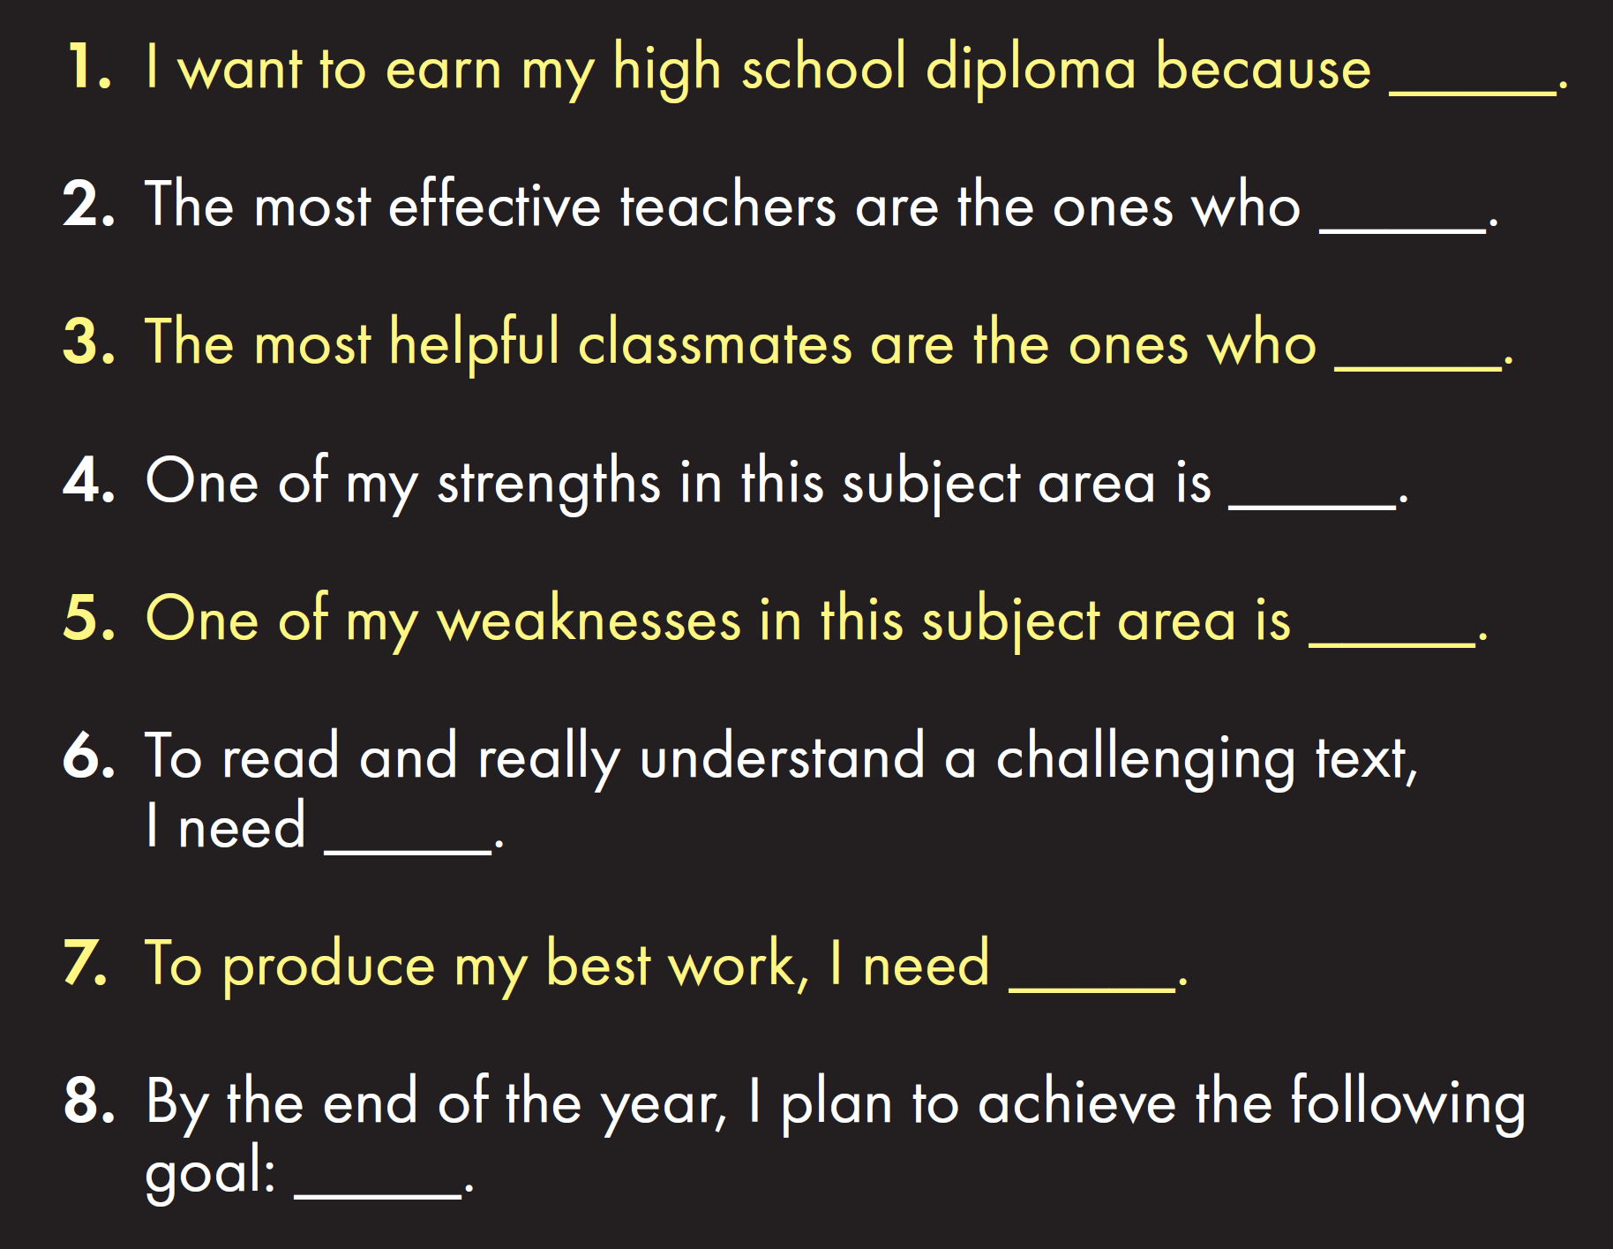

Slide 27
White
Gray
Black

Slide 30
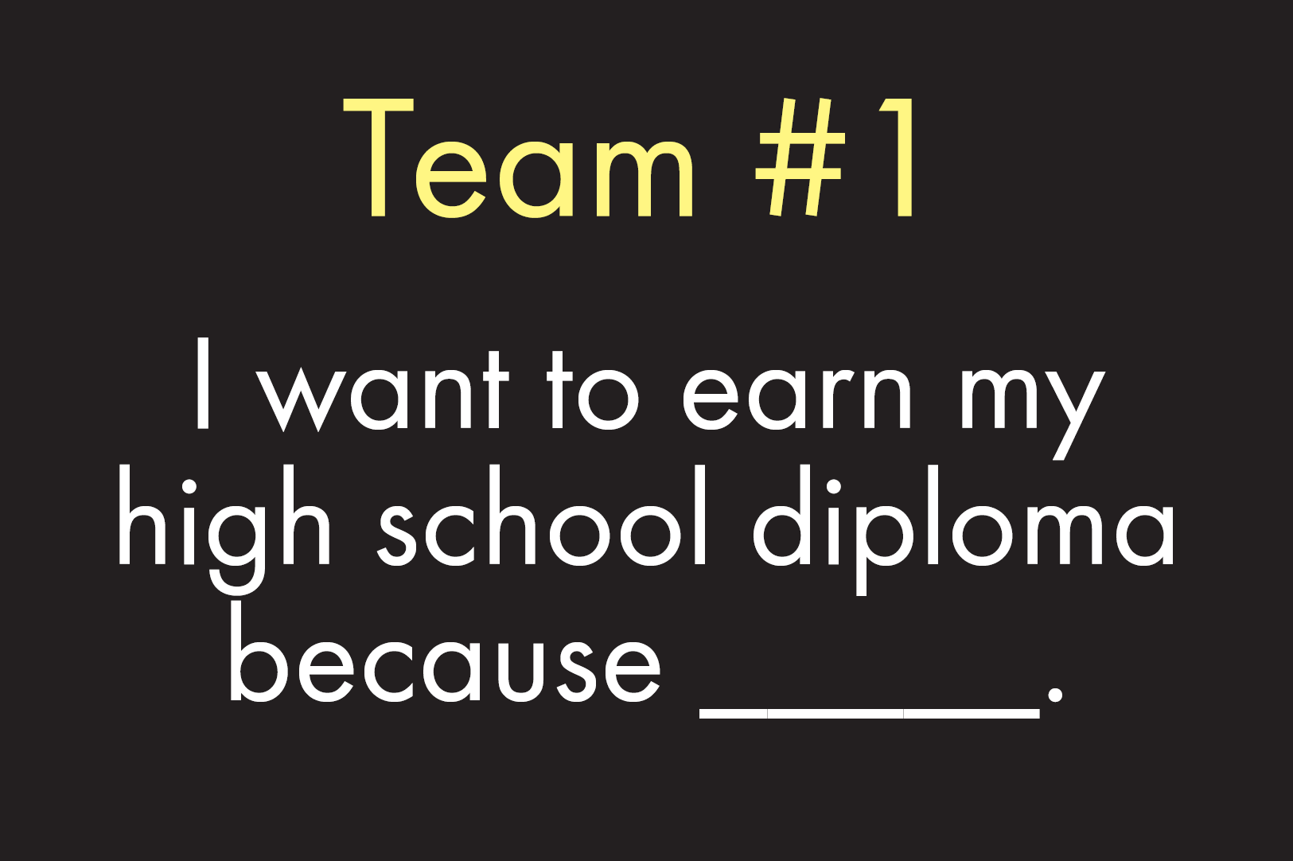

Slide 35
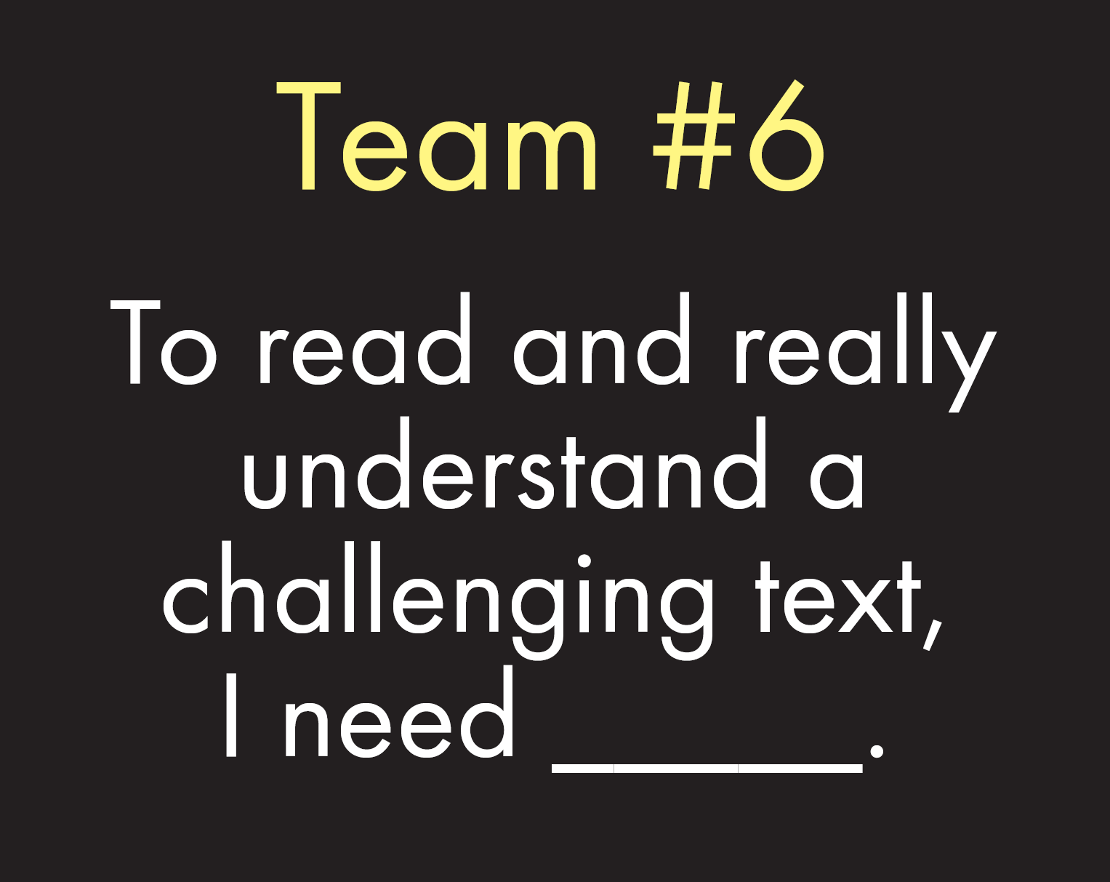

Slide 36
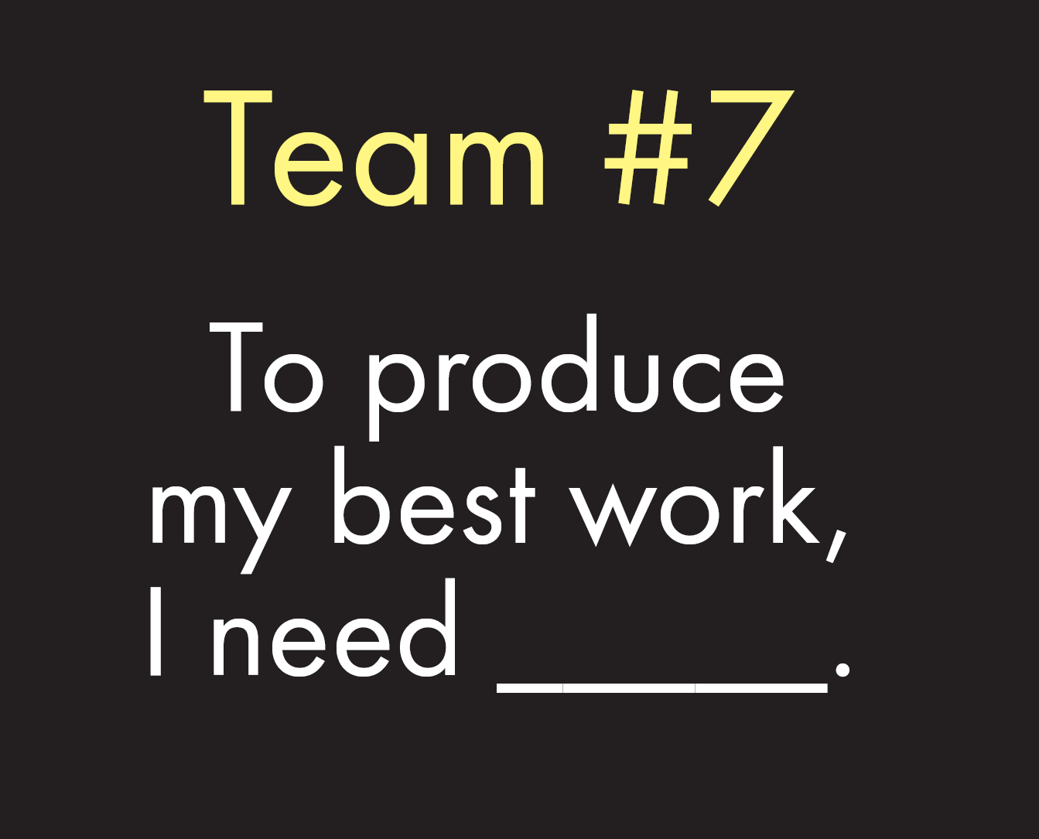

Slide 39
Announcements: 1. Please return all forms and lab fees by August 24. a. Safety Contracts (Must have for labs) b. Blue Syllabus (Includes important class info & Remind) c. Green Information sheet (helps me to get to know you) d. $5 Lab Fee (helps to pay for Med School Supplies)
LAUNCH 2018

