Slide 1
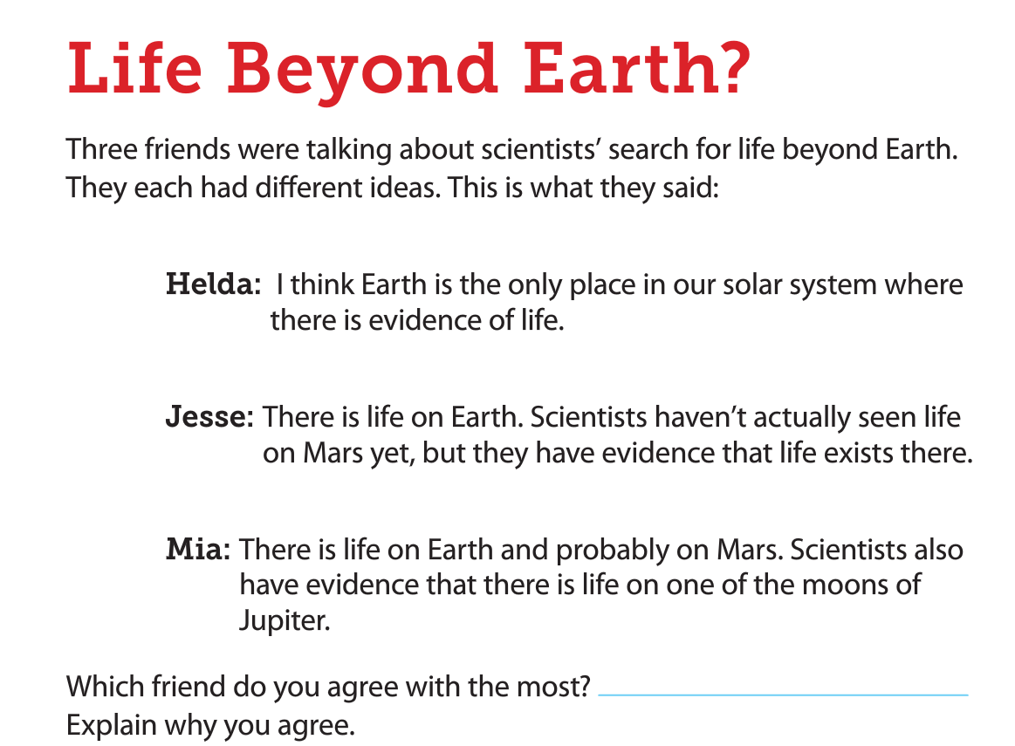
Science Starters: Part 1- Turn in any forms a. safety contract b. syllabus, c. information sheet d. $5 lab fee Part 2—Read article and answer on pg. 4 in workbook
August 21, 2018
Copy Learning Target and Success Criteria on pg. 1
Learning Target:
I will identify the characteristics of other objects in our solar system that may support life. (WAGON)
Success Criteria:
I can explain the reasons that the Sun allows life to exist.
You will need a highlighter today!
Agenda:
8/24—Science Forms Due
8/31—Life on Earth DCA
9/5—Open House

Slide 2
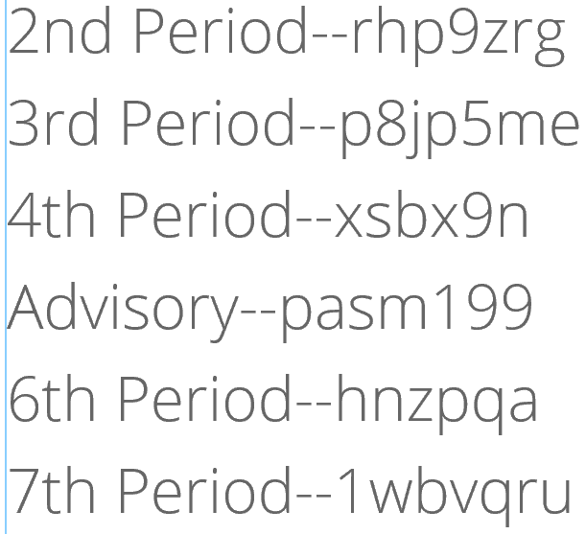
Agenda
Good Things
Job-Time Keeper
Finish Amoeba Sisters Notes pg. 3
You will receive your student number for science.
Log in to computers—Google Classroom See codes on the side for Google Classroom.
Begin background reading for ADI pg. 14
Reflection
Launch

Slide 3
Google Classroom
You will be assigned a student number.
Sign in to Google Classroom
Once you have signed in to Google Classroom then log off and put your computer back on the cart.
Begin reading pg. 14 in the workbook

Slide 4
ADI Reading pg. 14/15
You will need a highlighter.
After the reading, complete the chart on pg. 15

Slide 5
Reflection Question
What factors do scientists look for life beyond Earth?

Slide 6
Launch: Do the right thing even when no one is LOOKING.

Slide 7
Advisory Tuesday—Second Step Lesson/Social Contract Wednesday—Tutorial/Ice breakers Thursday—Tutorial/Ice breakers Friday—Reading Day

