Slide 1
Thursday January 24, 2019
Agenda:
1/28—Unit 5 Part 1 Vocabulary Quizizz
1/29—Unit 5 Part 1 Review
1/30—Unit 5 Part 1 DCA
Science Starter:
Answer the following question on the notecard provided.
Write your name and class period.
Which of the following traits has occurred as a result of natural selection?
Over time, a bear is able to perform tricks during a circus act.
Over time, lavender plants developed a sweet smell to attract pollinators.
Over time, tomatoes are bred to make more tomatoes per plant.
Over time, a person increases muscle mass with exercise.
Learning Target:
I will learn how the behavior of organisms can enhance survival.
Success Criteria:
I know how to describe behaviors of organisms to enhance survival.

Slide 2
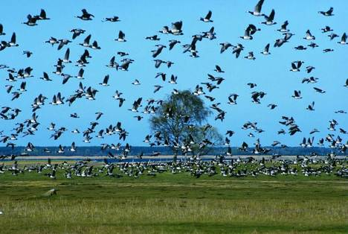
Agenda
1. Good Things
2. Rater Check In
3. Finish graph from the Evolution Lab
(10 minutes to finish---Turn in Friday 1/25)
4. Migration and Hibernation pg. 1
5. Animal Migrations pg. 24
6. Launch

Slide 3
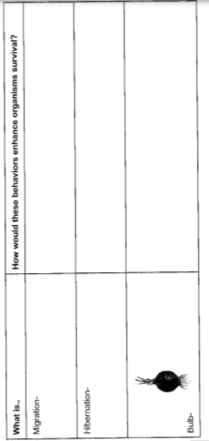
Pg. 1 TEKS Analysis
Makes finding necessary resources more likely
Allows animal to consume energy
Allows plant to store food during dormancy (plant is alive and not growing)

Slide 4
Photo by Serge Melki - Creative Commons Attribution License https://www.flickr.com/photos/67958110@N00
Created with Haiku Deck

Slide 5
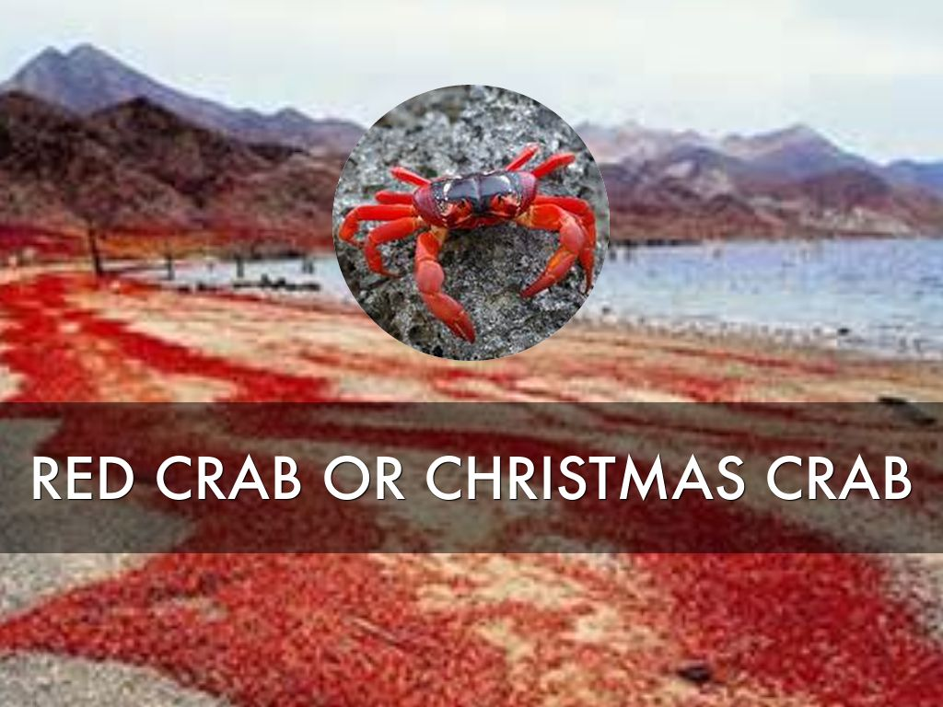

Slide 6
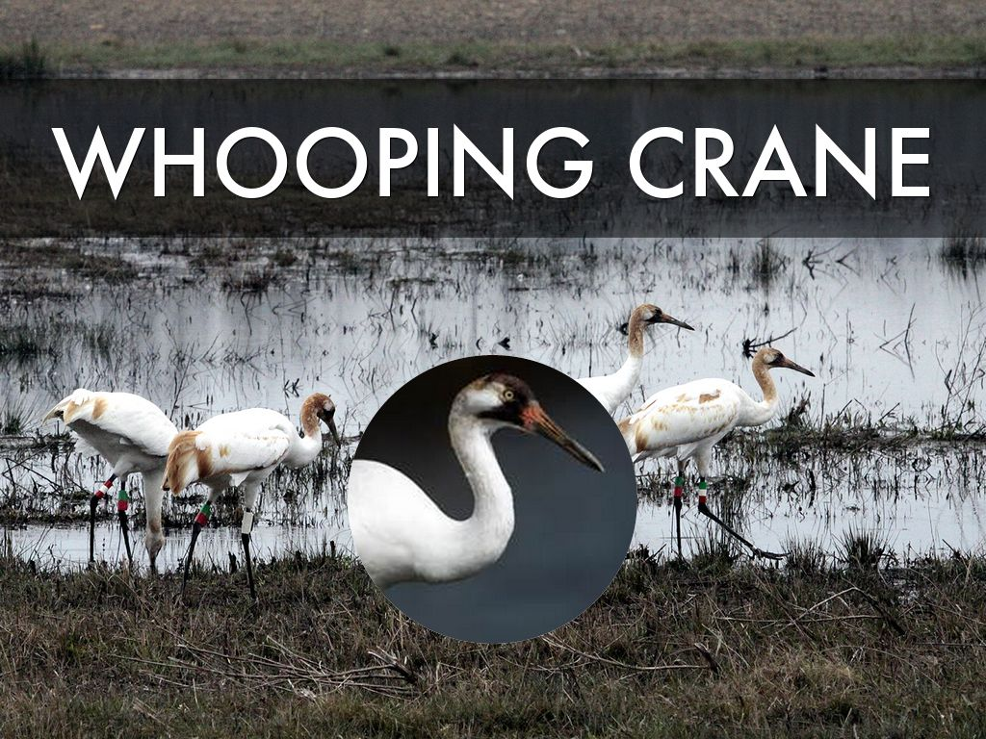
Photo by USFWS/Southeast - Creative Commons Attribution License https://www.flickr.com/photos/41464593@N02
Created with Haiku Deck

Slide 7
Photo by grandmasandy+chuck - Creative Commons Attribution-NonCommercial License https://www.flickr.com/photos/27784972@N07
Created with Haiku Deck

Slide 8
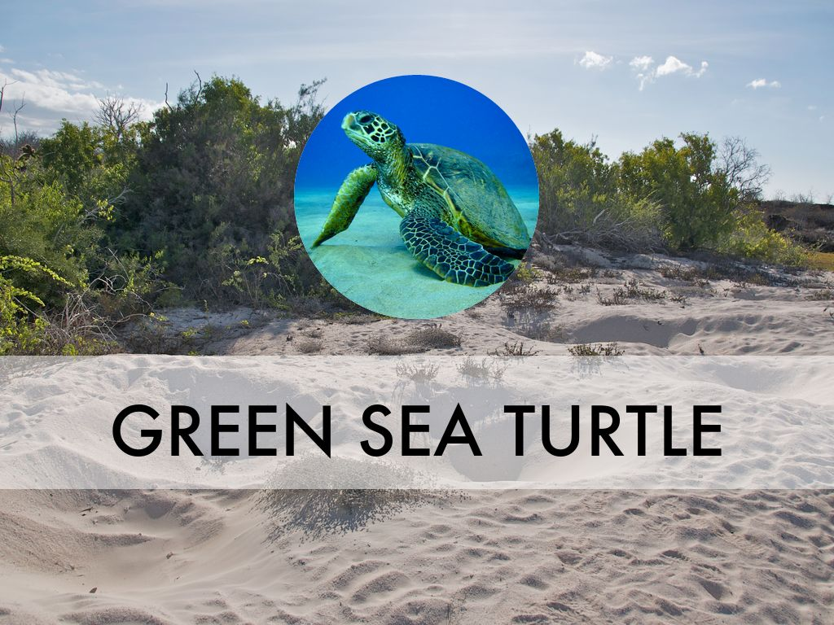
Photo by A.Davey - Creative Commons Attribution License https://www.flickr.com/photos/40595948@N00
Created with Haiku Deck

Slide 9
Photo by D-Stanley - Creative Commons Attribution License https://www.flickr.com/photos/79721788@N00
Created with Haiku Deck

Slide 10
Photo by Rainbirder - Creative Commons Attribution-NonCommercial-ShareAlike License https://www.flickr.com/photos/50079771@N08
Created with Haiku Deck

Slide 11
Launch: Do the Right Thing Even When No One is Looking. It’s Called Integrity!

