Slide 1
Science Starter: Continue working on graphs from the Evolution Lab. Once completed turn in the graphs. You will have 10 minutes in class today. Due Friday January 25
Wednesday January 23, 2019
Materials:
Natural Selection and Adaptation Workbook
Graph from Evolution Lab
Pencil
Agenda
Learning Target:
I will learn how genetic traits in organisms can change through selective breeding.
Success Criteria:
I can identify situations where traits have changed through selective breeding.

Slide 2
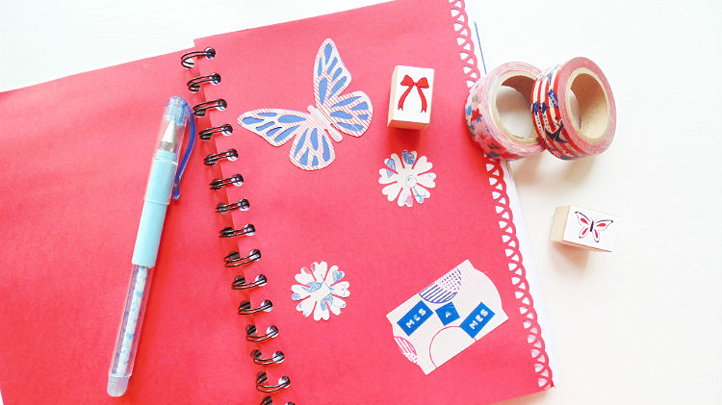
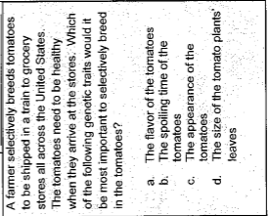
1. Good Things
Rater Check in
Let’s Answer the questions on Pg. 7—2BCD & 3DE
Evolution of Dogs pg. 22 (Read)
Dog Breeding pg. 23
Once your are given your dog answer the questions on pg. 23. (1-3)
We will answer scenarios 1-7 in your table groups.
Launch

Slide 4
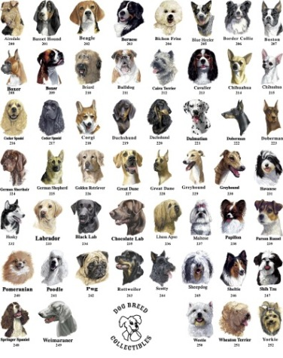
Dog Breeding activity Pg. 23
Breed 1:
Dog needed for racing. Must be very fast but medium sized (50cm tall). An enthusiastic worker and also a good hunter.
Breed 2:
Small (35-40cm tall) very friendly dog required as a companion to children. Long white hair preferable. Needs to be welcoming to strangers and able to live outside.
Breed 3:
Large (60cm tall), strong, muscular dog wanted for large game hunting. Must be able to work in a team and be away from home for long periods of time.
Breed 4:
Kind, patient, good-looking, long-haired dog wanted. Preferably light colored fur and large (65-70cm tall). Must be easy to train, obedient and able to get on with other people including children and strangers.
Breed 5:
Large dog (65-70cm tall), must like water and be a good swimmer and hunter. Must have good stamina and be an excellent guard dog.
Breed 6:
Small (35-40cm tall), very friendly dog required as a companion to children. Long white hair preferable. Needs to be welcoming to strangers and able to live outside.
Breed 7:
Dog required that must be an excellent hunter (very fast) and retriever of game. Must be medium sized (around 55 cm tall) with a short haired coat and definitely not slobber or smell.

Slide 5
Launch
Do the right thing even when no one is looking.
It’s Called INTEGRITY!

