Slide 1
Science Starter: Answer the questions on pgs. 22-23 pg. 22-Monday 2, 3, 4; Tuesday 4; Wednesday 2 pg. 23-Thursday 1; Friday 2, 3
Agenda:
8/30—Vocabulary Test
8/31-DCA Life on Earth
August 27, 2018
Learning Target:
(DO NOT RECOPY)
I will identify which planet is most capable of supporting life by providing evidence from my research.
Success Criteria
I can use my evidence to justify my claim of which planet can support life.
Materials: workbook, pencil, highlighter, laptop
Vocabulary—atmosphere, exist, sustain, radiation, microgravity, WAGON, accommodations, manned space exploration, proximity, habitable

Slide 2
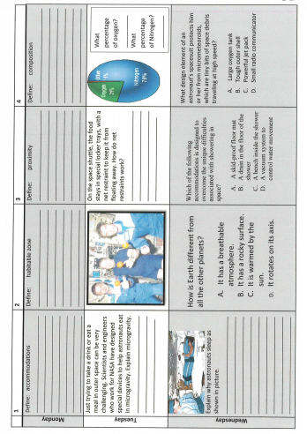

Slide 3
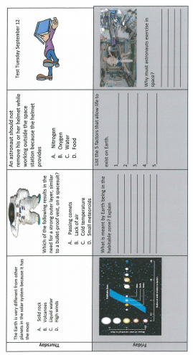

Slide 4
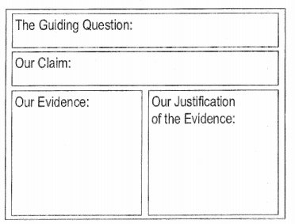
Agenda:
Good Things
Jobs—Friday we will sign up and begin Tuesday 9/4
Complete proposal on pgs. 16-17. DUE TODAY
Signature check on pg. 16 tomorrow
Prepare your presentation board rough draft on pg. 18.
Teacher signature on pg. 18
Google Slides in Google Classroom. One person in the group share with the rest of the group.
This will be a test grade! Due Tuesday!!!
(Homework if not completed)
9. Early finishers may begin Report on pg. 20 for EXTRA CREDIT! Due Friday!!!
Launch

Slide 5
Launch:
Do the Right Thing Even when No One is LOOKING!

Slide 6
Science Starter: Complete the learning target and have your workbook out ready to finish the ADI.
Agenda:
8/30—Vocabulary Test
8/31-DCA Life on Earth
August 28, 2018
Learning Target:
I will learn the essential details of conditions necessary for life to exist.
Success Criteria
(DO NOT RECOPY)
I can use my evidence to justify my claim of which planet can support life.
Materials: workbook, pencil, highlighter, laptop
Vocabulary—atmosphere, exist, sustain, radiation, microgravity, WAGON, accommodations, manned space exploration, proximity, habitable

Slide 7
Agenda:
Good Things
Jobs—Friday we will sign up and begin Tuesday 9/4
Signature check on pg. 16.
You do not have to complete pg. 18 as a rough draft. (Optional)
Teacher signature on pg. 18 (Not Required)
Google Slides in Google Classroom. One person in the group share with the rest of the group.
This will be a test grade! Due Friday!!!
(Homework if not completed)
Early finishers may begin Report on pg. 20 for EXTRA CREDIT! Due Friday!!!
Reflection Question and Launch

Slide 8
Reflection Question
Turn and Talk-
How do the characteristics of Earth allow life to exist?

Slide 9
Launch:
Do the Right Thing Even when No One is LOOKING!

Slide 10
Science Starter: Complete your learning target and success criteria.
Agenda:
TOMORROW 8/30—Vocabulary Test
8/31-DCA Life on Earth
August 29, 2018
Learning Target:
I will learn what accommodations are required for manned space exploration in the International Space Station (ISS) to support life.
Success Criteria
I can identify the effects of microgravity on the human body.
Materials: workbook, pencil, highlighter, laptop
Vocabulary—muscular atrophy, International Space Station (ISS), manned space flight, recycle, waste water, solar panel, MIR Space Station

Slide 11
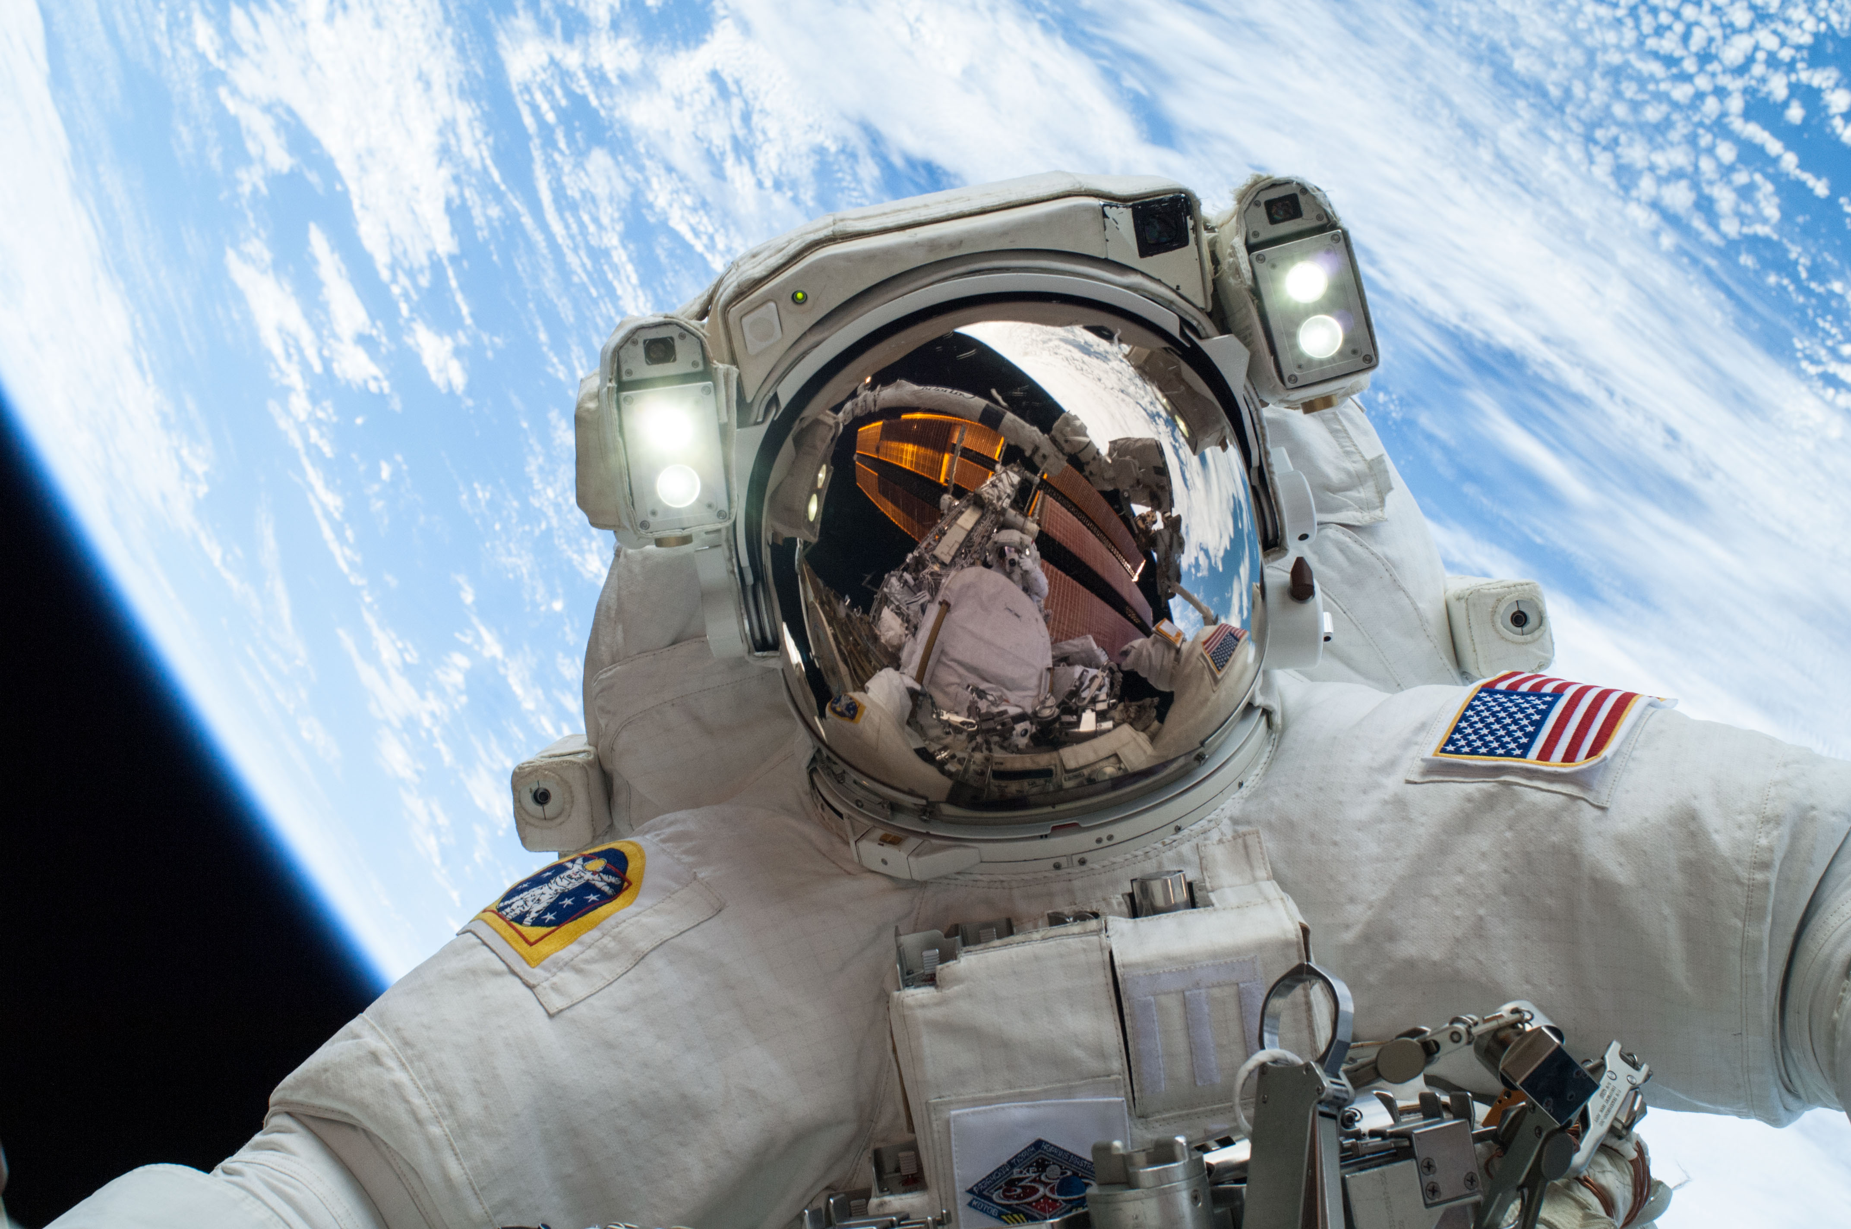
Agenda:
Good Things
Jobs—Friday we will sign up and begin Tuesday 9/4
Google Slides DUE TODAY!!!
WAGON Notes
Video Notes—Living in Space Notes pg. 21 (You will be filling in the effects and accommodations.)
Space Radiation: video
Water recycling on the space station: video
History of Spacesuits: video
Space suits: video
Space Dangers: video
Space Food: video
5. Reflection Question and Launch

Slide 12
Video Notes—Living in Space Notes pg. 21
(You will be filling in the effects and accommodations.)
Space Radiation: video
Water recycling on the space station: video
History of Spacesuits: video
Space suits: video
Space Dangers: video
Space Food: video

Slide 13
Pg. 5—WAGON Notes
Pick up the Review

Slide 14
Launch:
Do the Right Thing Even when No One is LOOKING!

Slide 15
Science Starter: Complete pgs. 22-23 in the workbook Seats will be assigned today.
Agenda:
8/30—Vocabulary Test/Seating Chart
8/31-DCA Life on Earth
August 30, 2018
Learning Target:
I will review the accommodations needed for manned space exploration.
Success Criteria
I can explain the accommodations needed for manned space exploration.
Materials: workbook, pencil, highlighter, laptop
Vocabulary—muscular atrophy, International Space Station (ISS), manned space flight, recycle, waste water, solar panel, MIR Space Station

Slide 18
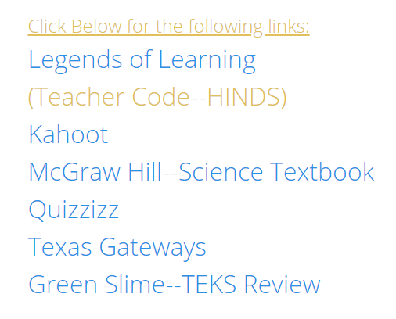
Agenda:
Good Things
Jobs—Friday we will sign up and begin Tuesday 9/4
Make sure you have turned in your Google Slides for the ADI. DUE FRIDAY!!!
Vocabulary Quiz- This will be on quizzizz. To log in go to Mrs. Hinds website and find the link for quizzizz.
Please enter the game
code. Then for the player
name…your first name and
The first initial of your last name.
You may take the quiz one time.
After the quiz, you may work on the DCA review.

Slide 19
Launch:
Do the Right Thing Even when No One is LOOKING!

Slide 20
Science Starter: Have your review sheet and workbook out to review for your DCA.
Agenda:
8/31-DCA Life on Earth
8/31—Google Slides due
August 31, 2018
Learning Target:
I will learn the process for taking a test on Eduphoria.
Success Criteria
I can demonstrate mastery of Life on Earth TEKS.
Materials: workbook, pencil, highlighter, laptop

Slide 21
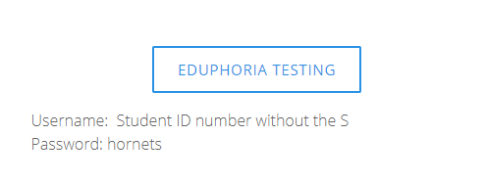
Agenda:
Good Things
DCA and Unit Test
You will be taking the DCA on the computer.
To log in go to Mrs. Hinds website and click on the eduphoria link.
User name is id number without the “s”
Password is hornets
You will take the DCA Life on Earth.
Take the DCA on the computer
Also, you must complete the paper copy
Turn in the paper copy
After the DCA, you will take the Unit Test.
Take the test on the computer
Also, you must complete the paper copy
Turn in the paper copy
Once both tests have been completed you may read quietly.

Slide 22
Launch:
Do the Right Thing Even when No One is LOOKING!

