Slide 1
Notes:
Local park and duck pond in Round Rock. We looked at it earlier when we were investigating the effects of drought on ecosystems. One of the effects of drought is uncovering new ground for terrestrial plant life to grow. This means succession! Depending on the type of ground uncovered it can be either primary or secondary succession.

Slide 2
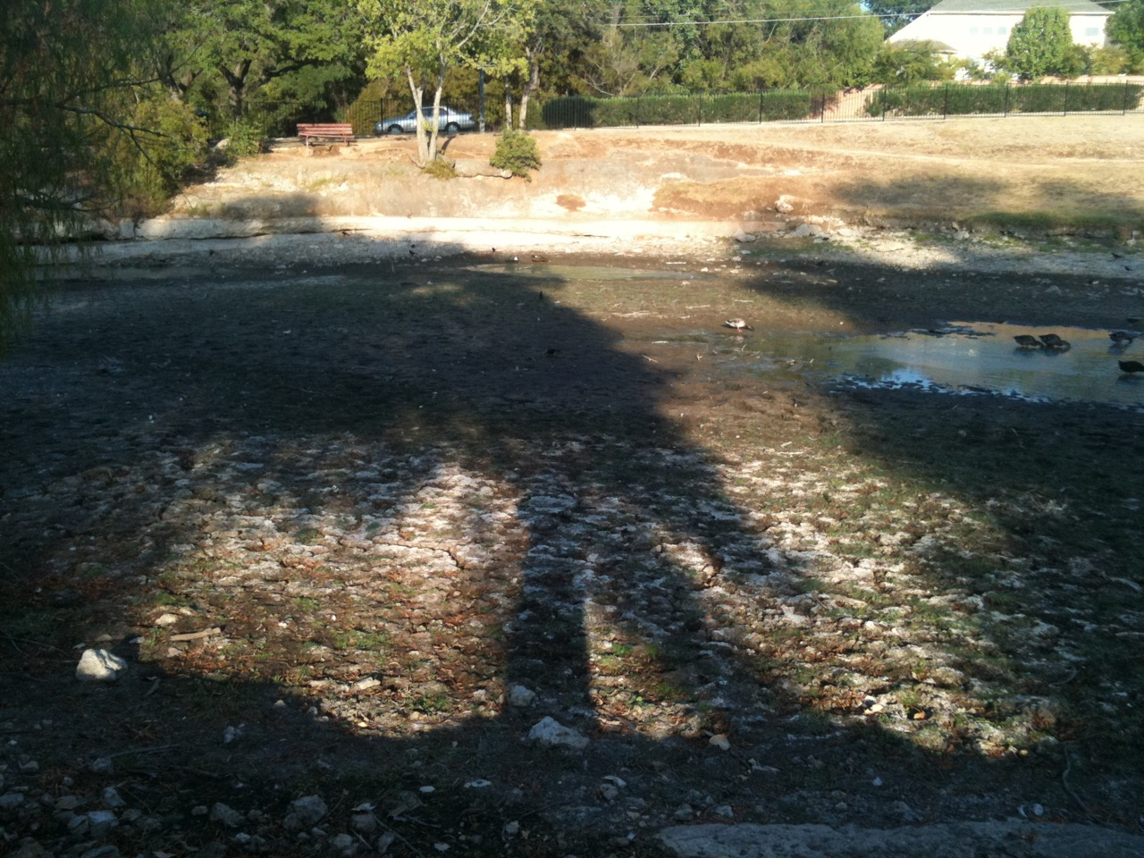
Notes:
Here we see a large portion of the pond bottom that is no longer covered by water. We can already see small grasses starting to grow. Evidence of secondary succession in action!

Slide 3
Notes:
This picture just shows how much new ground has been uncovered. It also shows that there are sections of the pond bottom that are sediment that can be used as soil for plants and there are also sections of bare rock.

Slide 4
Notes:
More grass growing in the sediment left behind.

Slide 5
Notes:
This portion of the pond has been uncovered longer than the previous section. We can see that the grass is more dense and longer in length.

Slide 6
Notes:
This area has been uncovered even longer.

Slide 7
Notes:
Closer to the edge we can even see some larger plants and small bushes have started to grow. This is due to continual yearly drought conditions that have kept the water level in the pond low for years. Only in the past few months has it reached such extremely low levels as it is at now.

Slide 8
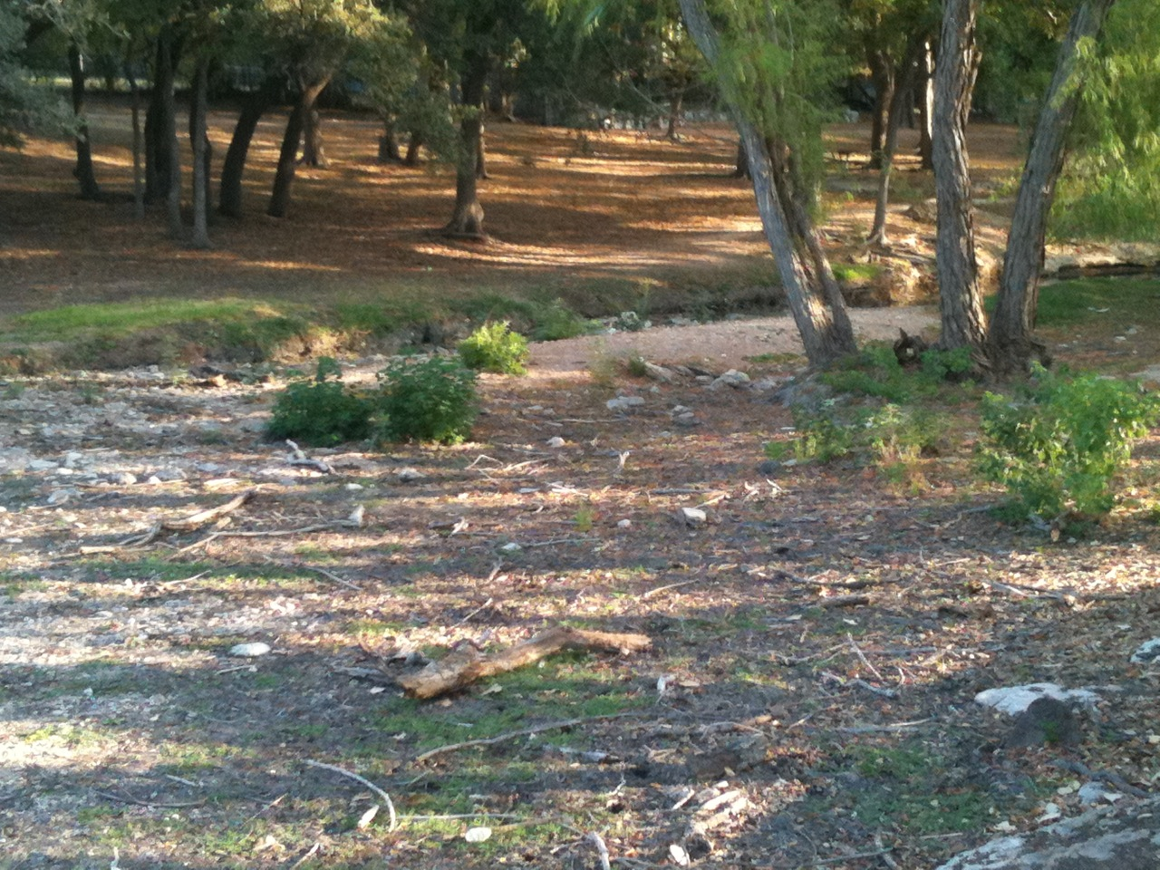

Slide 9
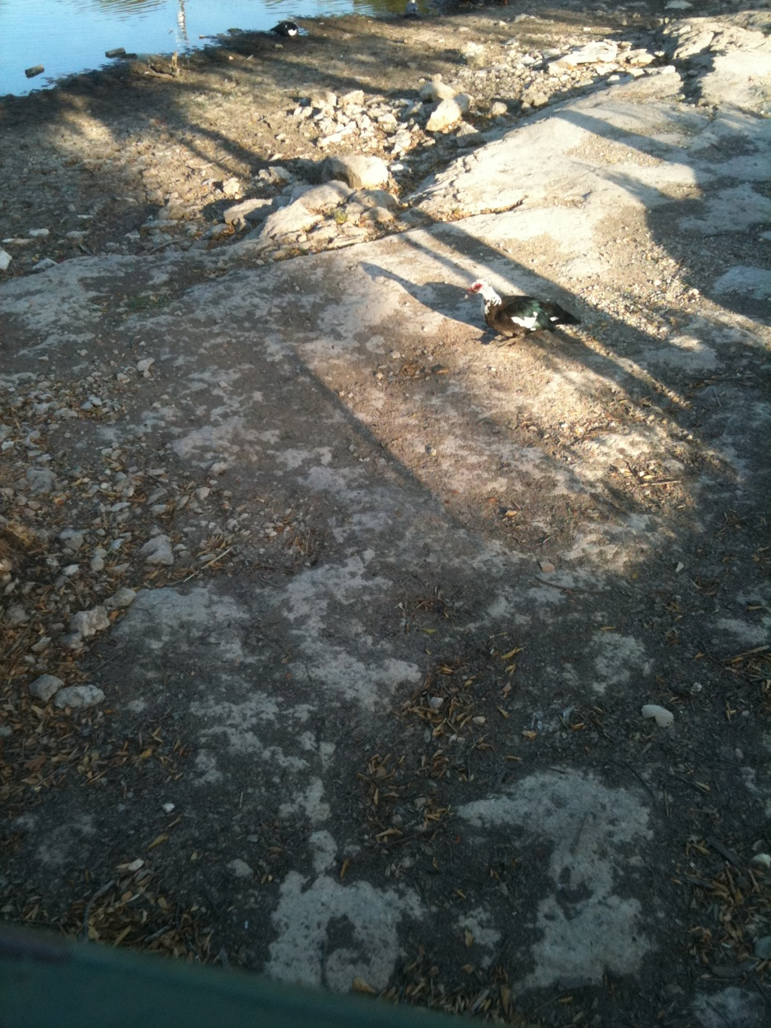
Notes:
Some of the bottom of the pond bed is bare rock and does not have sediment for plants to grow. Primary succession could occur in these areas.

Slide 10
Notes:
On some higher rocks evidence of primary succession can be found. Sediment that has blown into crevices or been created due to the break down of the rocks and the decay of organic material supports small plant life.

Slide 11
What do you predict this area will look like in 100 years if the water does not refill the pond?
Notes:
Here we can see evidence of both primary and secondary succession occurring. What do you predict this area will look like in 100 years if the water does not refill the pond?

Slide 12
Your Turn!
Look for examples of primary and secondary succession in your own neighborhood.
They can be at any stage of succession.
Take pictures or write description of what you see.
Explain:
how the pictures are examples of succession.
what stage of succession they are in.
what you predict the area will look like in 100 years.
how succession will affect the organisms living there.

