Slide 1
Science Starter
Turn in Homework
File all graded papers
Get your science journal ready for our next activity

Slide 2
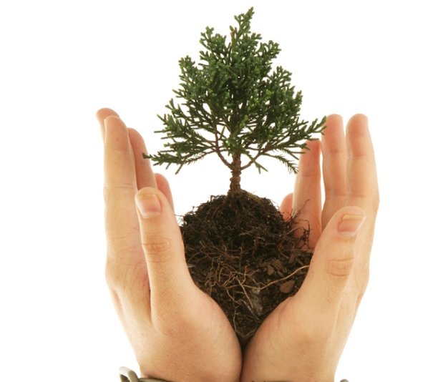

What does biodiversity mean?
bio – life
diversity – variety
Write your own definition for biodiversity in your science notebook using a complete sentence.

Slide 3
Biodiversity Activity
When a habitat is very diverse with a variety of different species, it is much healthier and more stable. One of the reasons for this is that disease doesn't spread as easily in a diverse community. If one species gets a disease, others of its kind are far enough away (due to the variety of other organisms) that disease is often stopped at the one or two individuals.
In this simulation, we represent a monoculture (the opposite of diversity) of second growth forests, using cards to represent trees in the forest. In this case, Live Oak trees were planted after an old growth forest was cut down. A disease strikes one of the Live Oaks, and because of the proximity of the other Live Oaks, disease spreads quickly.
The second part of this simulation, a biological diverse community will be symbolized (an old growth forest) In this scenario, a Live Oak still gets a disease, but this time it does not spread because the other Live Oaks are few and far between.

Slide 4
Activity : Reflection
1. Why didn't all the different trees get the disease? (hint - genetics)
2. Which forest would have more diversity of wildlife? Why?
3. Many species can only live/reproduce in 1 type of forest. The spotted owl is an example - it can only live and successfully reproduce in old growth forests(big, old cedars, hemlocks, etc.). If these old growth forests are cut down, it's unlikely this owl will survive. Environmentalists call it an "indicator" species." What does this mean? Why be concerned about 1 species?

Slide 5
What do you think?
How many species of plants and animals do you think there are in the world?
Do you agree or disagree with the statement below and why?
“If humans don’t have any use for a plant or an animal, then it might as well not exist in the first place.”
Notes:
Ask students to speculate on how many species of plants and animals they think there are in the world?
The answer is that nobody actually knows. Scientists have far more questions than they have
answers! Over 200 years ago the biologist Linnaeus told us that there were exactly 4,236 species.
Since then, biologists and other scientists have named and described approximately 1.4 million
species, although we know very little about the behavior of most of these species or the role they play in the ecosystem. Estimates of the total number of species of plants and animals range from 10 to 80 million. Over three-quarters of this number is probably made up of members of the insect family.
The following open-ended statement will give students an opportunity to examine their own values, and to realize that not all their peers share those values! Read the following sentence aloud to your students:
“If humans don’t have any use for a plant or an animal, then it might as well not exist in the first
place.”
• Ask your students if they agree or disagree with this statement, and to say why.
• Ask them to consider why might it be important to protect a species even though it may
have no direct value to humans?

Slide 6
BIODIVERSITY and
SUSTAINABILITY

Slide 7
Essential Questions
What is biodiversity?
What is sustainability?
How does biodiversity contribute to sustainability?
Notes:
SPEAKER’S NOTES:
We will talk about the definitions of biodiversity and sustainability. Then, we will discuss how biodiversity contributes to sustainability.

Slide 8
Biodiversity
7.10B describe how biodiversity contributes to the sustainability of an ecosystem.

Slide 9
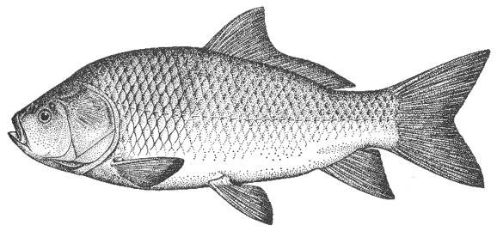
Biodiversity
The term “biodiversity” is a contraction of the phrase “biological diversity”.
Biodiversity means the richness and variety of life - of genes, species and ecosystems.
Notes:
SPEAKER’S NOTES:
Biodiversity is a contraction of the phrase “biological diversity”.
Biodiversity means the richness and variety of life - of genes, species and ecosystems.

Slide 10
Biodiversity
Biodiversity maintains the health of the earth and its people.
It provides us with food and medicine and contributes to our economy.
It tells us a lot about the health of the biosphere.
The greater the variety of species, the healthier the biosphere.
Notes:
SPEAKER’S NOTES:
Biodiversity maintains the health of the earth and its people.
It provides us with food and medicine and contributes to our economy. For example, we use plants and animals for food and medicine and we can harvest plants and animals and sell them to make money. In Manitoba, the fishing industry contributes $150 million annually to our economy.
Biodiversity tells us a lot about the health of the biosphere. The greater the variety of species, the healthier the biosphere is. Why is this? (pause, have students brainstorm answers).
[Possible answers]
more species = more links in food chains/webs = more stable
more plants = more food for other animals (more oxygen too)
more genes = better chances for survival through adaptation
a variety of ecosystems = more habitat for different species.]

Slide 11
The more links in a food web, the more stable it is.
Notes:
SPEAKER’S NOTES:
Removing one link from a food web that has many links does not affect it as much as if there were very few links.

Slide 12
Sustainability
The ability to maintain ecological processes over long periods of time.
Sustainability of an ecosystem is the ability of that ecosystem to maintain its structure and function over time in the face of external stress.
Notes:
SPEAKER’S NOTES:
Sustainability is the ability to maintain something over a long period of time. For an ecosystem, sustainability means maintaining ecological processes over long periods of time. What are these ecological processes? (have students respond).
[Possible answers]
Biogeochemical cycles, evolution, food chains and webs, population dynamics, succession.
So, if an ecosystem is able to maintain its structure and function over time in the face of external stress, it is said to be sustainable.

Slide 13
Sustainability
Is strongly linked to ecosystem health.
The more sustainable an ecosystem is, the healthier it is because it is able to “deal” with external stress better (i.e. limiting factors).
Notes:
SPEAKER’S NOTES:
Sustainability is an indicator of ecosystem health. The more sustainable an ecosystem is, the healthier it is because it is able to deal with external stress better.
What is “external stress” on an ecosystem? (have students respond)
[Answer: limiting factors.]
What are some examples of limiting factors? (have students respond)

Slide 14
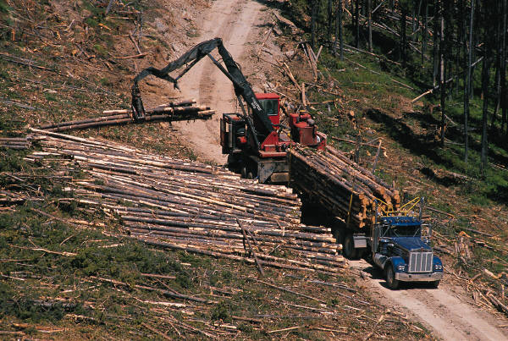
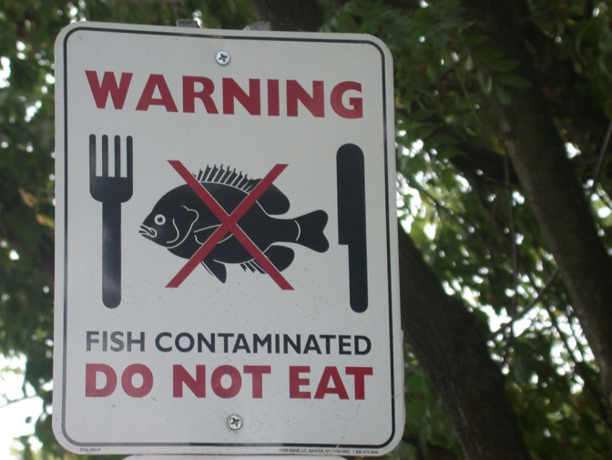
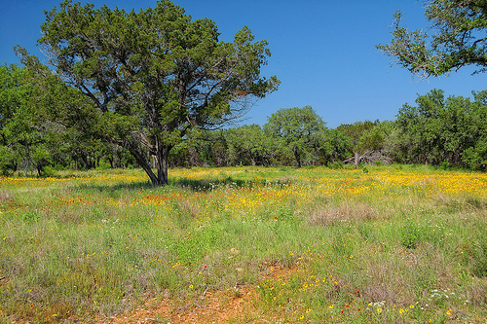
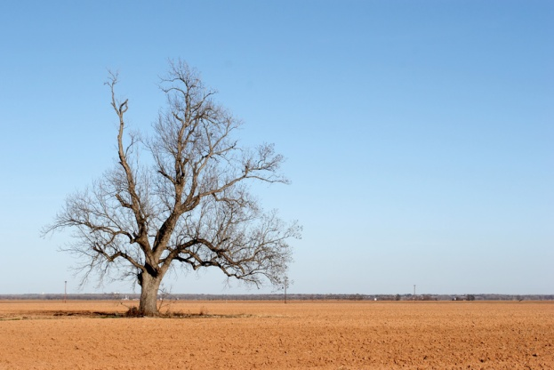
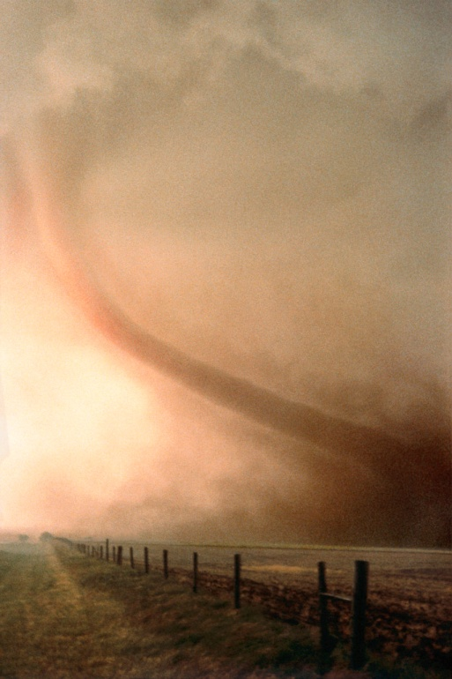
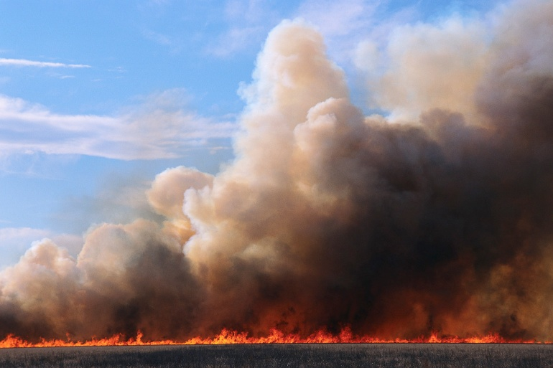
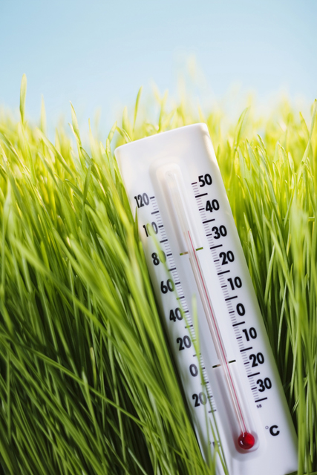
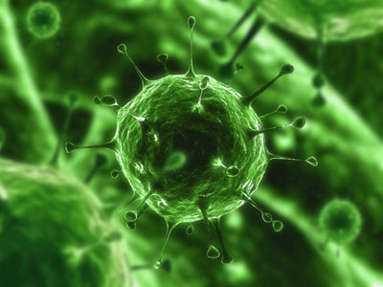
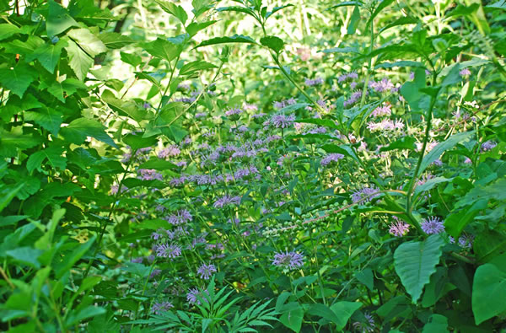
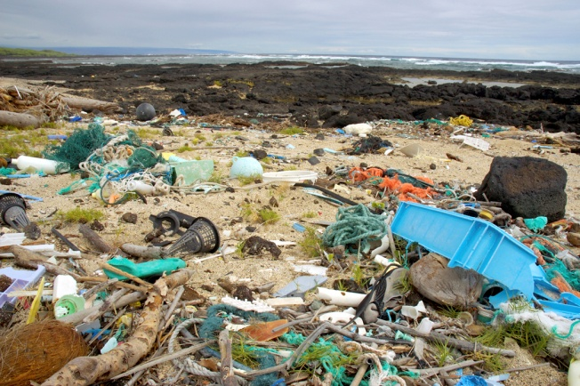
Brainstorm!
What threats are there to the sustainability of an ecosystem?
Notes:
Disease, limited resources (water, space, food, sunlight, etc.), human disturbance (pollution, destruction of habitat), catastrophic events (hurricane, wildfire, climate change),natural changes in environment, invasive species (An example in central Texas are the ashe juniper trees, commonly called cedar trees. These trees were once naturally controlled by fire but human settlement has reduced the natural fire cycle. Cedar trees suck more water from the ground inhibiting the growth of other species.)

Slide 15
Threats to Sustainability
The more organism that can fulfill a particular niche (energy role) in an ecosystem the more likely it is to sustain a threat.
Choose 3 of the following threats to ecosystem sustainability and explain why this is true:
Disease | Environmental change
Limited resources | Human disturbance
Catastrophic events | Invasive Species

Slide 16
Biodiversity and Sustainability
The biodiversity of an ecosystem contributes to the sustainability of that ecosystem.
Higher/more biodiversity = more sustainable
Lower/less biodiversity = less sustainable
High biodiversity in an ecosystem means that there is a great variety of genes and species in that ecosystem.
Notes:
SPEAKER’S NOTES:
How does an ecosystem become sustainable?
By having a lot of biodiversity.
The biodiversity of an ecosystem contributes to the sustainability of that ecosystem.
The higher the biodiversity of an ecosystem, the more sustainable it is. Conversely, lower biodiversity equals less sustainability.
Why is this?
The higher biodiversity in an ecosystem means that there is a greater variety of genes and species in that ecosystem.

Slide 17
Biodiversity and Sustainability
A great variety of genes and species means that the ecosystem is better able to carry out natural processes in the face of external stress.
Thus, the ecosystem is more sustainable.
Notes:
SPEAKER’S NOTES:
A great variety of genes and species means that the ecosystem is better able to carry out natural processes (such as biogeochemical cycles, population dynamics, evolution, succession, etc.) in the face of external stress.
The ecosystem will have more genes and species to help it carry out these processes. For example, there will be more species and more links in food webs, more plants to help with the biogeochemical cycles and more genes available for succession and evolution.

Slide 18
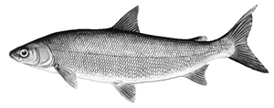
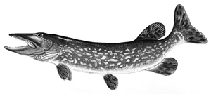
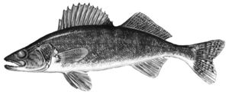
For Example...
The greater the variety of genes and species of fish, plants and animals in the Lake Winnipeg ecosystem, the more biodiversity.
Higher biodiversity will increase the ecosystem’s sustainability
Why is this important?
Whitefish
Northern pike
Walleye
Notes:
SPEAKER’S NOTES:
Lake Winnipeg’s ecosystem is home to a wide variety of fish species such as walleye, whitefish, pike, and goldeye.
There are many plant and animal species (e.g. fish) in this ecosystem and they all contribute to the biodiversity.
A greater variety of genes and species (biodiversity) in the Lake Winnipeg ecosystem contributes to its sustainability.
The sustainability of this ecosystem is enhanced by its biodiversity.
Why is the sustainability of Lake Winnipeg’s ecosystem important?
(have students respond).
[Possible answers]
Because people depend on this ecosystem for food, income, nutrients (from plants, land, animals, biogeochemical cycles).

Slide 19
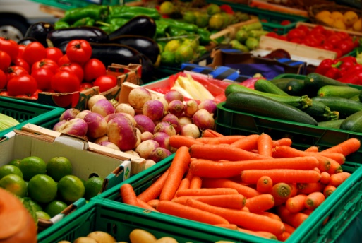
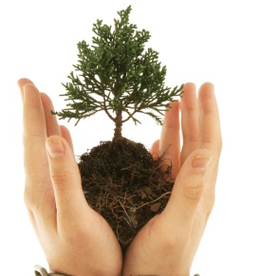

Write in your Science Notebook!
How does the amount of variety in producers or primary consumer in the food web affect the stability of the food web?
How does this relate to biodiversity?
How does this relate to the sustainability of an ecosystem?

Slide 20
Biodiversity Carousel Activity
In small groups you will circulate around the room to each station.
At each station read the title of the page and what other groups have already written. Add an explanation or provide additional examples.
Now take a walk around the room and read what everyone has written. Record your ideas and your classmates ideas in your science notebook.
Notes:
Groups will participate in a carousel. Write the titles of slides 19-25 on large flip chart papers and post these around the room.
Divide the class into seven groups and provide each group with a different colored felt pen. Ask them to write an explanation or provide examples at each station. Ask the groups to circulate clockwise every 60 seconds and add new ideas at each station. When students are finished, ask them to rotate to each station again and look at the ideas that were posted by others.
Students should record their ideas and the ideas of their classmates in their science notebooks.

Slide 21
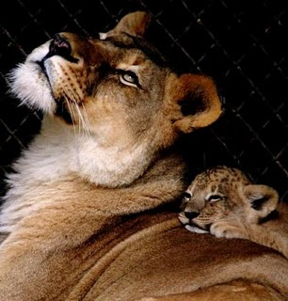
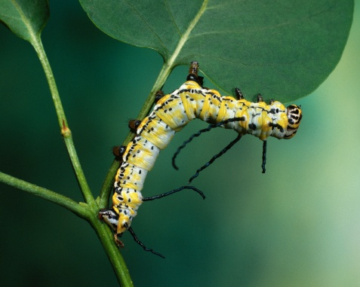
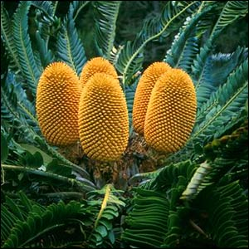
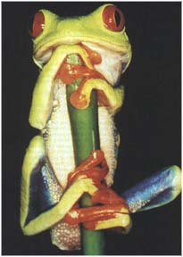
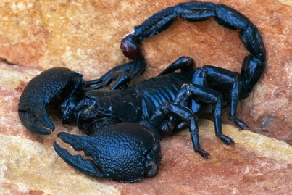
Biodiversity Belongs
The plants and animals with whom we share this planet have a right to exist – whether or not they are useful to humans.
Do you think it is fair for humans to make another species go extinct?
Notes:
Ask students draw a line of learning under what they have already written in their science notebooks. As the teacher presents the following slides students add anything new underneath their line of learning.
Biodiversity can be beautiful and can give us aesthetic pleasure like seeing wild animals, strange plants, or pretty flowers. But don’t’ the “ugly” or “useless” animals and plants have the same right to exist as humans do? They are all products of a complex system of life on earth. Humans should respect other forms of life and make sure our actions don’t destroy them. We are more interdependent with other living organisms than you might think.
Scientists were shocked to find that an entire class of organisms are at the brink of extinction. These are the amphibians. Amphibians have a harder time with global warming than mammals and other organisms, because their bodies have permeable skin that absorbs water and oxygen, and their lives depend on clean and fresh water. About 122 species of amphibians have already gone extinct, with 5,734 known species. But scientists believe that both figures could be underestimates because of all the unknown species. The latest threat, being a rapidly spreading fungal disease, is is predicted to wipe out about half the amphibian species exposed to it within six months. Chytridiomycosis, which damages the skin, is caused most by climate change and polluted water.
About 1/2 of the earth's plant species are facing extinction. The species most at risk include those that live in only small geographical ranges and specific habitats.

Slide 22
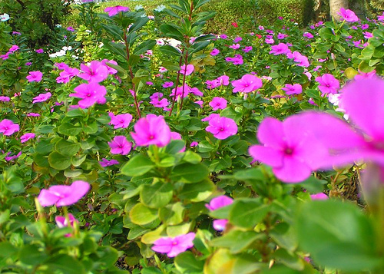
Biodiversity helps us heal ourselves
Over a hundred different species of plants are known to provide medicine for humans. Forty percent of the medicines found in pharmacies are derived from plants. Without the Rosy Periwinkle, many more children would die from Childhood Leukemia.
Does the cure for cancer
or the common cold lie
in a local plant?
Notes:
Many animals and plants may hold the key to some marvelous invention or medicine. For example, Willows gave us Acetylsalicylic acid, or ASA, the active ingredient in Aspirin.

Slide 23
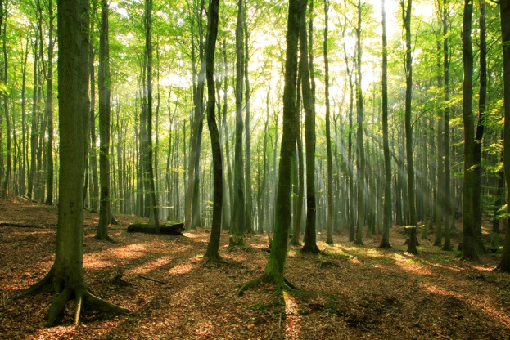
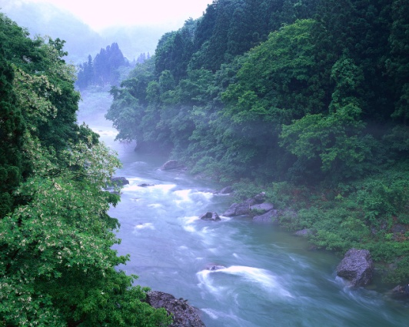
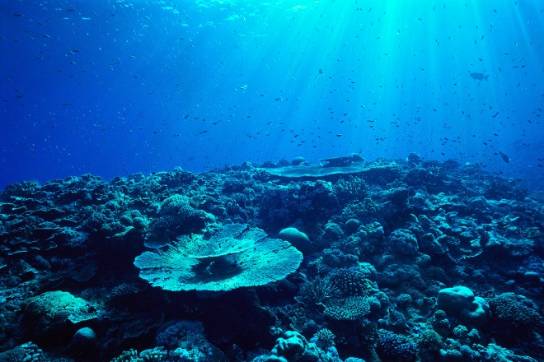
Biodiversity keeps natural areas together
Natural areas (ecosystems) provide us with essential services like clean air and fresh water. Every time we lose a species from an ecosystem we change the way the whole system works.
If this goes on for too long, the area loses its ability to support the organisms living there and its ability to provide us with these essential services.
Notes:
The loss of animals or plants from an ecosystem will affect other species in the food chain, which may in turn affect humans due to the food web effect.

Slide 24
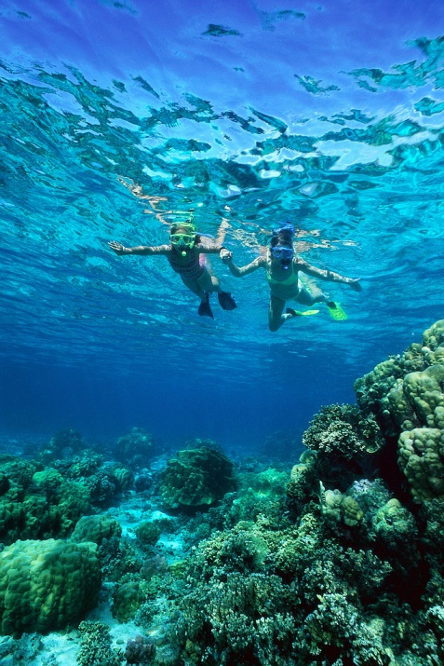
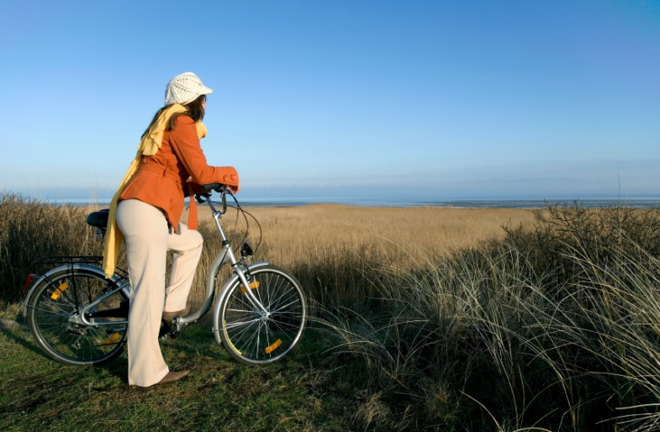
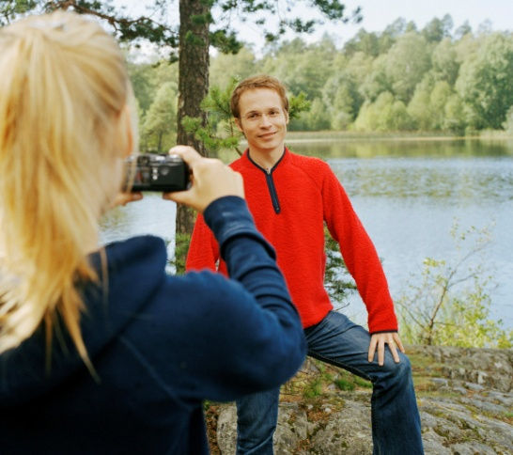
Biodiversity attracts tourists
Tourism is the most rapidly growing industry in the world; and ecotourism (which helps people enjoy nature and ecosystems) is the most rapidly growing kind of tourism!
All kinds of places need to preserve biodiversity to keep their economy strong.
Notes:
Ecotourism may well be the best hope for the survival of protected areas, as it offers an economic argument for the preservation of nature, and can be done in a sustainable manner.

Slide 25
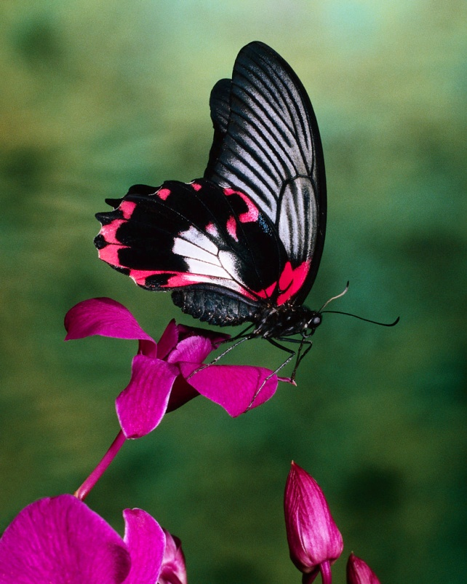
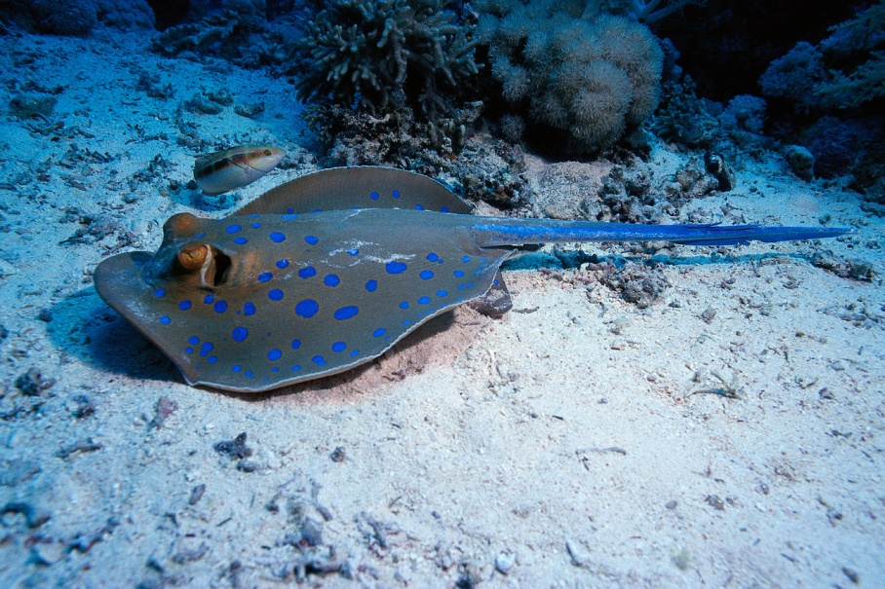
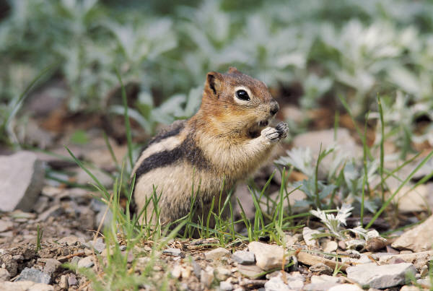
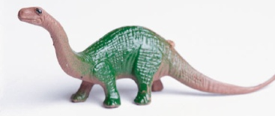
Biodiversity helps life to continue on earth
Biodiversity is life’s insurance policy and helps evolution to take place.
For example: biodiversity helped usher in the age of mammals 65 million years ago, when the dinosaurs became extinct!
Notes:
The little rat-like mammals scurrying around at the time of the dinosaurs were warm blooded, a fact which may have contributed to their survival while all the dinosaurs went extinct. Evolutionary expansion, or “radiant evolution” into the vacant niches left by the dinosaurs allowed mammal biodiversity to soar. The more species there are, the more adaptability there will be to changing conditions like global climate change.

Slide 26
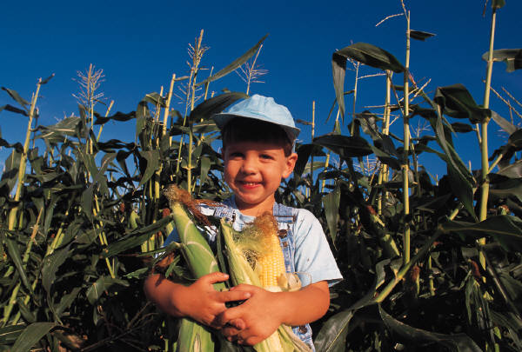
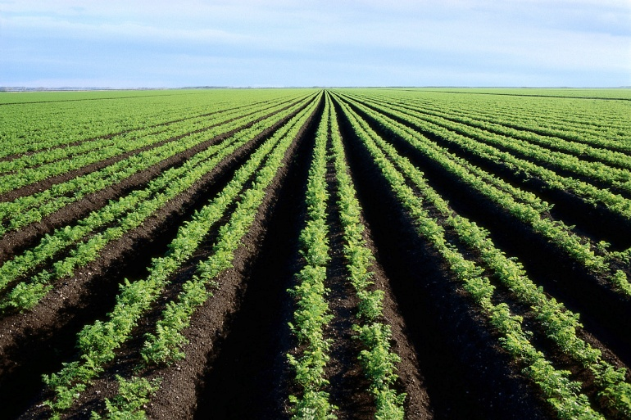
Biodiversity gives us food
20 species of plants (wheat, rice, corn, potatoes, barley, cassava, sorghum, etc.) give us 80% of the food we eat.
If disease or insect pests attack these crops, we’ll need the more resistant varieties of these plants that are currently growing wild.
Notes:
Since humans need a variety of different plants and animals to breed crops and animals suitable for use on farms. A decrease in biodiversity means that scientists have fewer species to choose from when they try to develop a new type of species or crop. For example, when a fungus wiped out 15% of the American corn crop in 1970, biologists bred resistant hybrids from a species of Mexican wild corn.

Slide 27
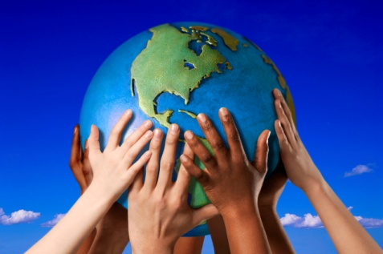
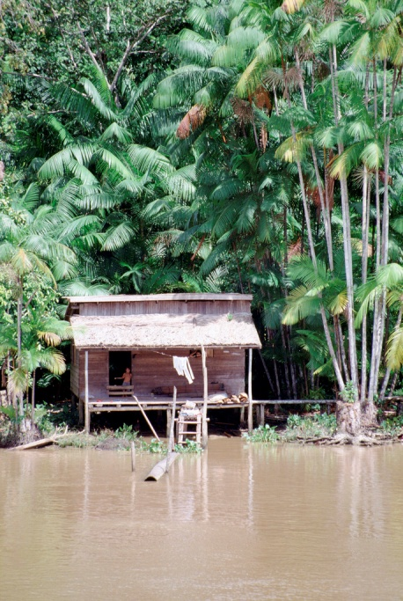

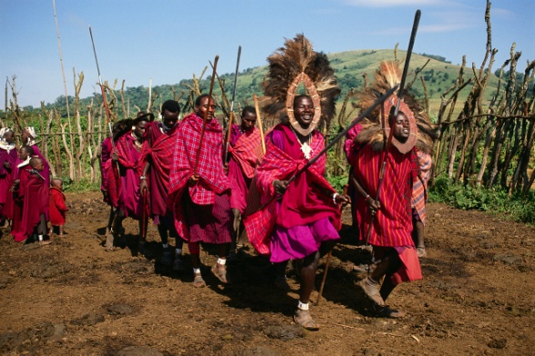
Biodiversity helps us preserve OUR diversity
The large number of human cultures that exist add to the diversity of the human experience and enrich us as a species.
The loss of biodiversity also threatens these cultures, particularly those that live close to the land, for example, in the forests of the Amazon.

Slide 28
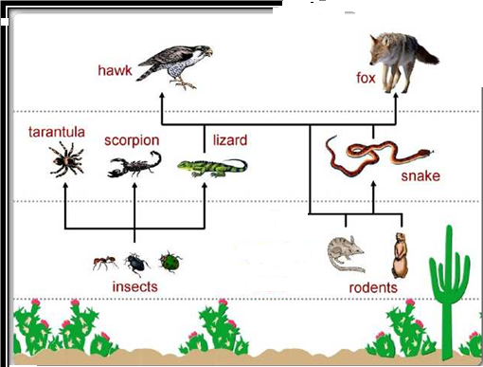
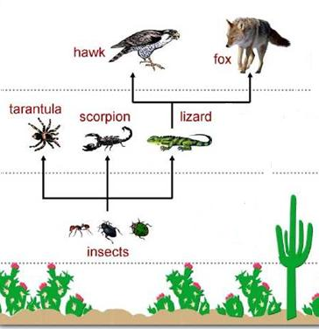
Formative Assessment
Examine the two food webs below.
Make 3 claims about why one of the food webs below is less sustainable than the other. Support your claims with explanation as well as evidence from the food webs.
Notes:
Give students two examples of food webs in the same type of ecosystem, a biodiverse food web and a food web that is not biodiverse. Ask students to make 3 claims about why the less biodiverse food web is less sustainable than the biodiverse food web and support their claims with explanation and/or evidence from the food webs.

Slide 29
What can you do?
As a group brainstorm a list of things YOU can do to protect biodiversity!

