Slide 1
August 17, 2018
Science Starter:
Part 1: Turn in any forms, lab fees, etc. to the completed basket on Mrs. Hinds lab desk. MAKE SURE YOUR NAME IS ON EVERYTHING
I have extra envelopes for lab fees. (include your name and class period)
Part 2: Agenda Important Dates
Forms Due for Mrs. Hinds Class—August 24
Life on Earth DCA—August 31
Open House—September 5 at 6pm
Learning Target:
I will learn GO GREEN expectations for Hopewell Middle School.
I will learn procedures and expectations for Mrs. Hinds Science Class.
Success Criteria:
I can demonstrate GO GREEN expectations for Hopewell Middle School.
I can explain procedures and create expectations (Social Contract) for Mrs. Hinds Science Class.

Slide 2
GO GREEN LESSON Second Period—9:14-10:07 Respectful Third Period—10:11-11:01 Hallway and Cafeteria Expectations 4th Period 11:05-11:55 Expectations are High Advisory/Lunch 11:59-12:49 (Lunch 12:19) Agenda Expectations 6th Period 12:53-1:43 Eager to Learn 7th Period 1:47-2:37 New Start Each Day

Slide 3
Classroom Scavenger Hunt Blackout
You will have 7 minutes to complete as much as you like.
You may work with a partner.
You may use a clipboard.
When I say go you may begin

Slide 4
Social Contract
How do you want to be treated by Mrs. Hinds?
How do you want to be treated by each other?
How will you treat Mrs. Hinds?

Slide 5
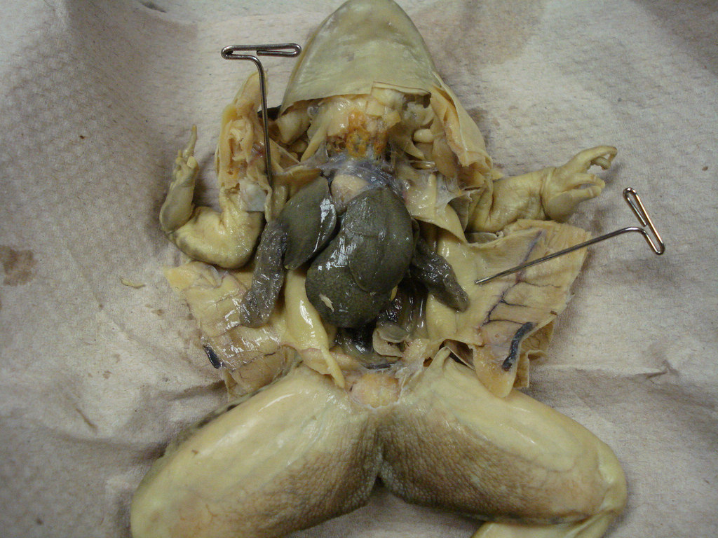
What to expect in Mrs. Hinds class?
We will celebrate Good Things every day!
NEW THIS YEAR…We will have class jobs (if you want one).
We will do lots of labs, stations, ADI’s, and of course DISSECTIONS in April and May!!!
Beginning Monday---Life on Earth!
August 22 (Mr. Hinds b-day)
Ms. Marquez arrives…our new student teacher!
She is here until December 5!
Launch:
Do the right thing…
Even when no one is looking!

